Slide 2
Talking Real Value of Cloud Computing to Customers
LS163i
Nigel Gibbons
Executive Chairman
UniTech
Notes:
Come on a journey through research built on client engagements backed by Chartered Accounting oversight. You will see a new perspective on CFO's (Chief Financial Officers)/Accountants as a much overlooked relationship gold mine in your Cloud sales and customer consultation strategies. Get insight into research that articulates the hidden value tied up on your customer's balance sheets that you can put to use. You do not need to be an accountant, just bring your business common sense!

Slide 3
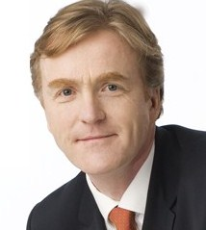






Nigel Gibbons
UniTech – Executive Chairman
Microsoft Certified Trainer (MCT)
BCS Chartered IT Professional (CITP)
Microsoft Business Value Planning (MBVP)
Certified Information Systems Auditor (CISA)
Certified Information Systems Security Professional (CISSP)
Microsoft Certified Information Technology Professional (MCITP)
Strategic Business Planning & Audit
    Azure Circle Partner
    Cloud Security Alliance—UK and Ireland
    Information Security Audit and Control Association (ISACA)
    International Information Systems Security Certification Consortium (ISC)2
    EuroCloud
    Voices for Innovation
    Microsoft Partner Advisory Council
    Microsoft Engagment Board
    IAMCP UK Vice President
Notes:
Its not about me its about the shared insights I believe I continuously experience from my engagements across the security industry, and especially the SME sector which is the predominant space that Microsoft Partners occupy.
I work with clients at a strategic level evolving Business use of IT, leveraging existing investments, product development, focusing investment for maximum value, improving business processes and productivity. Experienced in how best to tap the benefits of Cloud Computing and evolve Enterprise IT Architectures in an increasingly security conscious and privacy aware world.
My Philosophy is - "Success with Technology involves an ability to cut through unnecessary complications with clear, direct and flexible thinking. By learning to see with new eyes, looking beyond the obvious, moving freely from established ways of thinking, reappraising old assumptions, finding new answers.“
Vision & Goals …….. To provide and contribute towards rewarding experiences with exceptional people, advancing awareness and protecting individual’s rights as they are impacted by developing technologies; allowing me to return to the community and share what I gain.
I maintain a number of professional qualifications encompassing Information Technology, Security, Asset Management and Valuation.

Slide 4
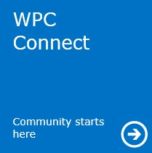




NRG ‘PB’ curve
Benefit
Number of slide
Notes:
Presentation benefit Curve - to keep you in the Green Zone.

Slide 5
Communication
"I am a dealer in words, and words are the most powerful drug known to humanity"
Rudyard Kipling

Slide 6
Setting the Scene
Notes:
Windows Azure Resources
Windows Azure TrustCenter - http://www.windowsazure.com/en-us/support/trust-center/
Windows Azure SLA - http://www.windowsazure.com/en-us/support/sla/
Windows Azure EA Pricing Overview - https://ea.windowsazure.com/home/pricingoverview.pdf
Windows Azure IaaS FAQ
http://www.windowsazure.com/en-us/pricing/details/virtual-machines/
http://www.windowsazure.com/en-us/pricing/licensing-faq/
http://www.windowsazure.com/en-us/pricing/license-mobility/
Product Use Rights
http://www.microsoft.com/licensing/about-licensing/product-licensing.aspx
Online Services (User or Device Subscription License, Services Subscription License, and/or Add-on Subscription License) (Page 70+)
Windows Azure Services (Page 93+)
Product List
http://www.microsoft.com/licensing/about-licensing/product-licensing.aspx
Windows Azure Services (Page 48+)
Windows Azure Services (Page 163)

Slide 7

What Cloud means for your Customers
What Could Cloud Mean?
Notes:
We have all tried various methods to sell cloud, but the still 67% (TechTarget) are cost focused, so that’s why I’m sharing these thoughts with you.

Slide 8
Bust a Myth Time
It does not have to be ‘All In’
On-Premises & Cloud
= Hybrid
Notes:
Park one false belief, this is not a force march to get you into the cloud, it’s a Hybrid world and will be for the foreseeable future for most.

Slide 9
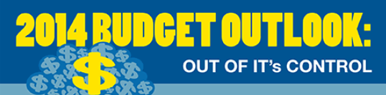
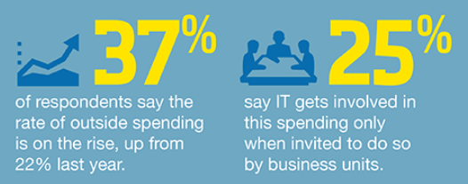
Cloud = Change
Cultural Challenge
  From ITD Decision Makers to BDM’s & Rise of the CMO
  From Infrastructure to Applications
  From Bloated Capital Budget’s to Lean, Mean & Agile …
Notes:
Technology spent is shifting from IT to Business: In 2015, CMO will buy more technology than IT
Only 21% of CIO keep full control of IT budget, the Business is buying/building apps not infrastructure → IT Needs to accelerate focus on delivering functionality (apps)
Increase importance of CMO (Chief Marketing Officer)

Slide 10
Think Differently
Notes:
Today I ask you to think differently about the challenges facing business, and how Cloud in the mix is a material Win Win.

Slide 11
Your NBF!
No:1
B
S
O
Balance Sheet Obesity
Notes:
I am going to introduce you to my new best friends:
BSO
TCA
CSI
I don’t recommend you use these to your clients, but to get your heads in gear as to how you can confront their pains, some of which they will not even be aware of due to cultural conditioning and attitudes of the past.

Slide 12
Your NBF!
No:2
T
C
A
The Corporate Aneurism
Notes:
I am going to introduce you to my new best friends:
BSO
TCA
CSI
I don’t recommend you use these to your clients, but to get your heads in gear as to how you can confront their pains, some of which they will not even be aware of due to cultural conditioning and attitudes of the past.

Slide 13
Your NBF!
No:3
C
S
I
Corporate Social Irresponsibility
Notes:
I am going to introduce you to my new best friends:
BSO
TCA
CSI
I don’t recommend you use these to your clients, but to get your heads in gear as to how you can confront their pains, some of which they will not even be aware of due to cultural conditioning and attitudes of the past.

Slide 14
A Journey
& a Tale or 2
Balance Sheet Obesity
The Corporate Aneurism
Corporate Social Irresponsibility !
Notes:
I don’t recommend you use these to your clients, but to get your heads in gear as to how you can confront their pains, some of which they will not even be aware of due to cultural conditioning and attitudes of the past.

Slide 15
Balance Sheet Obesity
Notes:
Obesity = A Solution? A Stress response to worldly pressures form the basic to the severe. Uncannily like the pressures on IT from a business.
Like Businesses unwilling to free up their tied up cash on their balance sheets through use of cloud. It's an awareness and insecurity thing,
Make poor choices – They may be safe and work, but not necessarily the right ones for the business.
Comfort in the familiar.
Protection of ‘empires’ - silo’d attitudes.

Slide 16
Balance Sheet Obesity
Epidemic!
Investment Potential is languishing
In Hardware
Inappropriate perpetual licensing & maintenance
Underutilized software & maintenance contracts
In-direct areas
Wasting Skilled Professionals
Heat/Light/associated infrastructure
Training & Compliance
NB: Not all Business Models favour Opex
Notes:
There is a health warning to any generalizations and this is no different, Not all businesses favour Opex. Know your client first before you get on ANY soap box.

Slide 17
Research
SME Focus
Accounting anonymised
Companies not identified
Balance sheets & P&L line items directly related to IT.
Rounded balance sheet figures DOWN
Non-Statistical sample, but indicative
16 Businesses
10 – 80 employee’s.
x4 with 200+
Adjusted for reality
Remember Hybrid!
Removed 40% of costs from potential savings

Slide 18
The Potential
United Kingdom
1-49 employees (Small) @ 4.8m = 99.30%
50-249 employees (Medium) @ 30k = 0.6%
European Union
1-10 employees (Micro) @ 20m = 91.8%
10-49 employees (Small) @ 1.5m = 6.9%
50-249 employees (Medium) @ 250k = 1.1%

Slide 19
The Numbers
Apologies to the US ;-)
United Kingdom
£1.2Billion
Based on only £40k saving per business
That’s just for the 30,000 Medium sized!
European Union
£65 Billion
Again based on only £40k saving per business
That’s only the 250,000 Medium sized!

Slide 20
Yes you Heard Right
A Partner Opportunity
£1.2Billion
£65Billion

Slide 21
A tale ….
Legal Sector
£800,000

Slide 22
The Engagement Formulae
Customers like it Simple
Audit
Plan
Execute
IT Cost Audit ➔ Visible & the Off-Balance Sheet
Art of the Practical➔ Cloud Roadmap Baseline Potential
Managed Services ➔ It’s an Evergreen world
Notes:
How you can become the weight loss Guru for your customers Balance Sheets. And NO I do not mean hack their bank accounts ;-) There is a much more legitimate way that should be met with a smile!

Slide 23
3rd Party Figures
Hudson Consulting
Messaging & Collaboration
Year 1 $23,662
Year 2 $40,662
Year 3 $290,662
ERP
Year 1 $1,123,300
Year 2 $473,300
Year 3 $473,300
Ref: http://us.hudson.com/it/cloud-computing-cost-savings
Notes:
If you don’t believe me then just look, there is plenty of third party evidence.

Slide 24
Corporate Aneurism

Slide 25
Thesis
Epidemic Event Horizon!
  Most Applications & data will be in the cloud within 10 years
To maintain competitiveness & innovation organisations should be adopting a ‘Cloud-First’ strategy
Today!

Slide 26
Cloud First
Youthful Cultural Shift
Start-ups do
Why not established business?

Slide 27
Bust a Myth Time
It does not have to be ‘All In’
On-Premises & Cloud
Hybrid
Notes:
Park one false belief, this is not a force march to get you into the cloud, it’s a Hybrid world and will be for the foreseeable future for most.

Slide 28
Corporate Aneurism
Remission
Growth / Market Share
Time

Slide 29
Corporate Aneurism
Terminal
Growth / Market Share
Time

Slide 30
Think Apps FIRST !

Slide 31
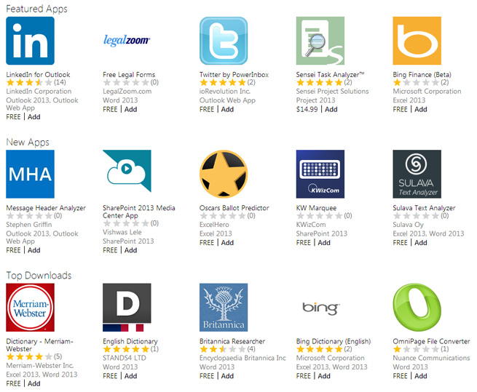
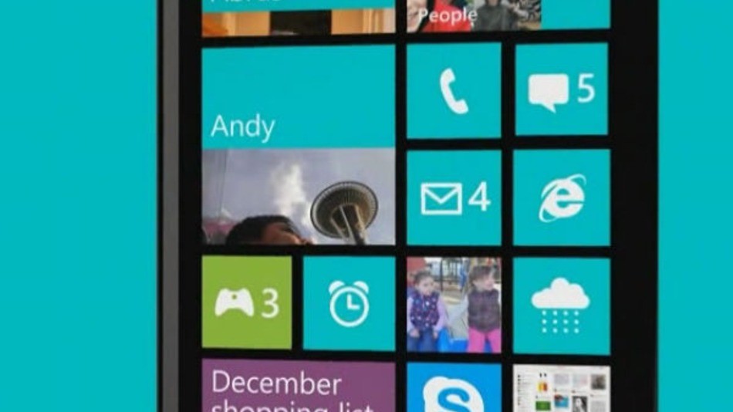
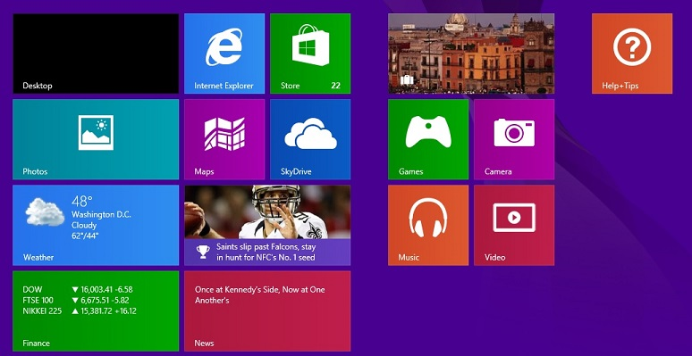
Across all Surfaces
Notes:
Think Apps first, be that mobile, Desktop or Online (SharePoint / Office365).

Slide 32






Delivering Innovation & Differentiation
Cloud App Tech enables Revenue, Expansion, Consumer Reach & Cost Reduction Opportunities
Multi-device
+
Rapid lifecycle
Existing Applications
Any data, any size
+
Secure & available
Lower Cost ➔ Differentiate to Grow Business
Speed to Use ➔ Business Decision Maker Winner
Mobilise ➔ Hybrid Agile Architecture across Datacenters, Cloud, Apps & Devices
Change
Notes:
What is missing in this presentation? Infrastructure, the magic moment is when you start to ‘Just think Apps’.
Applications are what are driving this change. Think APP first, not infrastructure.
Business functionality. Business wants it now and is just doing it if IT does not respond.
Delivering new business opportunities through Multiple devices, and evolving rapidly (failing quickly and evolving).
Connecting with Data anywhere.

Slide 33

Real World FACTS
BT – Community WebKit
30% cost saving on original 3,000 sites
Today = 10,000+ Websites
@£700/month
7pence per site /month, ALL in !
Cheapest Hosting is x15
Notes:
It worked for BT, how about your customers.

Slide 34
Corporate Social ‘Irresponsibility’

Slide 35
Corporate Social ‘Irresponsibility’
Not to be confused with its brethren CSR
Heath Risk
  Poor practices drives culture
  Moral impacts employee churn
  Investor relationship challenges
  Long Term Customer value/Capture/Retention
Customer Risk
  Innovation latency contagion
  Business Continuity
  Supply chain instability & Uncertainty

Slide 36





Dev + Test + Learn
Enable innovation
with test & dev labs in the cloud
Cost effective
Improved developer agility
Ship/tested in realistic scale
Use existing development tools & languages
Access on-premise resources if necessary
It’s TEST data (Mitigate Risk)
Dev
Test
Learn
Virtual
Machines
Virtual
Machines
Virtual
Machines
VHD
> PowerShell
Windows Server
SQL Server
Lab Sandbox
Visual Studio
Developer
On-premises
Windows Azure

Slide 37
Dev & Test Cost Facts
Paid for
STANDARD:
MSDN PRICE:
SAVINGS:
Windows Server
SQL Standard
BizTalk Standard
SQL Enterprise
BizTalk Enterprise
.09/hr
.64/hr
.75/hr
2.19/hr
2.11/hr
.06/hr
.06/hr
.06/hr
.06/hr
.06/hr
33%
90%
92%
97%+
97%+
Notes:
Out of the gate I would like to challenge many of your organizations to utilize MSDN benefits that you probably have sitting on the shelf.

Slide 38




Dev & Test Cost Facts
FREE !!!
professional
premium
ultimate
premium
$100
PER MONTH
$50
PER MONTH
$100
PER MONTH
$150
PER MONTH
3 VMs for 16 hours a day
professional
premium
ultimate
premium
$100
PER MONTH
$50
PER MONTH
$100
PER MONTH
$150
PER MONTH
80 VMs for 20 hour load test

Slide 39





Dev & Test Cost Facts
FREE !!!
professional
premium
ultimate
premium
$100
PER MONTH
$50
PER MONTH
$100
PER MONTH
$150
PER MONTH
50 HDInsight nodes for 10 hrs
professional
premium
ultimate
premium
$100
PER MONTH
$50
PER MONTH
$100
PER MONTH
$150
PER MONTH
Up to 100 web sites + DB

Slide 40
Last but not Least ….

Slide 41
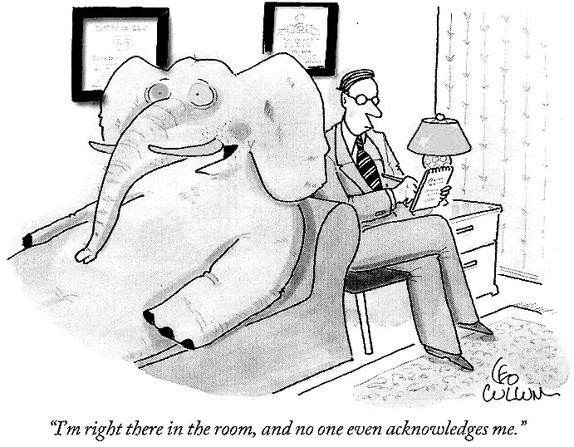

Slide 42

Microsoft Core Pillar
& Differentiator

Slide 43
Understand what you mean by Security
Break it down
Trust
Risk
Security
Notes:
Break it down and make it tangible.
It is often that iron bound door that is slammed in your face by a client who is in effect saying, don’t go there, I have used the S word and that is the end of the discussion.
Time for a little push back. Security is something that is very indistinct, it means different things to different people. For a business not to get hamstrung by a security paranoia culture it needs to be rationalised in terms of business impacts, values attributed and practical decisions based on those outcomes made to reflect and support the business strategy.
There can never be sufficient controls and agreements to mitigate all concerns if trust is a missing factor in the client-supplier relationship.

Slide 44

Notes:
For example. Dev.Test. It is what it says, and that should include the data, so what risk exists? Apart from to your wallet/budget!

Slide 45
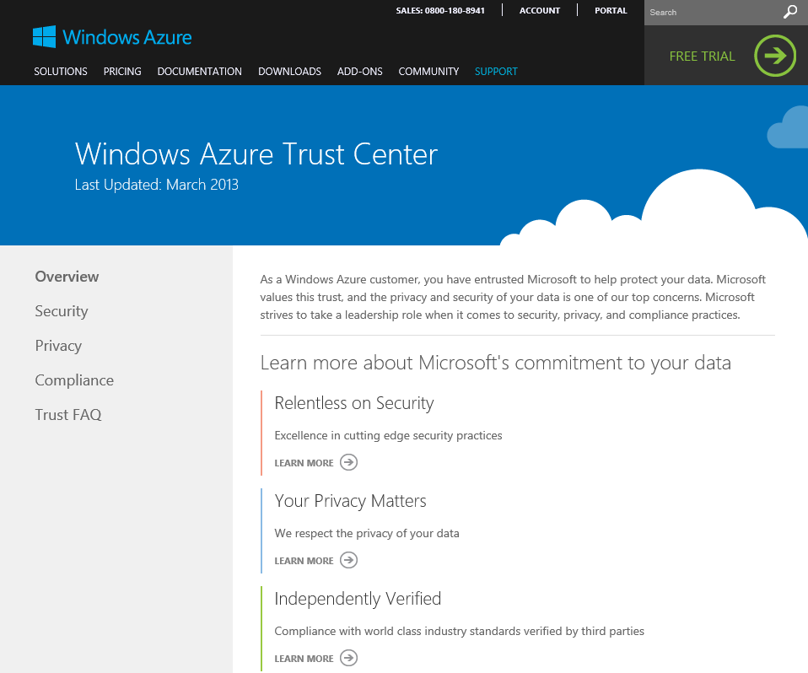
Windows Azure Trust Center
One location to aggregate content across Security, Privacy, and Compliance
Detailed FAQ section
Trust Center pillars match O365
Windows Azure Core Services:
  ISO 27001
  E.U. Model Clauses
Constantly updated on details, e.g.
  HIPAA BAA
  SSAE 16 SOC 1 Type 2
  FISMA / FedRAMP
http://www.windowsazure.com/en-us/support/trust-center/

Slide 46
































































If your worried …… DON’T

Slide 47
Homework ….

Slide 48
Business Needs your Help
To open their eyes to the potential…
Business Fitness Specialists!
Or
Weightloss Guru
Or
Trusted Advisor

Slide 49
Get your Head Around the Numbers
The Partner Opportunity
£65 BILLION

Slide 50
Just think Apps!
Notes:
Think Apps first, be that mobile, Desktop or Online (SharePoint / Office365).
This is the New World Route to Market.

Slide 51
In Your Own Words
…. lead by example
"I am a dealer in words, and words are the most powerful drug known to humanity"
Rudyard Kipling
Notes:
Words have power and impact with sincerity when spoken from a position of knowledge and experience.

Slide 52

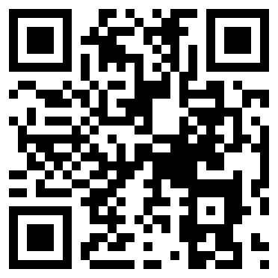
Notes:
NRG Business Details

Slide 53

Evaluate this Session in WPC Connect!
Use a CommNet station, your PC or mobile device
Any evaluation will enter you into a drawing for prizes each day
How satisfied were you with this session?
WPC donates $1
for every session evaluation
How satisfied were you with the speaker(s)?
How valuable was the session’s content?
WPC donates $5 for overall evaluation
Comments
https://connect.digitalwpc.com

Slide 54

© 2014 Microsoft Corporation. All rights reserved. Microsoft, Windows, and other product names are or may be registered trademarks and/or trademarks in the U.S. and/or other countries.
The information herein is for informational purposes only and represents the current view of Microsoft Corporation as of the date of this presentation. Because Microsoft must respond to changing market conditions, it should not be interpreted to be a commitment on the part of Microsoft, and Microsoft cannot guarantee the accuracy of any information provided after the date of this presentation. MICROSOFT MAKES NO WARRANTIES, EXPRESS, IMPLIED OR STATUTORY, AS TO THE INFORMATION IN THIS PRESENTATION.

