Slide 1

Myth Busting
Data Security & Cloud
Presenter ~ Nigel Gibbons
Notes:
Welcome…
But First…

Slide 2

Nigel Gibbons
UniTech - Executive Chairman
BCS Chartered IT Professional (CITP)
Microsoft Buisness Value Planning (MBVP)
Certified Information Systems Auditor (CISA)
Certified Information Systems Security Professional(CISSP)
Microsoft Certified Inromation Technology Professional (MCITP)
Strategic Business Planning & Audit.
Insititute of Information Security Professionals (IISP)
Information Security Audit & Control Association (ISACA)
International Information Systems Security Certification Consortium or (ISC)2
Cloud Security Alliance - UK & Ireland
EuroCloud
Voices for Innovation
Microsoft Partner Advisory Council
Microsoft Executive Partner Board
IAMCP UK & International Board Member
Notes:
Its not about me its about the shared insights I believe I continuously experience from my engagements across the security industry, and especially the SME sector which is the predominant space that Microsoft Partners occupy.

Slide 3

Overview
Part 1
Part 2
The reach of Uncle Sam and the realities of US regulation such as the Patriot Act.
Part 3
The myth of Lock-in in context – Microsoft Online Services (Azure, Office365 etc) as the real Open Platforms.
Busting the top 10 business concerns with Cloud Security
The boundaries of Data responsibility, and accountability
Compliance and Cloud Computing.
Shared real world Business engagement scenarios
How secure is Cloud Computing?
Coffee Seed by arztsamui freedigitalphotos.net

Slide 4



NRG ‘PB’ Curve
(Presentation Benefit)
Benefit
Number of slide
Notes:
My job today is to keep you in the Green Zone.

Slide 5
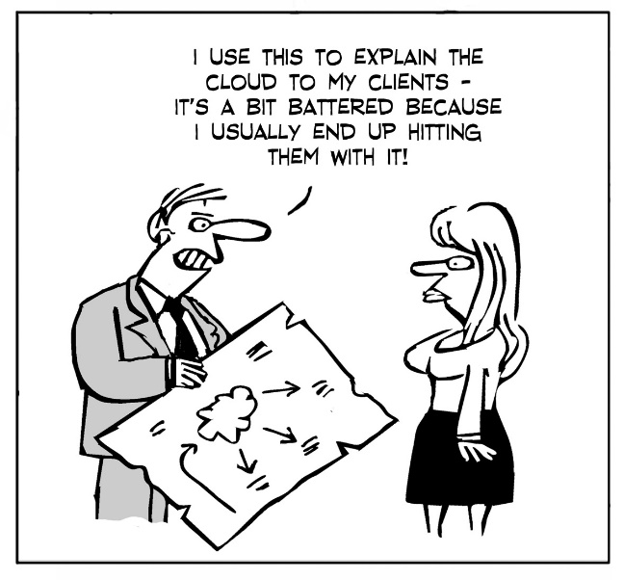

Slide 6
Structure
Foundation
State of the Digital nation
Real World
Execute
Notes:
Focus is on the ‘Shared’ and ‘on-demand’ form of cloud computing. Bespoke and dedicated ‘Private Clouds’ are proprietary and beyond containment for trending effectively as each tends to be unique.

Slide 7
How Secure is Cloud Computing?
Part 1
Busting the Top Business Cloud Security Concerns
Presenter ~ Nigel Gibbons
Notes:
Welcome…
But First…

Slide 8
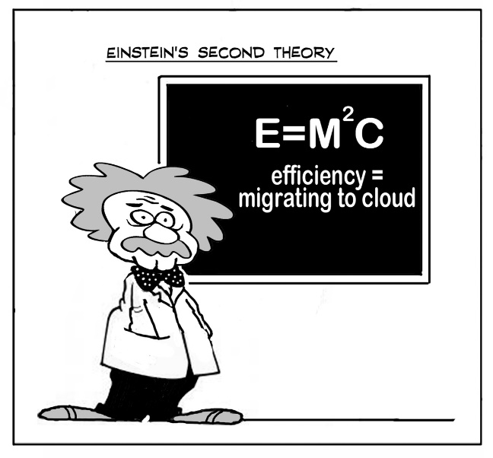
Notes:
You don’t need to be an Einstein to realise the benefits that Cloud Computing offers and the change it is manifesting not just on the way we view technology but the strategic impacts it is having deep into organisational strategic thinking.

Slide 9









In the News
Sony Finds More Cases of Hacking of Its Servers
By NICK BILTON , May 2, 2011
Sony said Monday that it had discovered that more credit card information and customer profiles had been compromised during an attack on its servers last week.
Expect targeted attacks
after massive Epsilon email breach, say experts. Database of stolen addresses is a gold mine for hackers and scammers
By Gregg Keizer, April 4, 2011
    The high-profile data breach Epsilon Interactive reported April 1 caused quite a stir, as the company noted on its web site that “a subset of Epsilon clients' customer data were exposed by an unauthorized entry into Epsilon's email system.” BtoC brands including Best Buy, Kroger and Walgreen were among the estimated 2% (of Epsilon’s approximately 2,500 clients) affected by the attack.
Microsoft warns of phone-call security scam targeting PC users
By Nathan Olivarez-Giles, June 17, 2011
Microsoft is warning its customers of a new scam that employs "criminals posing as computer security engineers and calling people at home to tell them they are at risk of a computer security threat."
Expedia's TripAdvisor Member Data Stolen in Possible SQL Injection Attack
By Fahmida Y. Rashid, March 24, 2011
TripAdvisor discovered a data breach in its systems that allowed attackers to grab a portion of the Website's membership list from its database.
Microsoft Exposes Scope
of Botnet Threat
By Tony Bradley, October 15, 2010
Microsoft's latest Security Intelligence Report focuses on the expanding threat posed by bots and botnets.
Microsoft this week unveiled the ninth volume of its Security Intelligence Report (SIR). The semi-annual assessment of the state of computer and Internet security and overview of the threat landscape generally yields some valuable information. This particular edition of the Security Intelligence Report focuses its attention on the threat posed by botnets.
Nasdaq Confirms Breach in Network
BY DEVLIN BARRETT, JENNY STRASBURG AND JACOB BUNGE
FEBRUARY 7, 2011
The company that owns the Nasdaq Stock Market confirmed over the weekend that its computer network had been broken into, specifically a service that lets leaders of companies, including board members, securely share confidential documents.
RSA warns SecurID customers after company is hacked
By Robert McMillan, March 17, 2011
EMC's RSA Security division says the security of the company's two-factor SecurID tokens could be at risk following a sophisticated cyber-attack on the company.
Hack attack spills web security firm's confidential data
By Dan Goodin in San Francisco Posted in Security, 11th April 2011
Try this for irony: The website of web application security provider Barracuda Networks has sustained an attack that appears to have exposed sensitive data concerning the company's partners and employee login credentials, according to an anonymous post. Barracuda representatives didn't respond to emails seeking confirmation of the post, which claims the data was exposed as the result of a SQL injection attack.
Notes:
Security threats are a top of mind challenge for today’s organizations.
Security attacks continue to be top news today, namely because when an organization is attacked, it usually means customers’ data have been compromised.
Threat landscape and attacker motivations have evolved over the past 20+ years. In the past, hackers were motivated by personal fame and bragging rights. Today, Cyber attacks have become big business. We now find experts and specialists that focus on large hacking efforts gaining access to sensitive data that they can sell on the black market. We are also seeing CyberSpy Specialist with national interests at stake.
And their attacks are getting more sophisticated with attackers targeting every layer in the stack – including users.
NDA - Microsoft Confidential
Microsoft Security Strategy Briefing

Slide 10
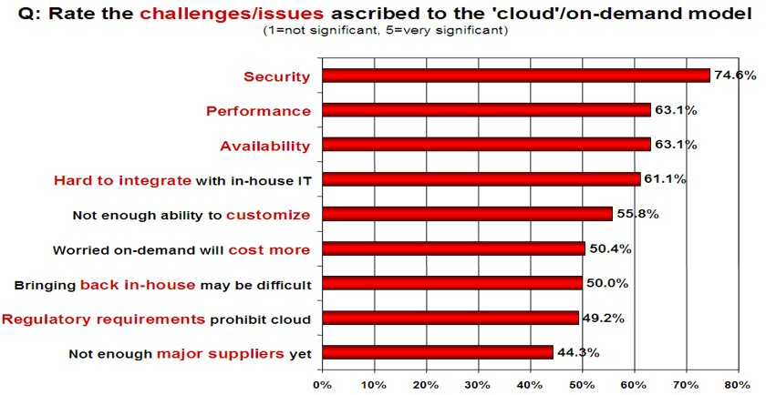
IDC Survey
Notes:
FACT – Security IS the principle up front and central issue on customers minds.
All the other issues are largely diffused once the Security issue has been addressed.
But what does it actually mean in our customers

Slide 11
Security or insecure!
Ignorance
Position in threat landscape
Compliance
Out there!
Possession
Control
Change
The Unknown
Cost perception
Notes:
But what do we mean by Security?
In 90% of client engagements the reality of their ‘Security’ concerns are more born out as ‘insecurity’.
Unless this is confronted and confronted in an empathetic and well supported way the challenges will not go away.

Slide 12
The Mobile Effect
Cloud is a form of mobile computing
But then there is Mobile as well…BYOD
24x7x365 from anywhere, anytime, anyways
90% internal
80% external
Notes:
When once 90% of data was contained and shared within a secure corporate LAN environment it is now inverted to over 80% external shared and often hosted as well. Furthermore the added dimension of partner and customer access portals increases the management nightmare.

Slide 13
Security
Trust
Risk
Security
Notes:
Break it down and make it tangible.
It is often that iron bound door that is slammed in your face by a client who is in effect saying, don’t go there, I have used the S word and that is the end of the discussion.
Time for a little push back. Security is something that is very indistinct, it means different things to different people. For a business not to get hamstrung by a security paranoia culture it needs to be rationalised in terms of business impacts, values attributed and practical decisions based on those outcomes made to reflect and support the business strategy.
There can never be sufficient controls and agreements to mitigate all concerns if trust is a missing factor in the client-supplier relationship.

Slide 14
NIST (The National Institute of Standards and Technology)
Despite concerns about security and privacy, the NIST concludes that:
"public cloud computing is a compelling computing paradigm that agencies need to incorporate as part of their information technology solution set."
Notes:
The good news for NIST is …. And when they refer to Agencies they mean Government Agencies. So if it is good for Government then it should be good for business.
But that does not mean just signing up and away you go.

Slide 15
Myth #1:
Security Problem
Insecurity
EDUCATION

Slide 16


Slide 17


Notes:
The message first and for most is clear.

Slide 18
References
CSA (Cloud Security Alliance) – Top Threats Working Group ‘Notorious Nine’
Gartner report -‘Assessing the Security Risks of Cloud Computing’
Notes:
To determine How Secure Cloud Computing is, the approach I have taken is to assess the current to Threats and perceived threats. As fact and urban myth often sit side by side as equals they both represent fuel for any position in any discussion. Therefore it is appropriate to take these perspective.
Surveys of Cloud Business user perceptions.
Real threats.

Slide 19
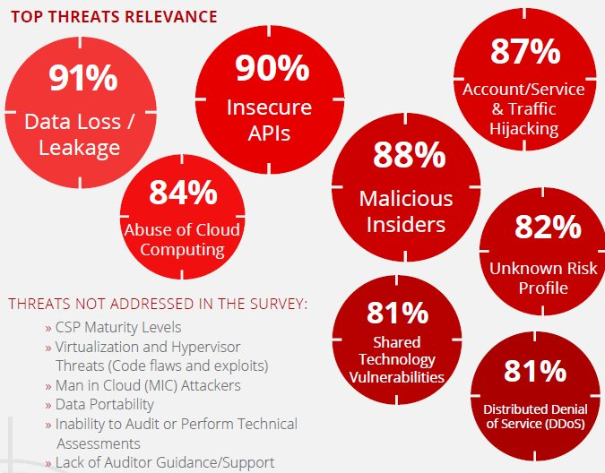
Perceptions
Notes:
We are going to take a whistle stop tour through the Notorious nine to set the landscape for Busting the Business Myths that have arrisen.

Slide 20
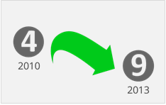
Shared Technology Vulnerabilities
Threat #9
Multi-tenant architecture challenge hardware technologies & hypervisors
Inappropriate levels of control or influence on the underlying platform
Examples:
  Joanna Rutkowska’s Red & Blue Pill exploits
  Kortchinksy’s CloudBurst presentations
Notes:
http://www.informationweek.com/security/application-security/new-virtualization-vulnerability-allows/240001996
Single Vulnerability can compromise an entire cloud at once.
Requirement for defence in DEPTH to include compute, storage, network, application, monitoring and user security enforcement.

Slide 21
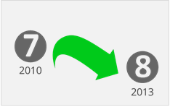
Insufficient due diligence
Threat #8
Too many ‘Gold Rush’ CSP’s & Customers
When adopting a cloud service, features and functionality may be well advertised,
What about:
  details of internal security procedures,
  configuration hardening,
  patching, auditing, and logging
  Compliance?
Notes:
Rushing to adopt cloud can also have its implications in terms of extracting and modifying SLA’s and agreements.
Moving internal systems to the cloud without appreciating the full implications of the changing security and Threat environment.
Businesses lack capability of resource and are trying to use OLD skills and OLD approaches to a fundamentally NEW threat environment.
IRS asked Amazon EC2 to perform a C&A; Amazon refused. http://news.qualys.com/newsblog/forrester-cloud-computingqa.html
Heartland Data Breach: Heartland’s payment processing systems were using known-vulnerable software and actually infected, but Heartland was “willing to do only the bare minimum and comply with state laws instead of taking the extra effort to notify every single customer, regardless of law, about whether their data has been stolen.”
http://www.pcworld.com/article/158038/heartland_has_no_heart_for_violated_customers.html

Slide 22
Myth #2:
Technology Problem
The tendency for businesses to bypass IT departments and information officers.
Credit Card Cloud
Value neutraliser
Resource – CSA: Security as a Service Implementation Guide
Notes:
Don’t answer all instances with technology. People & Process biggest hole.
DO NOT make singular tactical investments as these do not often raise security posture. Needs to be Holistic proactive & insightful approach.
Tools, tradecraft, or command & control infrastructure is not an answer. It is the WHO and HOW behind this. You will never maintain state on latest Tools, tradecraft, or command & control infrastructure.

Slide 23
New IT generation new skills
Myth #3:
Reuse old Skills
IT experience is not lost
New set of skill technical skills
  Developers
  Infrastructure
  Architects
New set of business skills
  Partnership
  Strategic

Slide 24
Opportunity Knocks
Where a business does not have structured IT resources then it is the ‘Trusted’ technology partner who MUST fill this role.

Slide 25
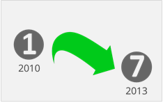
Abuse of Cloud Services
Threat #7
Criminals leverage cloud compute resources
Cloud providers Targeted
IaaS offerings have hosted:
  Zeus botnet,
  InfoStealer trojan horses
  botnets command & control
Impact = IaaS blacklisting
Notes:
Cross- VM Side Channels & Their use to extract Private Keys http://www.cs.unc.edu/~yinqian/papers/crossvm.pdf
Pirate Bay ditches servers and switches to the Cloud http://news.cnet.com/8301-1023_3-57534707-93/pirate-bay-ditches-servers-and-switches-to-the-cloud/

Slide 26
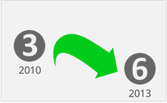
Malicious Insiders
Threat #6
Level of access means impact considerable
Lack of hiring standards
Legislative friction (Monitoring / Disciplinary)
Impact:
  Brand damage,
  Financial loss
  Productivity downtime
Notes:
CERN defines an insider threat as such: http://www.cert.org/insider_threat
“A malicious insider threat to an organization is a current or former employee, contractor, or other business partner who has or had authorized access to an organization's network, system, or data and intentionally exceeded or misused that access in a manner that negatively affected the confidentiality, integrity, or availability of the organization's information or information systems.”

Slide 27
CERN defines an insider threat as:
“A malicious insider threat to an organization is a current or former employee, contractor, or other business partner who has or had authorized access to an organization's network, system, or data and intentionally exceeded or misused that access in a manner that negatively affected the confidentiality, integrity, or availability of the organization's information or information systems.”
Notes:
CERN defines an insider threat as such: http://www.cert.org/insider_threat

Slide 28
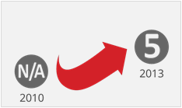
Denial of Service
Threat #5
Prevention of use of a Cloud Service:
  Bandwidth (such as SYN floods)
  CPU
  Storage
Incur unsustainable expence!
Asymmetric application-level attacks:
  Web Apps poor at differentiating hits.
  Not a new attack vector
Notes:
As Cloud Use Grows, So Will Rate of DDoS Attacks http://www.infoworld.com/d/cloud-computing/cloud-use-grows-so-will-rate- of-ddos-attacks-211876
94 percent of data centre managers reported some type of security attacks
76 percent had to deal with distributed denial-of-service (DDoS) attacks on their customers
43 percent had partial or total infrastructure outages due to DDoS
14 percent had to deal with attacks targeting a cloud service
Computerworld: DDoS is Cloud’s security Achilles heel (September 16, 2011) http://www.computerworld.com.au/article/401127/ddos_cloud_security_achil les_heel/
OWASP: Application Denial of Service: https://www.owasp.org/index.php/Application_Denial_of_Service
Radware DDoSpedia http://security.radware.com/knowledge-center/DDoSPedia/

Slide 29
DOS Facts
94 percent of data centre managers reported some type of security attacks
76 percent had to deal with distributed denial-of-service (DDoS) attacks on their customers
43 percent had partial or total infrastructure outages due to DDoS
14 percent had to deal with attacks targeting a cloud service

Slide 30
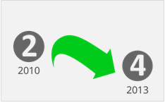
Insecure Interfaces & APIs
Threat #4
Exposed software interfaces or APIs
Security and availability of services dependent upon the security of these.
Exposures:
  unknown service or API dependencies
  API security Key weakness
  clear-text authentication
  Data unencrypted to process
Notes:
Insecure API Implementations Threaten Cloud http://www.darkreading.com/cloud-security/167901092/security/application- security/232900809/insecure-api-implementations-threaten-cloud.html
Microsoft Research on risk of single sign-on http://research.microsoft.com/pubs/160659/websso-final.pdf
"All these flaws allow the attacker to sign in as the victim to her accounts on the websites using SSO services even without knowing the victim’s password,“
Web Services Single Sign-On Contains Big Flaws http://www.darkreading.com/authentication/167901072/security/news/2326
02844/web-services-single-sign-on-contain-big-flaws.html

Slide 31
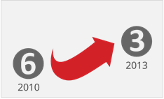
Account or Service Traffic Hijacking
Threat #3
Reuse of Credentials and passwords
Eavesdrop on activities and transactions:
  manipulate data,
  return falsified information,
  Redirect clients to illegitimate sites
Prohibit Sharing accounts
2 Factor Authentication
Notes:
Prohibit the sharing of account credentials between users and services.
Leverage strong two-factor authentication techniques where possible.
Employ proactive monitoring to detect unauthorized activity.
Understand cloud provider security policies and SLAs.
Amazon purges account hijacking threat from site http://www.theregister.co.uk/2010/04/20/amazon_website_treat/
Zeus bot found using Amazon’s EC2 as C&C Server http://www.theregister.co.uk/2009/12/09/amazon_ec2_bot_control_channel/
http://www.infoworld.com/d/cloud-computing/hackers-findhome-in-amazons-ec2-cloud-742
http://vmetc.com/2009/03/12/virtual-machine-sniffer-on-esxhosts/

Slide 32
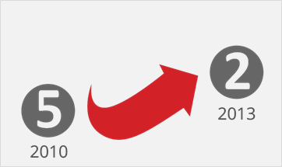
Data Loss
Threat #1
Deletion or alteration of records / Loss of an encoding key, without a backup
Jurisdiction and political issues
Impact:
  Loss of core intellectual property
  Compliance violations
Under new EU data protection rules, data destruction & corruption of personal data are considered forms of data breaches requiring appropriate notifications.
Notes:
Just ask Mat Honan, writer for Wired magazine: in the summer of 2012, attackers broke into Mat’s Apple, Gmail and Twitter accounts. They then used that access to erase all of his personal data in those accounts, including all of the baby pictures Mat had taken of his 18-month-old daughter.
Cloud Computing Users Are Losing Data, Symantec Finds http://news.investors.com/technology/011613-640851-cloud-computing-data- loss-high-in-symantec-study.htm
Kill the Password: Why a String of Characters Can’t Protect Us Anymore http://www.wired.com/gadgetlab/2012/11/ff-mat-honan-password-hacker/

Slide 33

Data Breaches
Threat #1
Cross-VM Side Channel Private key attack
Poor Multi-Tenant data architectures
Vendor Maturity
Advertising seepage
Mobile – Multi Service Architectures
BYOD
Notes:
Cross-VM Side Channels and Their Use to Extract Private Keys http://www.cs.unc.edu/~yinqian/papers/crossvm.pdf The University of Wisconsin and RSA Corporation released a paper describing how a virtual machine could use side channel timing information to extract private cryptographic keys being used in other virtual machines on the same physical server.
Multi-Tenant Data Architecture http://msdn.microsoft.com/en-us/library/Aa479086

Slide 34
Myth #4:
Data Security
It’s in the Name! But its not in practice .….
Data
Environment
Notes:
We are largely securing the ‘Environment’ NOT the ‘Data’

Slide 35
Data Ownership does not transfer
Myth #5:
Responsibility Transfer
Concepts of
  Data Controller (Purpose, Conditions & Means)
  Data Processor (Sub-processor & Model Clauses)
Service Level Agreements
  Availability
  Disaster Recovery
  Support
Notes:
Regulation, model clauses do not extend to agreements between processors and sub-processors.

Slide 36
Cloud is a State of ‘Persistent Jeopardy’
Myth #6:
Risk is Static
Commodity Threat = Casting net wide, trying to gain max access, no idea of who or value of targets
Targeted Threat = Adversary going after YOU because of some IP. Understand the WHO = Advanced Threat

Slide 37
Advanced Persistent Threats
Evolutionary
Artfulness & Creativity in attacks
When adopting a cloud service, features and functionality may be well advertised,
What about:
  details of internal security procedures,
  configuration hardening,
  patching, auditing, and logging
  Compliance?
Notes:
Ever more challenged how we protect that which is of true value. No longer the network boundary, but protecting the DATA, wherever it goes, however it is being accessed, regardless of its form factor, prepared and ready to protect that with robust encryption, and architecture that enclaves and segments the network and or environment in which we hold our valued IP so if and when compromise have ability to pull back quickly and engage the threat to mitigate the damage that compromise could incur.
Think of your organisation from the Threat actor. Most people can break into their own home in under 10 minutes, sobering, but demonstrates awareness of the target environment. This is how APT actors are approaching your organisation as a target. They may not even have to penetrate your organisation to compromise it.

Slide 38
Just because you are not on a hit list IF you have IP worth being stolen KNOW that someone is going after it.
You are either being compromised or have been compromised.
State-Sponsored Hacker Group Stealing 1TB of Data a Day - http://www.esecurityplanet.com/hackers/state-sponsored-hacker-group-stealing-1tb-of-data-a-day.html

Slide 39
Persistent Jeopardy
Origin = Jocus (Joke) + Parti (Divide)
I read this as a fool will be parted from his riches!
Riches today being the data at the heart of our Information Society, the hidden asset value on Corporate balance sheets

Slide 40
Myth #7:
Non-Compliance
Certification Status
CERT MARKET REGION
SSAE/SOC Finance Global
ISO27001 Global Global
EUMC Europe Europe
FERPA Education U.S.
FISMA Government U.S.
PCI CardData Global
HIPAA Healthcare U.S.
HITECH Healthcare U.S.
ITAR Defense U.S.
Reuters reported 60 Ave regulatory changes PER business day.
16% increase, 20% increase every year since 2008 financial crisis.
Notes:
So many Compliance mandates. Focus on making right investments on security posture and compliance mandates should fall under that = Become secure to become compliant.
Reuters reported 60 Ave regulatory changes PER business day. 16% increase, 20% increase every year since 2008 financial crisis.

Slide 41
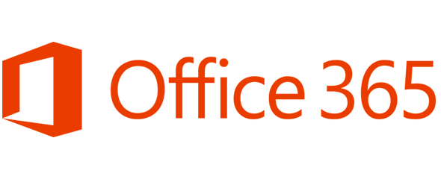
Compare Security & Compliance
Financially-backed, guaranteed 99.9% uptime Service Level Agreement (SLA)
Always-up-to-date antivirus and anti-spam solutions to protect email
Safeguarded data with geo-redundant, enterprise-grade reliability and disaster recovery with multiple datacentres and automatic failovers
Best-of-breed data centres with SAS 70 and ISO 27001 certification
Notes:
Don’t get me wrong Microsoft are doing a fantastic job and with Office 365 and last month the game changed again.
If you have not taken a look at Office365 then you must. It will impact your business whether your an ISV, SI, infrastructure or Dynamics.
Which is why the next few slides are CLITICAL for you to understand. These are built on experience and real market lessons you will not get elsewhere.

Slide 42
Cloud is not inherently Secure
Myth #8:
Cloud is Secure
Same traditional IT security rules apply
New set of skill – IT & Business
Game Changer:
  Access to cheap IT
  Access to Enterprise IT
  Access to professional support resources
Easier to be Secure & Compliant

Slide 43
Part 3 …. After
Myth #9
Myth #10

Slide 44

Stephen McGibbon
Worldwide Chief Technology Officer, Microsoft
http://notes2self.net
https://twitter.com/notes2self

Slide 45
Real World Scenarios
Part 3
The Myth of Lock-In
Presenter ~ Nigel Gibbons
Notes:
Welcome…
But First…

Slide 46
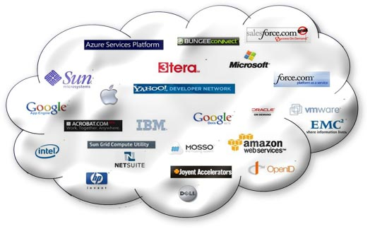
Cloud All in!

Slide 47
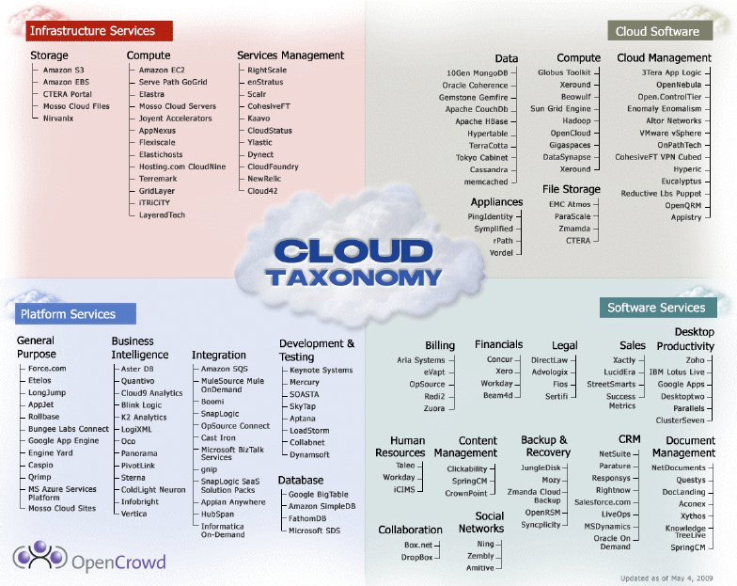

Slide 48
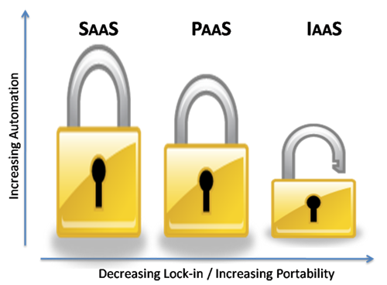
A Control Thing

Slide 49
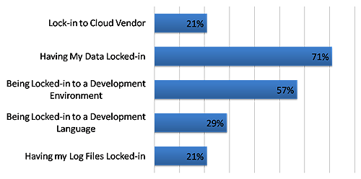
Lock-in Detailed
Whatever makes it expensive to switch between or interoperate with different vendors.

Slide 50
Interoperability
Peering
Commercial Agreements (x2 £’s)
Compatibility
Standards (Features)
Protocols
API’s & Languages (Common)
Portability
SLA’s (Contract breaks)

Slide 51
Cloud Maturity
Bern Treaty - global mail at a flat fee.
  Sender kept fee
  Every letter begat a reply
Cloud maturity ‘Event Horizon’:
  Infrastructure
  Asset mobility (ie: Move VM’s / apps around)
  Adaptive API’s & Data format’s.
TRUST
Notes:
The state of the cloud is analogous with the postal system in the 1800’s. We have better infrastructure between datacentres than they had between countries but it's still too expensive to move large amounts of data around. It's also too slow to send important, time sensitive data around at volume.

Slide 52

Best Options
SaaS – Application Provision
Microsoft Office 365 – Business Productivity Suite
PaaS – Compute & Storage
Azure Compute = Web, Service, and CGI Roles.
Azure Storage = Table, Blob, & Queue services.
Azure App Fabric = access control & the service bus
SQL Azure = clustered, high end instance of SQL Server
IaaS – Core Infrastructure
Azure VM’s - Windows & Linux
Azure Virtual Networks
Microsoft Global CDN
CRM Online – Sales management
InTune – Systems management
Notes:
JAVA example – Take application, creating a Role involves adding it to the service definition file, setting attributes in the service configuration file and providing a class to handle the Role lifecycle. The Role provides hooks to launch a Java application and ways to communicate with the Azure runtime. Instantiate a JVM Blob storage at role initiation.

Slide 53
Security Risk
Risk Mitigation Technology
Rogue Admin
RMS, BitLocker, LockBox, Physical Facility monitoring
Data Loss Prevention (DLP)
RMS; Exchange 2013 DLP Policies
Stolen/Lost Laptop
BitLocker
Stolen/Lost Mobile Device
BitLocker
Notes:
Above and beyond the robust encryption features detailed above, customers can choose to use Active Directory Rights Management Services (ADRMS) in Office 365. These features provide customers flexibility to select items they want to encrypt. Encrypting data at rest with ADRMS is also available. Email encryption with non-federated users is available with Office 365 enabling ad-hoc, encryption services with any recipient. Office Professional Plus offers advanced security with native support for Cryptographic Agility by integrating with the Cryptographic Next Generation (CNG) interfaces for Windows. Administrators can specify cryptographic algorithms for encrypting and signing documents.

Slide 54
Data Security
Encryption of data at rest using Rights Management Services
    Flexibility to select items customers want to encrypt.
    Can also enable encryption of emails sent outside
    the organization.
    Office 365 ProPlus supports Cryptographic Agility
    Integrates Cryptographic Next Generation (CNG) interfaces for Windows.
    Administrators can specify cryptographic algorithms
    for encrypting and signing documents

Slide 55
Authentication
Azure Integrated Active Directory
    Azure Active Directory
    Active Directory Federation Services
Enables additional authentication mechanisms:
    Two-Factor Authentication – including phone-based 2FA
    Client-Based Access Control based on devices/locations
    Role-Based Access Control
Notes:
Office 365 data and services are secured at the datacenter, network, logical, storage, and transit levels. In addition, it is critical for customers to be able to control who can access data and how they can use it. Office 365 is integrated with Active Directory, Azure Active Directory, and ADFS. This integration provides strong authentication and granular control over how IT professionals and users can access and use the service. Office 365 also conforms to standards such as WS-FED/SAML with ability to support multiple identity providers who implement these standards and are validated via the “Works with Office 365” program.
Customer End Federated identity and single sign on security provisions
Administrators can federate on-premises Active Directory Federation Services with the Office 365 services federation gateway. After Active Directory Federation Services is configured, all Office 365 users whose identities are based on the federated domain can use their existing corporate logon to authenticate to Office 365. This allows administrators to create additional authentication mechanisms such as:
Two-factor authentication
Client Based access control, allowing organizations to control how users to access information from specific devices or specific locations or combination of both (for example, limiting access from public computers or from public open Wi-Fi)
Role Based Access Control, similar to the access control procedure described above in ‘Automated Operations’ section for Microsoft personnel
With IM federation, Lync Online users can IM securely with users in other organizations that use Lync Online, on-premises Lync Server 2010, and even the Skype public IM network. All federated communications are encrypted between the IM systems using access proxy servers.
Phone Based two factor Authentication
Two-Factor Authentication enhances security in a multi-device, mobile, and cloud-centric world. Microsoft provides two-factor authentication that allows users to receive a PIN sent as a message to their phone and enter that PIN as a second password to log on to their services.

Slide 56
Compliance: Data Loss Prevention (DLP)
eMail
Prevents Sensitive Data From Leaving Organization
Provides an Alert when data such as Social Security & Credit Card Number is emailed.
Alerts can be customized by Admin to catch Intellectual Property from being emailed out.
Empower users to manage their compliance
Contextual policy education
Doesn’t disrupt user workflow
Works even when disconnected
Configurable and customizable
Admin customizable text and actions
Built-in templates based on common regulations
Import DLP policy templates from security partners or build your own
Notes:
Office 365 delivers a range of compliance features including Data Loss Prevention (DLP), eDiscovery and auditing and reporting functionality. Across these capabilities, the user experience is preserved and productivity is not impacted, leading to greater user acceptance. First lets talk about Data Loss Prevention.
Data Loss Prevention (DLP)
While viruses and targeted attacks can cause data breaches, user error is actually a much greater source of data risk for most organizations. Exchange provides Data Loss Prevention (DLP) technology that identifies, monitors, and protects sensitive data—and helps users understand and manage data risk. For example, DLP proactively identifies sensitive information such as social security or credit card numbers and alerts users via “PolicyTips” before they hit send. Administrators have a full range of controls and can customize the level of restrictions for their organization. For example, users can simply be warned about sensitive data before sending, sending sensitive data can require authorization or can be blocked from sending data completely. DLP features scan both email messages and attachments and comprehensive reporting about what data is being sent by whom is available to administrators.

Slide 57
Real World Scenarios
Part 3
Presenter ~ Nigel Gibbons
Notes:
Welcome…
But First…

Slide 58

Ignorance
Notes:
Danger with security is we all experience it and think we know how to deal with it.
Well that may be true in our own competencies but security is hard to take in isolation. You tighten one are and it is compromised by the backdoor weaknesses of another.

Slide 59

Notes:
There is risk with an uneducated approach.
The Cloud is all about risk mitigation.
How secure is my data, how can I trust the provider etc…
But keep it in relative to the size of organisation you are dealing with.

Slide 60
Vendor Maturity
Financial strength?
Service Level Agreements?
Where is my data?
Data segregation?
Who has access to my data?
What is your Disaster Recovery process?
Does your DR have regular independent checks, & available proof’s?
Notes:
Gartner – ‘Assessing the Security Risks of Cloud Computing’ report.
Here are seven of the specific security issues Gartner says customers should raise with vendors before selecting a cloud vendor.
Privileged user access. Sensitive data processed outside the enterprise brings with it an inherent level of risk, because outsourced services bypass the "physical, logical and personnel controls" IT shops exert over in-house programs. Get as much information as you can about the people who manage your data. "Ask providers to supply specific information on the hiring and oversight of privileged administrators, and the controls over their access," Gartner says.
2. Regulatory compliance. Customers are ultimately responsible for the security and integrity of their own data, even when it is held by a service provider. Traditional service providers are subjected to external audits and security certifications. Cloud computing providers who refuse to undergo this scrutiny are "signalling that customers can only use them for the most trivial functions," according to Gartner.
3. Data location. When you use the cloud, you probably won't know exactly where your data is hosted. In fact, you might not even know what country it will be stored in. Ask providers if they will commit to storing and processing data in specific jurisdictions, and whether they will make a contractual commitment to obey local privacy requirements on behalf of their customers, Gartner advises.
4. Data segregation. Data in the cloud is typically in a shared environment alongside data from other customers. Encryption is effective but isn't a cure-all. "Find out what is done to segregate data at rest," Gartner advises. The cloud provider should provide evidence that encryption schemes were designed and tested by experienced specialists. "Encryption accidents can make data totally unusable, and even normal encryption can complicate availability," Gartner says.
5. Recovery. Even if you don't know where your data is, a cloud provider should tell you what will happen to your data and service in case of a disaster. "Any offering that does not replicate the data and application infrastructure across multiple sites is vulnerable to a total failure," Gartner says. Ask your provider if it has "the ability to do a complete restoration, and how long it will take.“
6. Investigative support. Investigating inappropriate or illegal activity may be impossible in cloud computing, Gartner warns. "Cloud services are especially difficult to investigate, because logging and data for multiple customers may be co-located and may also be spread across an ever-changing set of hosts and data centers. If you cannot get a contractual commitment to support specific forms of investigation, along with evidence that the vendor has already successfully supported such activities, then your only safe assumption is that investigation and discovery requests will be impossible.“
7. Long-term viability. Ideally, your cloud computing provider will never go broke or get acquired and swallowed up by a larger company. But you must be sure your data will remain available even after such an event. "Ask potential providers how you would get your data back and if it would be in a format that you could import into a replacement application," Gartner says.

Slide 61
Vendor Maturity
Do you have a dedicated team to manage security vulnerability issues?
What is your vulnerability response success & track record?
What process improvements have you made as a result of vulnerabilities?
What is your release strategy? (How long do we have to wait for a fix!)
What training does you team(s) have on IS security Issues?
What % of your team is focused on security?
Notes:
Gartner – ‘Assessing the Security Risks of Cloud Computing’ report.
Here are seven of the specific security issues Gartner says customers should raise with vendors before selecting a cloud vendor.
Privileged user access. Sensitive data processed outside the enterprise brings with it an inherent level of risk, because outsourced services bypass the "physical, logical and personnel controls" IT shops exert over in-house programs. Get as much information as you can about the people who manage your data. "Ask providers to supply specific information on the hiring and oversight of privileged administrators, and the controls over their access," Gartner says.
2. Regulatory compliance. Customers are ultimately responsible for the security and integrity of their own data, even when it is held by a service provider. Traditional service providers are subjected to external audits and security certifications. Cloud computing providers who refuse to undergo this scrutiny are "signalling that customers can only use them for the most trivial functions," according to Gartner.
3. Data location. When you use the cloud, you probably won't know exactly where your data is hosted. In fact, you might not even know what country it will be stored in. Ask providers if they will commit to storing and processing data in specific jurisdictions, and whether they will make a contractual commitment to obey local privacy requirements on behalf of their customers, Gartner advises.
4. Data segregation. Data in the cloud is typically in a shared environment alongside data from other customers. Encryption is effective but isn't a cure-all. "Find out what is done to segregate data at rest," Gartner advises. The cloud provider should provide evidence that encryption schemes were designed and tested by experienced specialists. "Encryption accidents can make data totally unusable, and even normal encryption can complicate availability," Gartner says.
5. Recovery. Even if you don't know where your data is, a cloud provider should tell you what will happen to your data and service in case of a disaster. "Any offering that does not replicate the data and application infrastructure across multiple sites is vulnerable to a total failure," Gartner says. Ask your provider if it has "the ability to do a complete restoration, and how long it will take.“
6. Investigative support. Investigating inappropriate or illegal activity may be impossible in cloud computing, Gartner warns. "Cloud services are especially difficult to investigate, because logging and data for multiple customers may be co-located and may also be spread across an ever-changing set of hosts and data centers. If you cannot get a contractual commitment to support specific forms of investigation, along with evidence that the vendor has already successfully supported such activities, then your only safe assumption is that investigation and discovery requests will be impossible.“
7. Long-term viability. Ideally, your cloud computing provider will never go broke or get acquired and swallowed up by a larger company. But you must be sure your data will remain available even after such an event. "Ask potential providers how you would get your data back and if it would be in a format that you could import into a replacement application," Gartner says.

Slide 62
Vendor Maturity
Do you monitor ‘underground’ attack trends in your sector & have a response process?
Have you been subjected to independent security review & have proof’s to show?
Can you provide independent product user references?
Are you getting the picture?
Notes:
Gartner – ‘Assessing the Security Risks of Cloud Computing’ report.
Here are seven of the specific security issues Gartner says customers should raise with vendors before selecting a cloud vendor.
Privileged user access. Sensitive data processed outside the enterprise brings with it an inherent level of risk, because outsourced services bypass the "physical, logical and personnel controls" IT shops exert over in-house programs. Get as much information as you can about the people who manage your data. "Ask providers to supply specific information on the hiring and oversight of privileged administrators, and the controls over their access," Gartner says.
2. Regulatory compliance. Customers are ultimately responsible for the security and integrity of their own data, even when it is held by a service provider. Traditional service providers are subjected to external audits and security certifications. Cloud computing providers who refuse to undergo this scrutiny are "signalling that customers can only use them for the most trivial functions," according to Gartner.
3. Data location. When you use the cloud, you probably won't know exactly where your data is hosted. In fact, you might not even know what country it will be stored in. Ask providers if they will commit to storing and processing data in specific jurisdictions, and whether they will make a contractual commitment to obey local privacy requirements on behalf of their customers, Gartner advises.
4. Data segregation. Data in the cloud is typically in a shared environment alongside data from other customers. Encryption is effective but isn't a cure-all. "Find out what is done to segregate data at rest," Gartner advises. The cloud provider should provide evidence that encryption schemes were designed and tested by experienced specialists. "Encryption accidents can make data totally unusable, and even normal encryption can complicate availability," Gartner says.
5. Recovery. Even if you don't know where your data is, a cloud provider should tell you what will happen to your data and service in case of a disaster. "Any offering that does not replicate the data and application infrastructure across multiple sites is vulnerable to a total failure," Gartner says. Ask your provider if it has "the ability to do a complete restoration, and how long it will take.“
6. Investigative support. Investigating inappropriate or illegal activity may be impossible in cloud computing, Gartner warns. "Cloud services are especially difficult to investigate, because logging and data for multiple customers may be co-located and may also be spread across an ever-changing set of hosts and data centers. If you cannot get a contractual commitment to support specific forms of investigation, along with evidence that the vendor has already successfully supported such activities, then your only safe assumption is that investigation and discovery requests will be impossible.“
7. Long-term viability. Ideally, your cloud computing provider will never go broke or get acquired and swallowed up by a larger company. But you must be sure your data will remain available even after such an event. "Ask potential providers how you would get your data back and if it would be in a format that you could import into a replacement application," Gartner says.

Slide 63
Trust is King
Honesty
Trust
Deliver
Notes:
You will only realise the true value of Cloud if you can engage the ‘Service Tail’. To do so you have to achieve the holy grail of DEEP trust.
Trust not just in technical competency but in an understanding of your customers business and objectives.
Sometimes the truth can hurt but honesty is the key to the door. An open and frank engagement forms a sound platform for successful delivery, and there is nothing like success to foster trust.

Slide 64
Why get independently verified?
“I need to know Microsoft is doing the right things”
  Alignment and adoption of industry standards ensure a comprehensive set of practices and controls in place to protect sensitive data
  While not permitting audits, we provide independent third-party verifications of Microsoft security, privacy, and continuity controls
Microsoft provides transparency
This saves customers time and money, and allows Office 365 to provide assurances to customers at scale
Office 365 Trust Centre (http://trust.office365.com)
Notes:
Microsoft provides transparency for customers to evaluate service to meet their regulatory and compliance needs… The customer is responsible to evaluate the service and decides how to meet requirements.
Customers almost always start with insisting that they need to perform audits of Microsoft themselves. First, customer audits do not scale. We provide services to thousands of customers and we could not scale to handle audits by each customer. We also believe that our customers gain more value through the independent third parties that we leverage to produce in depth and comprehensive audits of our services. With ISO 27001 we believe that our customers get both the depth and breadth perspective on our environment and practices. In addition, we also believe that this leads to better security both through interaction with top talent from companies like Deloitte and BSI but also by limiting the details of our practices to as few as people as possible.
The internal Microsoft compliance team is responsible for auditing, monitoring, managing, and closing audit issues. Therefore, the team periodically conducts assessments of people, processes, and technology controls to assess operational effectiveness.
Independent Certification
In addition to internal assessment as described above, the Microsoft Online Services organization undergoes various independent third-party compliance audits to provide a greater level of assurance to our customers. Such independent, objective audits may also help satisfy customers’ legal, regulatory, and compliance obligations.
Demonstrating Compliance
There are a number of ways to demonstrate standards compliance. The Microsoft strategy is to undergo independent unbiased third-party compliance audits and certifications of Online Services to validate control design and operational effectiveness, from service development to physical deployment of infrastructure and operations. This third-party assurance enables our customers not only to be confident about the security of the Business Productivity Online Suite services, but in some cases it also enables them to satisfy their own legal, regulatory, and compliance obligations.
These third-party audits also save customers money by eliminating the need for customers to conduct their own audits, while at the same time providing a better control validation of Business Productivity Online Suite services via an independent third-party entity.
Can Microsoft Make Me Compliant?
Microsoft uses a framework-based approach to managing compliance-related controls, which enables our staff to plan, deliver, operate, and manage a customer’s compliance requirements.
Microsoft Online Services undergoes multiple third-party compliance audits annually to provide customers with a greater level of confidence. These independent audits can help customers satisfy legal, regulatory, and compliance obligations and can save them money through reduction in their audit costs.
Even though Microsoft Online Services certified to meet exacting standards– customers are responsible to ensure their own compliance with applicable policies, practices, and regulations. Microsoft does not claim and is not responsible for providing these certifications or to comply/not comply with these certifications on behalf of the customer.

Slide 65

Security On Ramp
Microsoft Security Assessment Tool
Gain visibility of service revenue potential
Identify in competency areas
Out of competency = Engage a Pro!
Notes:
If you follow this process you will not go wrong.
Use the tool, and impress the client, its billable and gets everyone onto a baseline for discussion.
Identify what your strengths are and stick to them. Partner to do the rest and enjoy building a trusted network of partner companies that can help you accelerate into future projects with conviction and the confidence of customers (back to the key trust point).

Slide 66
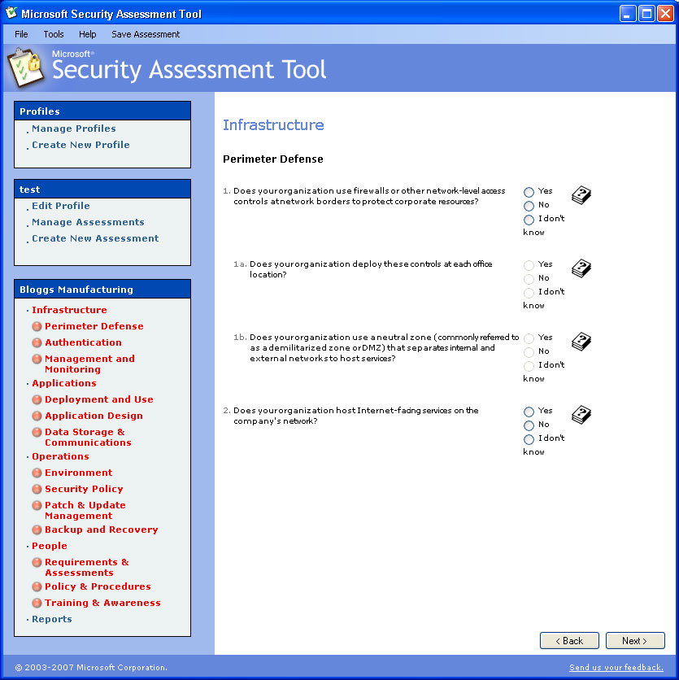
Microsoft Security Assessment Toolkit
http://technet.microsoft.com/en-gb/security/cc185712.aspx
Notes:
The Microsoft Security Assessment Tool is not a cloud specific tool. What it does is provide a valuable base lining exercise for organisations BEFORE they move to the cloud.
When you start talking cloud to clients and the security barriers start going up, it is useful to have a direct comparison with what the organisation is currently operating under. Often Cloud can deliver better than existing security and if not then it provides a clear demarcation line for negotiation with the cloud provider.

Slide 67
Cloud Security Alliance (CSA)
Service Implementation Guidance
https://cloudsecurityalliance.org/research/secaas/#_downloads

Slide 68
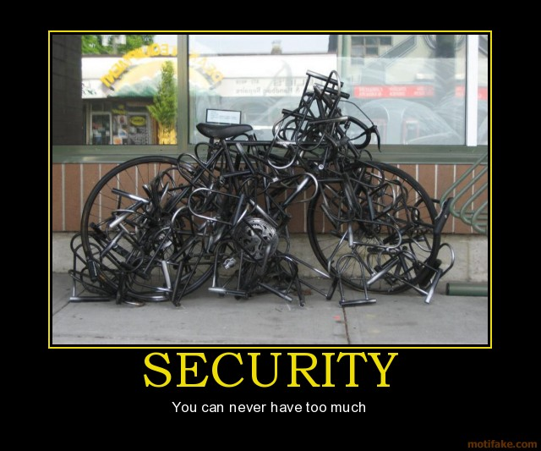
Notes:
You still need to ride the bike!

Slide 69

Notes:
The Coud, MPN and its competencies give you greater visibility of who can really do what.
IAMCP cuts through the dross and gives you a support network to develop your business into the cloud and build the all valuable service tail revenue.

Slide 70
IAMCP Vision and Mission - PACE
Vision
IAMCP the global business community for the Microsoft Channel
Mission
To maximize the business potential of its members through:
Peer to Peer Networking | Rhythm of events occurring globally
Advocacy | To legislatures, the media, to Microsoft and Microsoft Partners (liaison with VFI)
Community Outreach | On the lines of Social Entrepreneurship
Education and Growth | Provide Programs and experiences to grow the business capability and capacity of Partners

Slide 71
Thank You !
http://nrgfxit.net
https://twitter.com/nrg_fx
info@iamcp-uk.org
http://www.twitter.com/IAMCPUK
http://www.twitter.com/IAMCPOrg

