Slide 1
Notes:
BL38p Making Money with Microsoft Cloud, the Real-World How-To.
Session Type: Partner Panel Session
Track: Business Leadership/Sales Excellence/Marketing

Slide 2
Making Money with Microsoft Cloud.
The Real-World How-To
Nigel Gibbons
Chairman
UniTech tm
Notes:
Real-world scenarios and shared experiences that will help you accelerate your business adaptation to cloud computing. How working more effectively and efficiently can be achieved to make the tighter margin demands of the cloud. The pivotal role partnering models have in delivering richer and faster solutions. Moving beyond the subscription revenue, hear how the cloud really delivers value, how to evolve your strategic product roadmap planning and unique customer propositions. When it comes to the real-world lessons hear from ISVs and service partners who are successfully walking the talk.

Slide 3



Nigel Gibbons
Chairman – UniTech tm
Chartered IT Professional (CITP)
Microsoft Buisness Value Planning (MBVP)
Certified Information Systems Auditor (CISA)
Certified Information Systems Security Professional(CISSP)
Microsoft Certified Inromation Technology Professional (MCITP)
Strategic Business Planning & Audit
  IAMCP UK & International Board Member
  Microsoft Partner Advisory Council
  Microsoft Executive Partner Board
  Cloud Security Alliance - UK & Ireland
  Insititute of Information Security Professionals (IISP)
  Information Security Audit & Control Association (ISACA)
  International Information Systems Security Certification Consortium or (ISC)2
  EuroCloud
  Voices for Innovation
http://www.nigelgibbons.net
@NRG_fx
Notes:
Its not about me its about the shared insights I believe I continuously experience from my engagements across the industry, and especially through the IAMCP and the SME sector which is the predominant space that Microsoft Partners occupy.
I am here by the grace of IAMCP and whilst I may reference experiences these are from the broader church of IAMCP members and not exclusively my own.

Slide 4
Panel Format
Warm up & Positioning
  Set the Scene
  Heads up
Panel Shared Insights
  Experiences
  Real World
Audience Participation - Q & A
  Collect & Collate Questions
  Panel responses
Notes:
Introduction – NRG Intro followed by brief intro by each partner. Then NRG do a 10/15 minute setting the theme.
Panel Pointers – NRG to lead in each of the Panel with questions for panellists to either challenge or support the points made when I set the theme. Key points can be summarised as follows:
Solidsoft:
Shift from traditional Software Services to Cloud.
Microsoft support & Value add as a key partner:
Azure EA benefits.
Azure Circle
Organisational Cultural shift.
Discipline focus
Partnering support of the new model.
MetaVistech
Subscription based pricing and the unique volume ‘metering’ your products use.
Online product delivery, and maintenance.
Backend management and monitoring
Perception of ‘free’ functionality as a value add.
Partnering, use of a channel to drive market.
Litera:
Traditional ISV to Cloud – Hybrid approach.
Microsoft program benefits – how this has affected our approach:
azure incubator program
MPSC
Gold cert ISV
Office TAP 15
Premier support for ISVs
Hi-potential ISV partner
Go to market – Full Armor example presenting and automating delivery of product & Partnering.
Audience Engagement Q&A – My plan here is to capture questions and consolidate them for about 5 mins with the audience, this will give each of you time to hear and prepare your thoughts before I then put the questions in a consolidated form to each of you in turn.

Slide 5



The Panel
Litéra Corp
  Global ISV – Independent Software Vendor
  Document Lifecycle Management ‘Document Confidence’
Solidsoft Ltd
  SI – Solution Integrator
  ‘The Game has Changed, we are Cloud based now’.
Metavis Technologies
  ISV – Independent Software Vendor
  Product that ‘Organize SharePoint Environments’

Slide 6

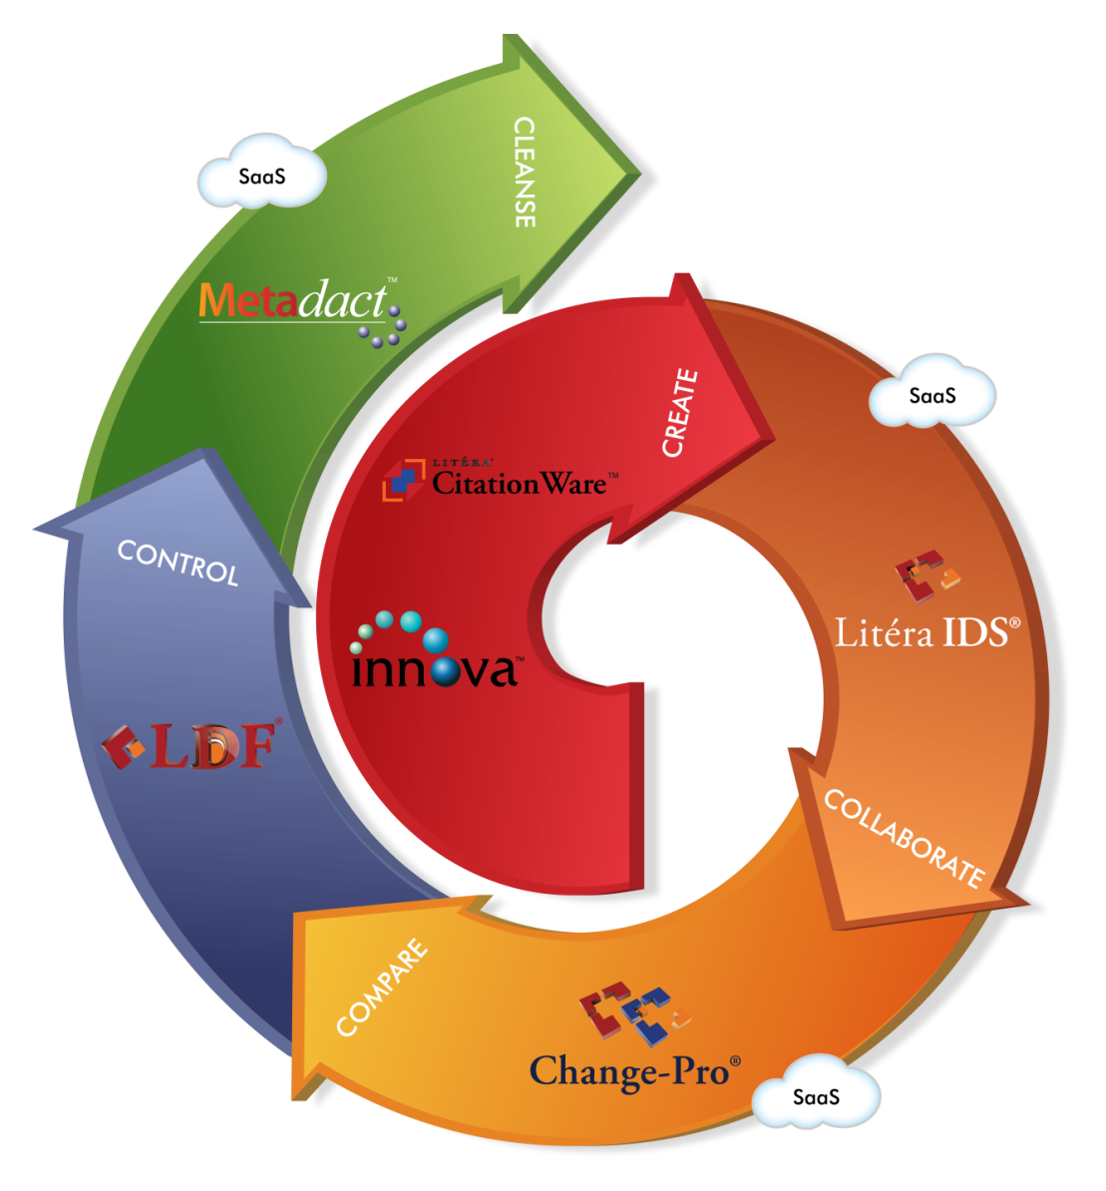
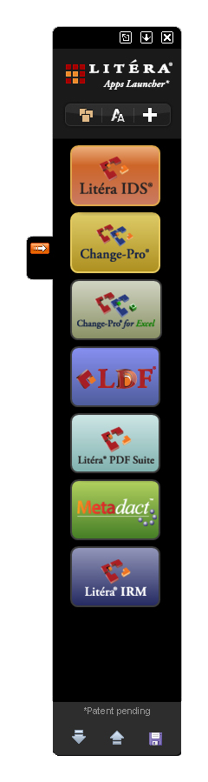

Content Confidence – Lifecycle Of Documents
The most comprehensive collection of collaborative
content lifecycle management available in an integrated suite.
www.litera.com

Slide 7
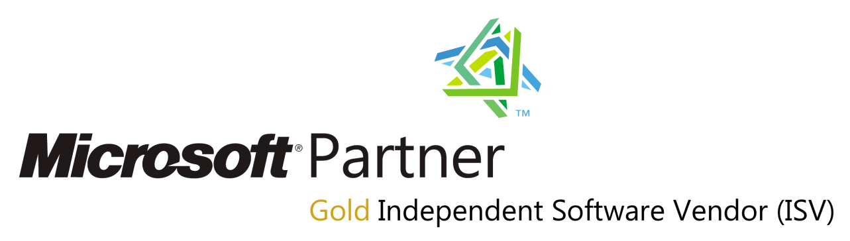
MetaVis Technologies
Leader in SharePoint Information Management tools for Office 365 including:
  Migration
  Administration
  Backup
  Information Architecture
  Classification
Easy to install and use www.metavistech.com

Slide 8




Solidsoft
who we are
  UK SME based in Basingstoke
  independently owned consultancy practice
  established in 1993
  what we do
  specialise in design and build of
  enterprise architectures and business
  applications for cloud and traditional
  environments with Microsoft technologies
our services
  architecture and road map planning
  consultancy and troubleshooting
  full lifecycle solution development
  business continuity support

Slide 9
Event Horizon
Consumer Driven Usage
  BYOD
  Mobile Work force / Anywhere, anytime (Any ‘Surface’!)
  New Segments
Pivotal Platforms
  Windows 8 on ALL ‘Surfaces’.
  Cloud – Azure & Office365
  Marketplaces – New delivery models
Revenue
  Margin shift = different charging models / Maintain Margin
  Regulatory fall-out (Second soft v. Oracle)
  New Revenues
Notes:
Not juts Cloud computing. It is more than just the technologies and products needed to build and deliver Cloud services. It is about the real benefits Cloud computing models deliver to business and the tectonic shifts this is having, accelerated by the recession, on how traditional businesses operate and view their strategies now and into the future.

Slide 10

Change

Slide 11

Directive

Slide 12

Temptation / Ignorance
Notes:
Cloud looks like a quick cut and paste to some.
DON’T Rush it.

Slide 13

Notes:
The Challenge is how business get their heads around the ‘Cloud Computing’.
Business on both sides of the table – IT Companies and their Customers.
The reason for this is Cloud Computing is not very distinct.

Slide 14
Transformation
Microsoft
You
Customer
Partnership

Slide 15
Microsoft
R & D Department
Software
Services
Support
MPN
Leverage benefits
Engagement
Accelerator Programs
Incentives
Marketing Campaigns
Go for Gold
Certify
Azure Circle
Notes:
Microsoft program benefits – how this has affected our approach:
azure incubator program
MPSC
Gold cert ISV
Office TAP 15
Premier support for ISVs
Hi-potential ISV partner

Slide 16
You
Culture
Cloud, what does it mean for your company
Shift from traditional Software Services to Cloud
Focus
Be clear on what you do, be the best
Partner to do the rest
Revenue
Realism, know your Resource Utilisation
Maintain Margins under pressure
Go to Market / Pricing
Notes:
A shift change in the way you will retain and protect value, placing emphasis on Brand. With changing landscape and perception of software value moving from old world of point releases to real-time updates.

Slide 17
You
ISV (CSV)
Subscription
SI
Annuity

Slide 18
Customer
New Age of Trust
Traditional trust under review
Event horizon risk of churn
New Models of Engagement
Business Context NOT just Technology
Cloud delivery
Corporate attitudes evolving (Business v. IT)
Visibility
Choice
Brand
Notes:
What is demanded by the market today is an increased ability for IT services companies to communicate and shape purpose in a Business context NOT just Technological, the challenge is how to provide visibility of this capability to the customer and ready the delivery channel.
Please believe me this is Re-defining Corporate Structures as we have known them, their processes and traditional modus operandi.

Slide 19
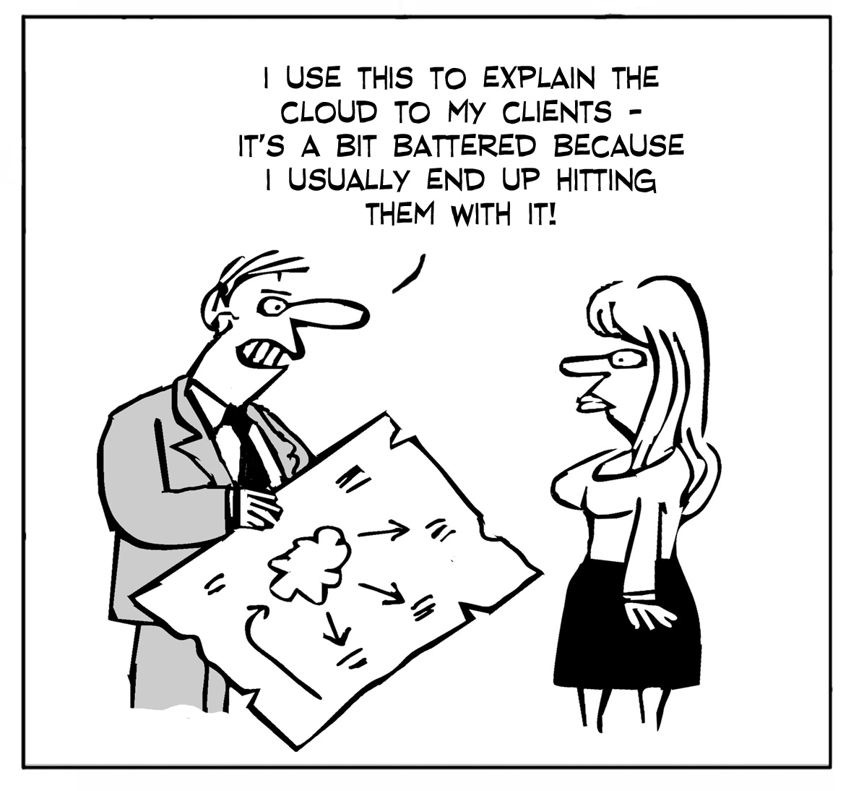
New Standards Required in Sales!

Slide 20

SLA’s
Service Level Agreements
Notes:
Most SLA’s are not worth the paper they are printed on.

Slide 21
Q & A
?
?
?

Slide 22


Partnering is the key
Notes:
Partnering is key and that is where the IAMCP is your friend and a trusted networking resource, your safety net of professional organisations that can be drawn on as an extension of your own team.
IAMCP cuts through the dross and gives you a support network to develop your business into the cloud and build the all valuable service tail revenue.

Slide 23

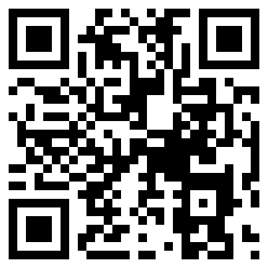
Notes:
NRG Business Details

Slide 24
© 2012 Microsoft Corporation. All rights reserved. Microsoft, Windows, and other product names are or may be registered trademarks and/or trademarks in the U.S. and/or other countries.
The information herein is for informational purposes only and represents the current view of Microsoft Corporation as of the date of this presentation. Because Microsoft must respond to changing market conditions, it should not be interpreted to be a commitment on the
part of Microsoft, and Microsoft cannot guarantee the accuracy of any information provided after the date of this presentation. MICROSOFT MAKES NO WARRANTIES, EXPRESS, IMPLIED OR STATUTORY, AS TO THE INFORMATION IN THIS PRESENTATION.

