Slide 1
‘Open source policy mindshare, a challenge to SMEs’

Slide 2
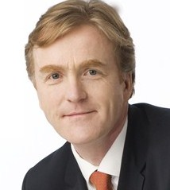





Nigel Gibbons UniTech~ Chairman
Strategic Business Planning & Audit.
Chartered IT Professional (CITP)
Microsoft Buisness Value Planning (MBVP)
Certified Information Systems Auditor (CISA)
Certified Information Systems Security Professional(CISSP)
Microsoft Certified Inromation Technology Professional (MCITP)
http://nigelgibbons.net
@NRG_fx
IAMCP UK & International Board Member
Microsoft Partner Advisory Council
Microsoft Executive Partner Board
Cloud Security Alliance - UK & Ireland
Institute of Information Security Professionals (IISP)
Information Security Audit & Control Association (ISACA)
International Information Systems Security Consortium (ISC)2
EuroCloud
Voices for Innovation
Notes:
Its not about me its about the shared insights I believe I continuously experience from my engagements across the security industry.
I may reference experiences these are from the broader church of Microsoft partners and members of the IAMCP and not exclusively my own.

Slide 3





Slide 4


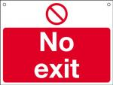
NRG ‘PB’ Curve Presentation Benefits
Benefit
Number of slide
Notes:
My job today is to keep you in the Green Zone.

Slide 5
Open Source
Open Standards
Notes:
Open Source needs to be put into context with Open Standards. In many debates they get horribly mashed up to the extent that Open Standards are pulling through a distorted and wholly ambiguous value proposition for Open Source.

Slide 6

Mindshare
Policy real-estate

Slide 7

Communication
Making it Material
Notes:
Secondly the issue is about COMMUNICATION!
The OSS community has done a great job, with the help of some very big COMMERCIAL interests (IBM, Google, Facebook, Red Hat etc)

Slide 8
What is going on?
Key issues at stake:
Data
Identity, Federation, Trust / Security
Lock-in
Quality of Service
Government orchestrated organisations
Industry Associations & Policy Groups
Notes:
A lot of discussion of cloud services models &

Slide 9
Govt. Orchestrated Standards Bodies
Regionally discrete
National Institute of Standards and Technology
www.nist.gov
European Commissions Information Society
http://ec.europa.eu/information_society

Slide 10
SME’s
Policy Battleground
EU SME Figures |  | Org's | Employ | Employee Ave
Total SME's | 100% | 20,708,000 | 89,947,000 | n/a
1-10 employees or <2m (Micro) | 91.8% | 19,058,000 | 39,630,000 | 2
10 - 50 employees or < 10m(Small) | 6.9% | 1,424,000 | 27,652,000 | 19
10 - 249 employees or <50m(Medium) | 1.1% | 226,000 | 22,665,000 | 100
Large Enterprises |  | 43,000 | 43,414,000 | 1,010
EU Info Society & NORM/APME

Slide 11
Communication
Getting the messaging right
Open
Free
Policy
SME
Notes:
There are many ways to address the debate, the most dangerous is to get drawn into the emotive territory of Open Sources ‘Gift Economics’.

Slide 12
Communication
Getting the messaging right
Open (Standards) > Interoperability
Gift Economics >
Digital Slavery
Policy >
Commercial Apartheid!

Slide 13

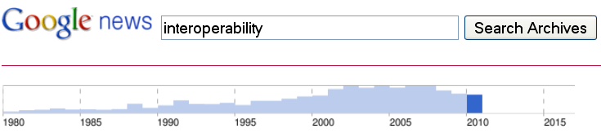
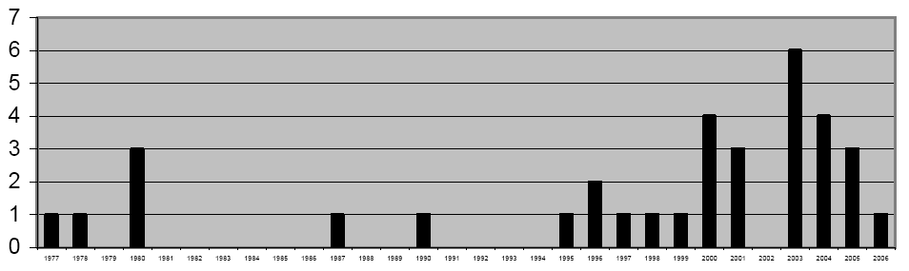
‘INTEROPERABILITY’ definitions proposed in research papers, reports, standards, or government documents
Notes:
SOURCE: Andy Hopkirk (UK National Computing Council)
This is real, it is very much on the radar.

Slide 14
Definitions Games in the name!
Interoperability
?
?
?
Open Standards
Notes:
But before we get into the good stuff we need to strike out a Curve Ball. While I’ve got you fresh!
And before you start checking your schedule concerned that you have walked into an English lesson, the value of this to you is the ability to demonstrate understanding in the face of the new battle ground …
True interoperability means connectivity based on truly open standards that - by definition - do not favour any one software provider.
But the general understanding of Interoperability for the purposes of this presentation is more aligned with the term you may get wielded by some technocrats – Intraoperability - which is yet to make an appearance in the Oxford English Dictionary you can remind them.

Slide 15
Definitions Interoperability
“The ability of two or more systems or components to exchange information and to use the information that has been exchanged”.
Institute of Electrical and Electronics Engineers.
IEEE Standard Computer Dictionary
Notes:
So let’s start by getting our terminology right so we are all taking a common perspective on this.
Firstly we need a definition.

Slide 16
Important
Interoperability
“Open and interoperable are two words in the Information Technology world susceptible to misunderstanding at best, at worst to self-serving abuse. It is important to clarify their accepted meanings, because how they are understood in the market has direct practical consequences for consumers, vendors and regulatory authorities”.
European Committee for Interoperable Systems
Notes:
Why is this even relevant?

Slide 17

Notes:
The new battle ground.
We will come back to this shortly.

Slide 18
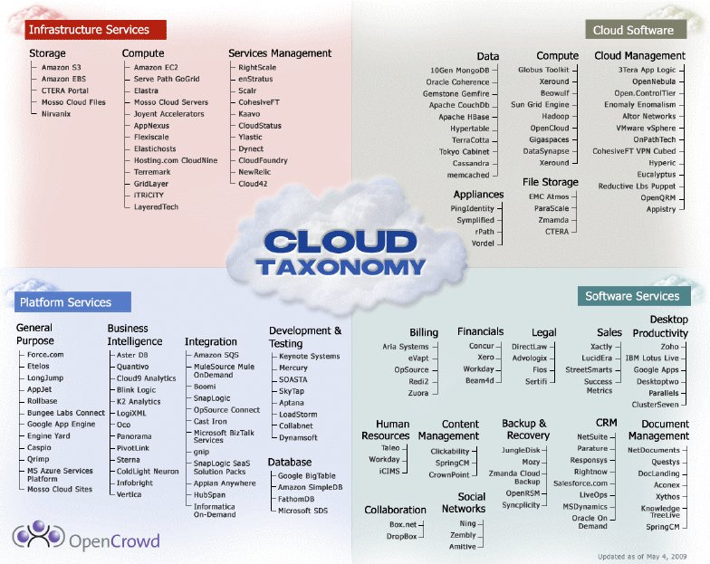

Slide 19

Interop’ Clarification NOT one & the same

Notes:
So interoperability IS NOT the same as Open Standards.
Open Standard implies interoperability ‘ab-initio’ (from the start, the ground-up) and invariably subject to Open Source not for profit usage.
Interoperability is commercially driven process, which could be confined to a dedicated scope of Vendors or product types or uses.
Often ‘post-facto’ (after the event)
Example - The Protocol Freedom Information Foundation (PFIF), a non-profit organization created by the Software Freedom Law Centre, signed an agreement with Microsoft to receive the protocol documentation needed to fully interoperate with the Microsoft Windows workgroup server products and to make them available to Free Software projects such as Samba.
This was driven by the EU in 2004, and is perhaps a more heavy armed side of Interoperability.
Latterly though the EU has demonstrated an unusual insight to the dynamics of innovation and wealth generation in the context of these two issues. IDABC (European Union's programme for Interoperable Delivery of European eGovernment Services to public Administrations, Businesses and Citizens). Where they have dropped the Open Standards orientated thinking and OSS pre-requisites.

Slide 20
The Commercial Divide A misconception
¥
£
=
€
$
Interoperability
=
Open Standards
Notes:
A crude conclusion to the semantics that is often drawn, but not strictly true in the new world of Cloud Computing.
Interoperability is a commercial driven interest or outcome.
Open Standards have a less distinct commercial motivation.

Slide 21

Common Goal Play as a team!
Notes:
To provide effective and efficient exchange, not necessarily OPEN.
The realities in a commercial world are that to benefit from technology you need to leverage the unique features that make the system you have chosen stand out, in so doing you are using proprietary elements that make it less portable.

Slide 22
‘Free’
Getting the messaging right
Free
Code
But what else?
Gift Economics or Digital Slavery
Free or just a blank cheque!
Open Code everyone's a software vendor?

Slide 23

Notes:
This is how the Open Source Community would like to be seen and how they project themselves as the good guys into the minds of policy makers.

Slide 24


Slide 25

Notes:
As for the Open Source Community, the invidious reality is how they are being taken for granted. The ‘Gift Economics’ behind much of their voluntary time and effort is little more than Digital Enslavement (see my earlier blog on which expands this them in a social media context). Where all title and ownership is denied to them for the productivity of their communal efforts. Economic value that finds its way into the hands of a few – Red Hat, IBM, Google, and Facebook amongst others. This is no egalitarian outcome but the concentration of wealth in large commercial businesses built on the shifting sands of goodwill, not the sound economics of commercially prudent investors and SME’s.

Slide 26
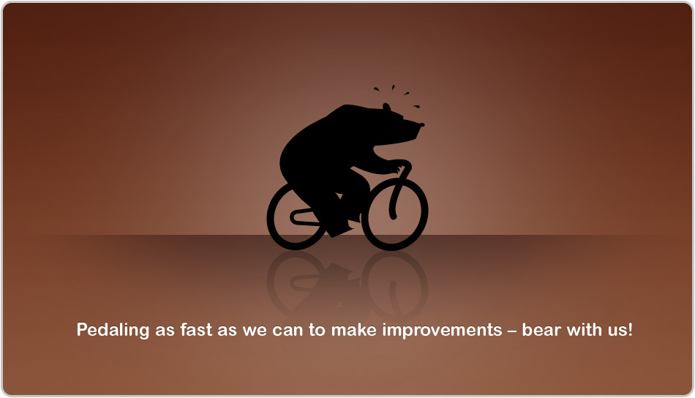
Adopters Dilemma
Accidental Software Vendor
Notes:
Companies attracted to the modification of Open Code end up finding they have an unwelcomed bedfellow in their own fledgling Software Development activities. Fine if it's your core competency, but many companies have enough problems getting on with their core business without broadening their risk landscape.
Outcome is companies have to satisfy an increasingly demanding user base with a fraction of the intellectual input that is available to dedicated software ISV’s.

Slide 27
Policy
Remedy Commercial distortion
Maximise diversity
Foster Independence
Solutions stand on their own merits
Business like, business value focused.

Slide 28
Policy
Prospects
Encourage Innovation
Stimulate growth
Wealth generation
Employment
Economic regeneration

Slide 29
‘Doesn't affect me!’

Slide 30

Notes:
The cloud is not a technology Debate, the business environment is the driver.
The cloud is an enveloping term that tries to coherently represent sets of business tools that are driving recognisable business processes.
Business process that will tap Cloud services will not be based on a single technology or IT Philosophy. The uniqueness and demands of Business process will only be serviced through diversity.
Re-define Corporate Structures. Processes and traditional modus operandi.

Slide 31
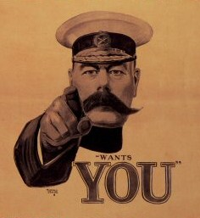
Notes:
Getting involved is not an option if your serious about the future of your market place.

Slide 32
A final thought ~ or two….
A final Thought
….or two .…
We all live under the same sky,
but we don’t all have the same horizon.
Konrad Adenaur (German Statesman; 1876-1967)
Don’t wait. The Time will never be just right.
Napoleon Hill (Author, 1883 – 1970)

Slide 33
Value
“The Value of IAMCP P2P Network on annual basis is worth US $10.2 Billion, IDC Study”

Slide 34


Slide 35
IAMCP Vision and Mission - PACE
Vision
IAMCP is the global business community for Microsoft partners.
Mission
To maximize the business potential of its members through:
Peer to Peer Networking | Rhythm of events occurring globally
Advocacy | To legislatures, the media, to Microsoft and Microsoft Partners (liaison with VFI)
Community Outreach | On the lines of Social Entrepreneurship
Education and Growth | Provide Programs and experiences to grow the business capability and capacity of Partners

Slide 36
Open Market Policy Groups
… & many more…
Microsoft Interoperability Executive Council
http://www.microsoft.com/interop/featured/IECCouncil.aspx
Voices For Innovation
http://www.voicesforinnovation.org
Digital Europe
http://www.digitaleurope.org
EuroCloud
http://www.eurocloud.org
European Committee for Interoperable Systems
http://www.ecis.eu
Notes:
DIGITALEUROPE - dedicated to improving the business environment for the European digital technology industry, and to promoting the digital technology industry's contribution to economic growth and social progress in the European Union.
Object management Group
Open Cloud Consortium
Cloud Computing Interoperability Forum (Google)
Distributed Management Task Force
Open Group
Network Centric Operations
Open Grid Forum
Trust in Digital Life

Slide 37
European Commission
Information Society
The Digital Agenda
Europe's strategy for a flourishing digital economy by 2020.
Outlines policies & actions to maximise the benefits
Commission is working with:
National governments
Concerned organisations
Companies.
An annual Digital Assembly brings stakeholders together to assess progress & emerging challenges.

Slide 38
NIST National Institute for Standards & Technology
An agency of the U.S. Department of Commerce
Founded in 1901
US's first federal physical science research laboratory
Areas in which NIST has had major impact:
Information Technology
X-ray standards for mammography,
scanning tunnelling microscopy,
pollution-control technology,
high-speed dental drills

