Slide 1
Tap the True Value of Partners
~ A New Age of Channel Discipline & Yield for ISV’s
Nigel Gibbons

Slide 2


Slide 3




Nigel Gibbons – Executive Chairman UniTech tm
Strategic Business Planning & Audit.
Chartered IT Professional (CITP)
Microsoft Buisness Value Planning (MBVP)
Certified Information Systems Auditor (CISA)
Certified Information Systems Security Professional(CISSP)
Microsoft Certified Inromation Technology Professional (MCITP)
http://nigelgibbons.net
  @NRG_fx
IAMCP UK & International Board Member
Microsoft Partner Advisory Council
Microsoft Executive Partner Board
Cloud Security Alliance - UK & Ireland
Insititute of Information Security Professionals (IISP)
Information Security Audit & Control Association (ISACA)
International Information Systems Security Certification Consortium or (ISC)2
EuroCloud
Voices for Innovation
Notes:
Its not about me its about the shared insights I believe I continuously experience from my engagements across the security industry.
I may reference experiences these are from the broader church of Microsoft partners and members of the IAMCP and not exclusively my own.

Slide 4






Slide 5



NRG ‘PB’ Curve (Presentation Benefits)
Benefit
Number of slide
Notes:
My job today is to keep you in the Green Zone.

Slide 6


Background
Notes:
So how did I ‘stumble’ into ISV channel development.
My historic relationship with the IAMCP has provided me with a deep understanding of the multi-faceted nature of partnering within the ICT sector. Having worked with a number of partners helping to put together structures of engagement and operational models forma service perspective it was the invitation over 2 years ago to get involved with Microsoft re-vamping of their Partner Network.
The catalyst for what I am presenting today came finally from an invitation to a private round table with Enterprise Ireland and discussions with an International Partner Channels specialist ex Microsoft Exec Paul Solski.

Slide 7
Notes:
Further on the Microsoft’s partner channel is perhaps the most mature and envied ecosystem in the industry. It is with years of experience working as a partner and the latter few years of being privy to the incredible depth and breadth of introspection and research that went into the new MPN that I feel somewhat informed as to what works.
And most importantly what works AT SCALE.

Slide 8

Notes:
Now before you fear that we are over 1/3 of the way through a presentation and you have just been hearing about me, well that is because I need you to understand where the following has come from and why it represents a viable and simple guide to getting your partner channel spun up or brought to heel.
Worried I am just firing blanks?

Slide 9

Fully Loaded !
Notes:
Don’t, I am coming at you fully loaded!

Slide 10
Health Check
90% of the ICT ISV in the market are SME’s
Rigid Partnering Models > Scalable & Elastic
Partners not delivering ? Product Scapegoat
Vendors competing with Partners
90/10 rule
Notes:
It is all good and well speaking about a Microsoft Partner channel, but the reality is that 90% of the ICT ISV out there in the market are SME’s and heavily weighted at the ‘Small end of that scale’.
My focus is on a scalable and elastic approach, like laying down the layers of paint on a premium motor vehicle, with each pass you build on the lustre of the former adding as you go. But enough of the simile's….
It is this audience that I have focused on as a neglected majority, as consultants have laboured long and hard producing partner channel program behemoths suited for the Large and deep pocketed rather than the niche and cashflow sensitive.

Slide 11
Getting the numbers right
A numbers game = Pointed end > Performers NOT Headcount.
Performance = Hitting Targets
Hitting Targets = Action
Action = Investment
Investment = ROI
It’s a Partnership!
Notes:
Too much channel building is around the WRONG number's game, more partners = more return!
You may recognise the model:
Glossy brochures and NFR (Not for Resale) software.
Expectation that Partners will self educate.
Hope to tap partners client base.
Building returns based on % of signed up partners and their stated client base.
The reality is that most partners in this genre are of the following profile:
Single point solution requirement to engage, want a discount but have no real intent to drive product further.
Want access to the software but cannot afford it so spin up a partnering facarde to get access to NFR licenses.
Simply NOT SUITABLE candidates, with no pria experience or discipline around re-selling or integrating into their solutions 3rd party product.
In fact it is likely to mean more friction and more frustration, and certainly not the expected results or discipline necessary for strategic revenue planning.

Slide 12

Blissful Ignorance
Notes:
With the exception of those who have it right I see many simply plugging away heads down, doing their thing, oblivious to the realities, but suspicious that something is not right but not sure what to do so better to do something than nothing so …. Plugging away at the old thing.

Slide 13


Slide 14
Gotcha’s
Vendor Agenda
  What is your model? Direct / Blended ?
Product Placement
  High, mid, low value / Large, medium or small org’s?
Partner Commitment
  Skin in the game!
Lack of mindshare
  Answers to combat choice in market.

Slide 15
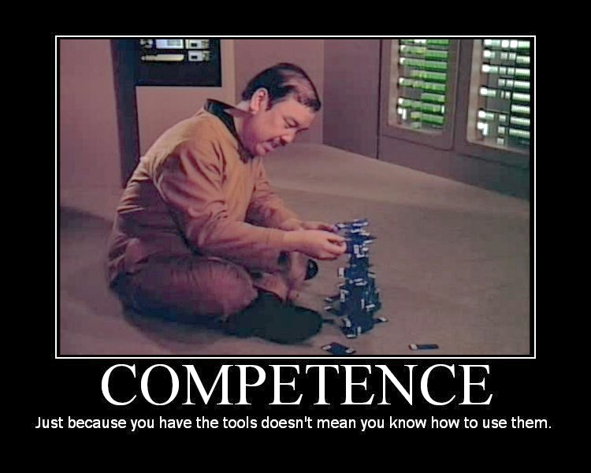
Notes:
The biggest challenge for many vendors is the fact that Partners MUST commit to using the tools and products and PAY for the training and privalage.

Slide 16

Notes:
Think smart and think agile. I even feel this works for the large enterprises as well, which could save them fortunes in consulting fee’s !!

Slide 17
The Preferred Scenario - The Player's
Vendor
Partner
Customer

Slide 18
Magic Formulae !
Number of Opportunities
  Research the No. Vertical Industry prospects in a Geo.
  How many will be in the market each year.
Divide by number of sales / Partner

Slide 19
Partner Profile
Create One…
  Vertical Industry Knowledge
  Complementary product / services
  Geographical reach
  Culture
  References !
Chose don’t be chosen

Slide 20
A Partner Focus
Strong business case demonstrating revenue yield
Stimulate a pro- active partner culture
Joint business plan (Executive Sponsored performance clause)
Joint marketing fund (attach to reward/discount structure)
REVIEW, learn and implement improvements
Structured training and support on products
Empower partners with self-sufficiency
Convince new Partners to sell YOUR product

Slide 21
Partner Channel Lifecycle
Analyse
&
Prepare
Qualify
&
Engage
Plan
&
Skill-up
Execution & Expansion

Slide 22
Objectives & Activities
Analyse & Prepare
ID Target market & Geo.
Create Partner Profile
Qualify & Engage
Secure commitment from decision maker
Communicate opportunity & Set expectations
Sign Partner Agreement
Skill-up & Plan
Skill’s & Support training to make Partner self-sufficient (£ £)
Set goals and review milestones
Execution & Expansion
Execute business/marketing plan’s & secure new Customers !
Develop skills & references
Review & evolve.

Slide 23
Timescales
3mths to recruit a partner
1-2month’s to get to market
6month’s execution to goals
Measure & Review at month 12 …. Kick or Commit!
Apply lessons learnt & repeat as needed.

Slide 24
Channel Partnering Model ‘Lite’ Summary
ISV Questions
ID How many Partners do you need?
No. Opportunities in an area / Sales per Partner.
Build a target market geographical coverage map
What is an Ideal Partner?
Reach the market continuously generating leads
Can close sales & provide on-going support / account management.
Commit resources to market, sell & support your product.
Notes:
90/10 rule – Do more than 10% of your partners generate 90% of your channel revenues?

Slide 25
Final Step
Commitment……

Slide 26



Thank you for your time
For your Next Steps contact us
Tel: Fax: E.Mail: Url: | +(44) 08456 586 555 +(44) 08456 586 556 solutions@unitech.net http://www.unitech.net
Head Office: | UniTech House, 25, Bernard Street, Edinburgh. EH6 6SH. UK.

