Slide 2

National, European & Global Standards drive adoption of Cloud Computing
BL15
Ro Kolakowski
Company Partner
6th Street Consulting
MPN partner since 2006
SharePoint
Anders Kingstedt - Ecru Consulting AB
Nigel Gibbons - Executive Chairman UniTech _{tm}
Lisa Slim
Microsoft Alliance Business Manager
Hewlett-Packard
MPN partner since 1989
HP Enterprise Business

Slide 4



Nigel Gibbons Executive Chairman – UniTech _{tm}
Chartered IT Professional (CITP)
Microsoft Buisness Value Planning (MBVP)
Certified Information Systems Auditor (CISA)
Certified Information Systems Security Professional(CISSP)
Microsoft Certified Inromation Technology Professional (MCITP)
Strategic Business Planning & Audit.
IAMCP UK & International Board Member
Microsoft Partner Advisory Council
Microsoft Executive Partner Board
Cloud Security Alliance - UK & Ireland
Insititute of Information Security Professionals (IISP)
Information Security Audit & Control Association (ISACA)
International Information Systems Security Certification Consortium or (ISC)2
EuroCloud
Voices for Innovation
http://nigelgibbons.net
#NRG_fx
Notes:
Its not about me its about the shared insights I believe I continuously experience from my engagements across the security industry, and especially the SME sector which is the predominant space that Microsoft Partners occupy.
I am here by the grace of IAMCP and whilst I may reference experiences these are from the broader church of IAMCP members and not exclusively my own.

Slide 5





Anders Kingstedt
CEO of Ecru Consulting
Chairman of Sweden’s NB as part of ISO JTC1 / SC38 / SGCC
Advisor and consultant with focus on
Cloud Computing
Life Cycle mgmt. & Governance
Integration
Notes:
BIO: More than 20 years in the IT space. Developer early on that moved on to work as manager and consultant. Focuses on IT Standardization, Cloud Computing, Integration, General development issues, Life Cycle management and Government issues. CEO of Ecru Consulting. Contracted by the EU through CEN to work within the CEN BII / CEN BII 2 workshops as a technical editor (two different contracts; 2008-2009 and 2011 – todate. Trivia: avid runner, father of two boys and a world class marathon runner. Active as coach and runner (masters level) often hired as referee and speaker at Athletic meets (track & field events).

Slide 6
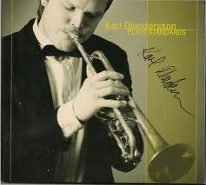

Standardizing the Cloud - The way forward
Notes:
Standardizing the Cloud is critical if we want to achieve a fast adoption. The lack of standards in terms of a common terminology, standards for portability and more is slowing down the Cloud Computing market growth. I am here to tell you about what’s going on, what needs to be done and how you engage with standardization initiatives around the world to help in standardizing the Cloud!

Slide 7

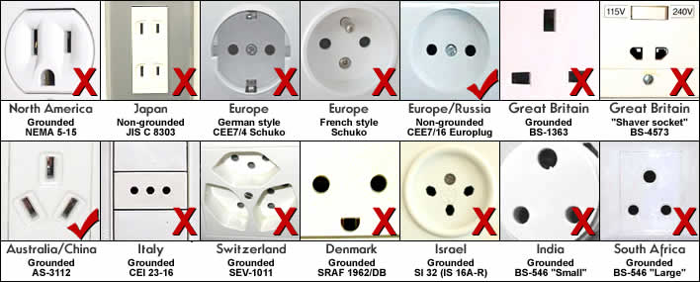
The rational for Standards
Notes:
The overall agenda is outlined below:
Introduction – why is standards important?
A few slides on the rational for standards, in general and in the IT domain specifically
What’s going on in the standards community in terms of standardizations efforts related to Cloud Computing?
ISO JTC1 / SC38 / SGCC
Other SDO’s
Current state of the SGCC
Example of initiatives in different countries
Prioritized domains (according to Swedens’s view)
Moving forward – joining forces and using scenarios and Use Cases together with an agile methodology to achieve results
Ad-hoc vs. formalized standardization
Pitfalls and potential show stoppers
Using standards to increase Cloud Computing adoption

Slide 8
The rational for Cloud Computing Standards
JANUARY 08, 2010
Cerf urges standards for cloud computing Management of cloud assets requires protocols, standards, and research, Internet protocol designer says
Vint Cerf, a co-designer of the Internet's TCP/IP protocols and considered a father of the Internet itself, emphasized the need for data portability standards for cloud computing during an appearance on Thursday evening.
There are different clouds from companies such as Microsoft, Amazon, IBM and Google, but a lack of interoperability between them, Cerf explained at a session of the Churchill Club business and technology organization in Menlo Park, Calif. – Infoworld, 2010
“As Cloud Computing Grows, Where Are The Standards?”
“Has the lack of standards hampered cloud computing adoption and development?”
“Cloud computing standards: the great debate”
“Can IEEE Help With Lack of Cloud Computing Standards?”
Notes:
Cloud Computing is not A thing. It’s a complex aggregate of many DIFFERENT elements. Cloud Computing covers many different domains. Each domain is subject to standardization and many domains already have mature and well accepted / adopted standards. But we need to related and expose those to Cloud Computing. And we need to understand where standards do NOT exist or are not fully developed or adopted. This work is currently underway.

Slide 9
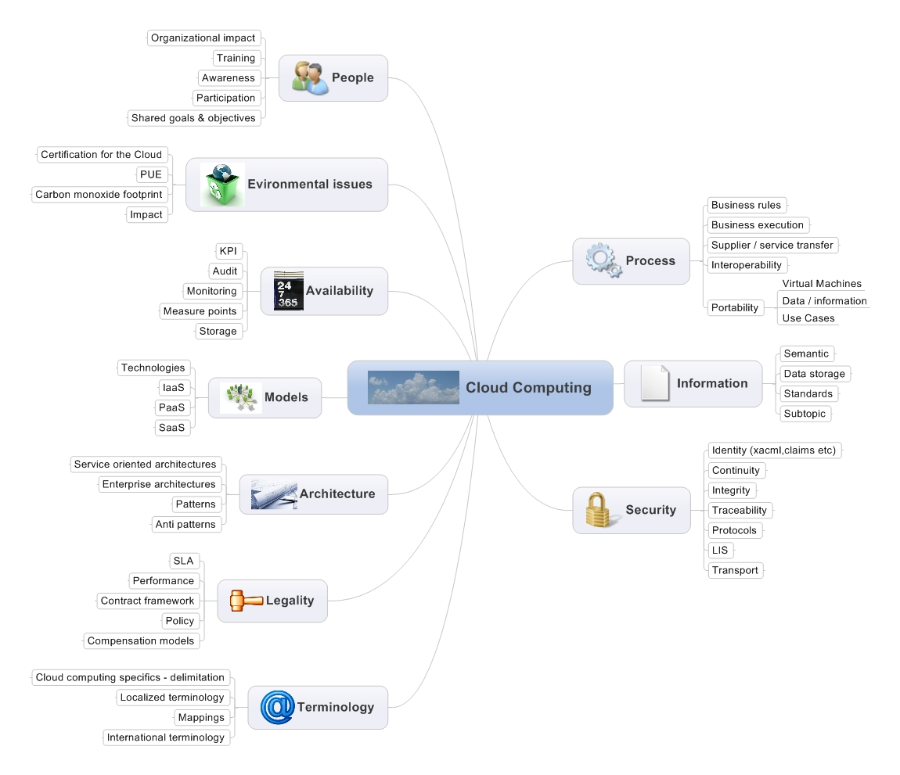
The rational for Cloud Computing Standards (cont’d)
Notes:
Cloud Computing on one hand represents an evolution. The internet infrastructure, XML, SOAP and SOA paved the way for Cloud Computing. And are, obviously, still important elements of Cloud Computing. But Cloud Computing (CC here after) must be treated as a new kid on the block nevertheless. Many aspects of CC are in fact revolutionary. New business models are transforming the industry. We need new ways of thinking about IT. We need new legal frameworks. Public procurement will be affected as IT resources are available to any agency through a simple IP connection. We need to understand what elements together form and constitute CC. And we need to standardize the usage and availability of most, if not all, elements. The areas depicted are exemplatory. It doesn’t follow NIST defintions of CC, but that’s not the point with the graphical representation. It just goes to illustrate the complexity of CC.

Slide 10






Developing Standards – Work in progress…
Notes:
Luckily enough – things ARE happeningen in the standardization space. Many standardization development organizations (SDO’s) are working standards in many of the CC domain that exist. The ones listed are just some of the global (and national) organizations currently working on development of standards. The work is partly coordinated and liaison has been setup. Many SDO convened in Boulder, CO in May to discuss how the mutual efforts can be further coordinated.

Slide 11





Moving Forward – the Standards Development Blueprint
Actors –
e g Producers
Areas (Domains)
Scenarios & UC
Capabilities &
requirements
Actors – e g Consumers
Template
Scenarios
Scenarios
Capability
Scenarios
Capability
Gap Identification
Use Cases
Interface Requirements
Use Cases
Use Cases
Coverage
Testing
Template
Candidate
Interface
Candidate
Interface
Candidate
Interface
Objectives & Goals
Process (methodology, division of work, tasks, objectives, verification etc.)
Notes:
Legend:
Actors (i.e.: stakeholder, scenarios – actors, Use Cases):
Categories of actors, e.g. consumers & producers
Areas:
The areas (domains) of Cloud Computing subject to standardization, e.g. ”security”
Goals:
The overall objectives and individual goals for the SGCC work must be made clear and the ongoing work must be verified against the set (and revised) goals on an ongoing basis
Capabilities & requirements:
Scenarios and Use Cases are used to map existing interfaces and to identify gaps. In the process ”candidate interfaces” will be successively listed and verified against interface requirements.
Scenarios (high level Use Cases) and Use Cases (low level; detailed) are used to capture and verify Cloud Computing capabilities and requirements
For a single scenario, many UC’s might exist
Process: in order to move the work forward, we need to apply /establish a process that will support the actual work
An agile and flexible model is suggested, allowing for ongoing verification of the resulted work. Stakeholders should be kept in the loop to secure and govern that the ”right” focus is maintained. An outline of a work model has been outlined by the Swedish NB (ref N180).

Slide 12
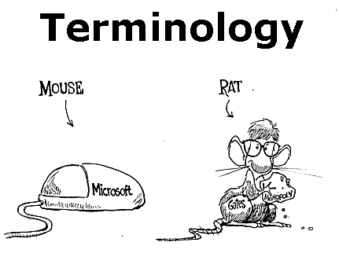
The Starting Point
Notes:
<With apologizies for the politically incorrect carton that I stumbled on when goo…. Sorry, binging for illustrations>
One of the most important areas to work on is terminology. Many potential users find it confusing and distracting that many vendors use different definitions in CC space or even come up with their own monikers for well-established definitions. In Sweden, the NB will start working on standardizing terminology based on the NIST definition. The objective is to provide a national (and localized) standard by 2012.

Slide 13
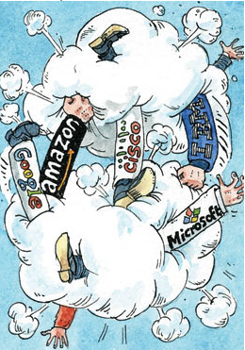
Threats & Pitfalls
De Facto vs. Formal
The race against the clock…
Adoption
Commercial interests….
Uncoordinated standardization efforts
Compliance
The Economist – the 2nd of April 2009
Notes:
The way to mitigate the risks of Standards development failure is mainly about establishing a good information & syncronization mechanism between the various SDO’s who are currently working on development of CC standards. This is already underway – liaisons have been established, but they need to be further refined and optimized. Why some CC players so far to not engage in the global standardization work remains unclear, but raises some concerns in terms of whether the formal standards coming out of ISO (and other SDO’s) will arrive in time to stop the de facto / ad hoc standards to become the actual standards used in the CC space.

Slide 14

Showstopper?
EU plans US company cloud ban
Rumour US makes our data protection laws a joke
08 Jul 2011 10:35 | by Nick Farrell in Rome | posted in Business
The dark satanic rumour mill is suggesting that the EU will ban cloud based services which are run by US companies.
Our sources say that European commissions are incandescent with rage after discovering that the US intends to apply its Partriot Act to all cloud based services in Europe. Microsoft has already said that it will have to comply.
But it appears to have caught the EU on the hop. Sophie in 't Veld, Dutch member of the European Parliament's civil liberties committee, wants to know how it is possible that the Patriot Act overrules the European data protection laws.
She is leading a counter attack, attempting to make sure that European data protection legislation can be adequately enforced, particularly on cloud based systems.
Brussels was stunned to discover that European data protection laws could be nullified by the invoking of the Patriot Act. Effectively, all data stored in Europe was subject to seizure by US spooks.
Read more: http://www.techeye.net/business/eu-plans-us-company-cloud-ban#ixzz1Rq8A3LvX

Slide 15

An European perspective
OECD
“Cloud computing has the potential to revolutionize the ICT sector and the way computing is undertaken”
- Report 3rd of September 2010: DSTI/ICCP(2010)15, OECD
EU
“Cloud computing provides massive opportunities for public authorities as well as SMB:s in the EU”
- EU member delegates, Brussels March 2010
Digital Agenda: Commission seeks views on how best to exploit cloud computing in Europe. Neelie Kroes, European Commission Vice President for the Digital Agenda, said: "I am excited about the potential benefits of cloud computing to cut costs, improve services and open up new business opportunities. We need a well-defined cloud computing strategy to ensure that we make the best use of this potential. The input we are requesting from all interested parties is important to get it right."
Notes:
Slide 13:
Forces are moving in Europe. The EU commission is promoting CC as ”the next big thing” and lists CC on the top of the Digital Agenda for EU.
Further comments – the Digital Agenda / EU directive. ” Cloud computing is already used widely, for example for web-based e-mail services. This trend is growing and cloud services are expected to generate revenues of almost €35 billion in Europe by 2014. Promoting the right conditions for citizens and businesses to best benefit from this technical development is one of the actions foreseen by the Digital Agenda for Europe (see IP/10/581, MEMO/10/199 and MEMO/10/200). The online public consultation will run until the August 31st. Responses will feed into the preparation of a European cloud computing strategy that the Commission will present in 2012.”

Slide 16


Concerns
For suppliers
Adoption
New business models
Betting on the ”right” standard
Knowledge
…
For consumers
Migration
Reliability
Availability
Security
Portability
Lack of standards
Knowledge
…
Notes:
Even though suppliers and consumers share many concerns related to Cloud Computing, there are also specific areas that might be of more concern for either category.
For suppliers
Adoption
New business models
Betting on the ”right” standard
Knowledge
…
For consumers
Migration
Reliability
Availability
Security
Portability
Lack of standards
Knowledge
…

Slide 17
Showstopper?
EU plans US company cloud ban
Rumour US makes our data protection laws a joke
08 Jul 2011 10:35 | by Nick Farrell in Rome | posted in Business
The dark satanic rumour mill is suggesting that the EU will ban cloud based services which are run by US companies.
Our sources say that European commissions are incandescent with rage after discovering that the US intends to apply its Partriot Act to all cloud based services in Europe. Microsoft has already said that it will have to comply.
But it appears to have caught the EU on the hop. Sophie in 't Veld, Dutch member of the European Parliament's civil liberties committee, wants to know how it is possible that the Patriot Act overrules the European data protection laws.
She is leading a counter attack, attempting to make sure that European data protection legislation can be adequately enforced, particularly on cloud based systems.
Brussels was stunned to discover that European data protection laws could be nullified by the invoking of the Patriot Act. Effectively, all data stored in Europe was subject to seizure by US spooks.
Read more: http://www.techeye.net/business/eu-plans-us-company-cloud-ban#ixzz1Rq8A3LvX

Slide 18
Building Trust in the Cloud

Slide 19
NIST (The National Institute of Standards and Technology)
Despite concerns about security and privacy, the NIST concludes that:
"public cloud computing is a compelling computing paradigm that agencies need to incorporate as part of their information technology solution set."
Notes:
The good news for NIST is …. And when they refer to Agencies they mean Government Agencies. So if it is good for Government then it should be good for business.
But that does not mean just signing up and away you go.

Slide 20

The Challenge
Notes:
The Challenge is how business get their heads around the ‘Cloud Computing’.
Business on both sides of the table – IT Companies and their Customers.
The reason for this is Cloud Computing is not very distinct, nice one for the salesman, not so good for the customer.

Slide 21

Notes:
“Cloud computing” is a consequence of economic and technological conditions.
We are witnessing a seismic shift in information technology — the kind that comes around every decade or so. It is so massive that it affects not only business models, but the underlying architecture of how we develop, deploy, run and deliver applications.
Economic and technological that have combined to cause a disruptive change in I.T. towards a service based economy.
And every wants a piece of the pie!

Slide 22
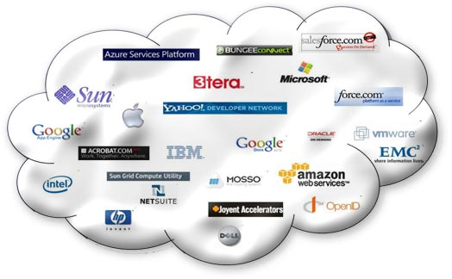
Cloud All in!
Notes:
The outlook is distinctly cloudy!

Slide 23
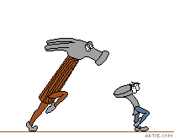
Temptation / Ignorance
Notes:
Security looks like low hanging fruit and for the uninitiated it can present itself as a cudgel to get customers to submit!

Slide 24

Ignorance
Notes:
A fundamental requirement in the cloud environment is that providers must offer visibility into their processes. With an internal IT infrastructure, the enterprise can see what is happening and knows what its risks are. With a cloud provider, the customer cannot know what lies behind the service unless the provider tells them.

Slide 25
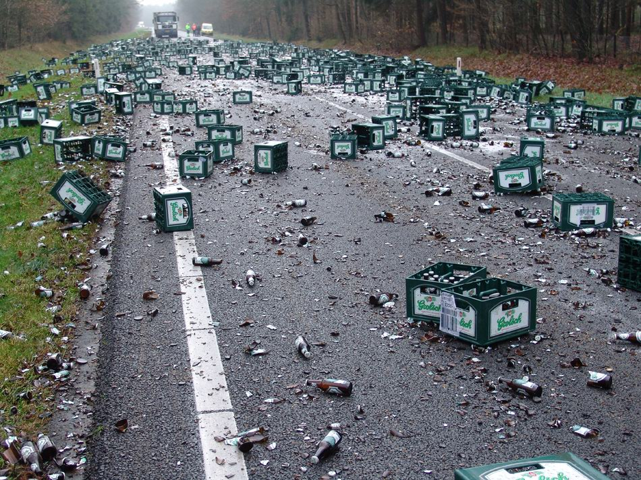

Slide 26
Trust is King
Honesty
Confidence
Trust
Notes:
You will only realise the true value of Cloud if you can engage the ‘Service Tail’. To do so you have to achieve the holy grail of DEEP trust.
Trust not just in technical competency but in an understanding of your customers business and objectives.
Sometimes the truth can hurt but honesty is the key to the door. An open and frank engagement forms a sound platform for successful delivery, and there is nothing like success to foster trust.

Slide 27
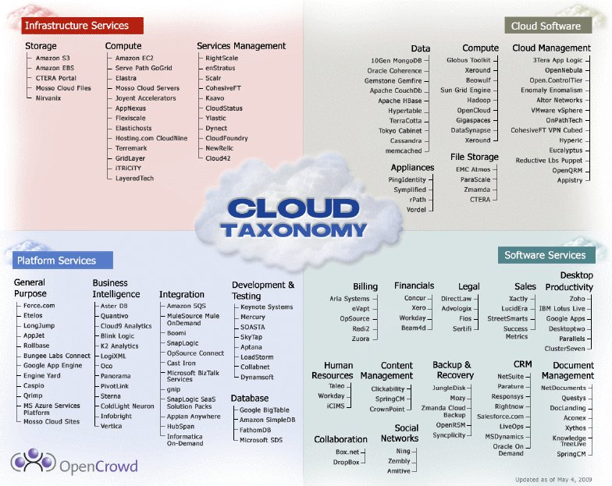
Notes:
Vendors are already staking their claims on Cloud territory, but what right do they have to profess and promote an excellence in such a fast evolving and far from mature IT ladscape?

Slide 28
The need for a ‘Trustmark’ Executive Summary
By creating a Trustmark’ for Cloud Service Providers across the community we will drive higher business standards through Certification by way of validation of service offerings.
Setting a higher mark by a Standard, and helping Service Providers improve transparency and security of supply to customers.
In harmony, supporting the development of new EU Data and Privacy regulation, the application of an ICT grass roots driven open community project fostering best practice and quality of service provision.
Utilise existing ICT association networks as participants which will help slipstream adoption, aware of the need for this type of standard in the market.
Lead by the IAMCP one of the largest ICT association with both an EU and International governance structure to support such an initiative.
Notes:
The value of Trustmark is that it provides a framework and a common language for understanding what a provider has to offer, so that the customer can make a more informed judgement about the suitability of the proposition for their needs. When coupled with a third-party auditing process, this offers additional comfort that the provider meets a recognised standard.

Slide 29
IAMCP Vision & Mission - PACE
Vision
IAMCP the global business community for the Microsoft Channel
Mission
To maximize the business potential of its members through:
Peer to Peer Networking | Rhythm of events occurring globally
Advocacy | To legislatures, the media, to Microsoft and Microsoft Partners (liaison with VFI)
Community Outreach | On the lines of Social Entrepreneurship
Education and Growth | Provide Programs & experiences to grow Partner business capability & capacity

Slide 30

Eurocloud
To create awareness of Cloud Computing throughout the society
To take an active role in the design of cloud industry processes and standards
To build a pan-European contact and knowledge sharing network
To build a strong relationship within the EU
To position the interests of the cloud industry within existing information technology associations
Notes:
SNIA (Storage Networking Industry Association), BSA (Business Software Alliance) or SIIA (Software and Information Industry Association) etc

Slide 31

Value Cycle
Sustainable Benefits Investment:
Quality Standard Credibility
Independent Governance
Cross Community Support
Industry Alignment & Recognition
Auditable
Mitigate Customer Risk
Increase Security
Increase Data
& Privacy Protection
Implement
Set accredited organisations aside with true Quality Standard Audit and Independence Trustmark.
Accreditation
Certification
QUALITY
Review/Maintain
Through a common & repeatable approach a sustainable initiative to add value and visibility of IT fulfilment partners for a new generation of Cloud Centric customers.
Business Value Proposition:
Service Provider Accreditation
Customer Security
Global IT industry leadership
Fulfillment of EU 2020 objectives
Alignment with EU Digital Agenda
Notes:
A number of separate initiatives are under way to create standards, best practice guidelines and certifications for various aspects of cloud computing and SaaS, while data centres already have to conform to established audit standards such as SAS-70 and ISO 27001. With no industry-wide co-ordination, there is a danger of prospective cloud buyers being confused by the advent of too many separate initiatives and competing or overlapping standards.

Slide 32
Benefaction Summary
Commercial / Public Sector Organisations
ICT Companies
EU Community Leadeship
Market & Customers
Alignment with market expectations & demands for Independent Demonstrable Qualilty Standard adherance.
Client / Tender qualification criteria, providing a basis for professional Indemnity insurance and assurance.
Increase confidence to engage participating vendor solutions, Licence Commitment and Partner Engagment.
Delivering to Europe 2020 Strategy objectives
Notes:
To be able to evaluate cloud providers, customers need to know what to ask for. As a baseline, a recognised industry certification can offer a commonly agreed checklist of questions.
At the moment, customers are devising their own questionnaires to send to providers. This creates an unnecessary duplication of effort both for customers in drawing up the questionnaires and then for providers understanding how to answer each one. Some form of standardisation on a common list of questions or an accepted external audit/certification will help reduce this extra cost on both sides.
A certification checklist that’s agreed by the industry will help providers to help themselves. It will ensure they can identify any gaps in their infrastructure or processes and fix them ready for certification. Reputable participants in the industry will benefit from measurements that help identify those who don’t play by the rules.

Slide 33

Getting the Balance Right
Certification and audit processes should not become so burdensome or inflexible that they block innovation and competition
Certification must be designed to work across the spectrum, from the smallest provider up to the very largest
Eurocloud
Notes:
Note of caution. Certification and audit processes should not become so burdensome or inflexible that they block innovation and competition, especially on the part of smaller players and new market entrants. Certification must be designed to work across the spectrum, from the smallest provider up to the very largest.

Slide 34
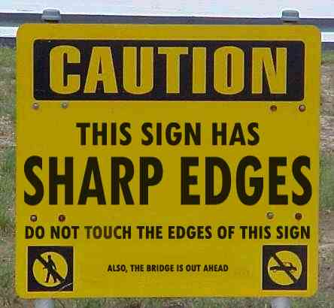
Beware Regulation (Health & Safety Executive)
Notes:
Better to self-regulate than get regulated.
EU discussion document on standards that get embodied in directive/regulation/legislation will automatically see Patent holders forfeit their rights where they cross over.

Slide 35
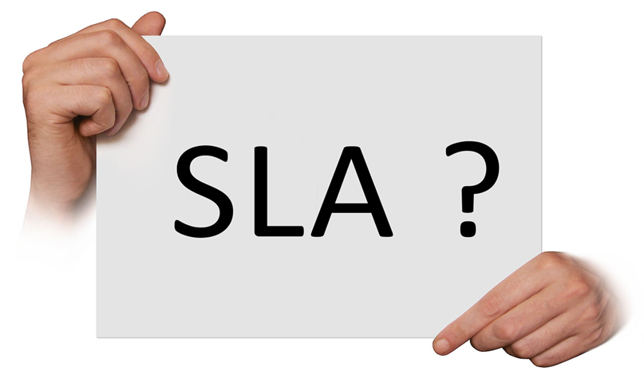
SLA’s Service Level Agreements
Driving much of the containment
Notes:
Most SLA’s are not worth the paper they are printed on and certainly no replacement for a Trustmark/certification or standardisation of service delivery.
Teeth are the only things worth focusing on with SLA’s = Simple Money back guarantee’s.

Slide 36

Notes:
It’s a cavalry charge, all sizes and shapes of businesses (service providers and customers alike) jostling for advantage.

Slide 37
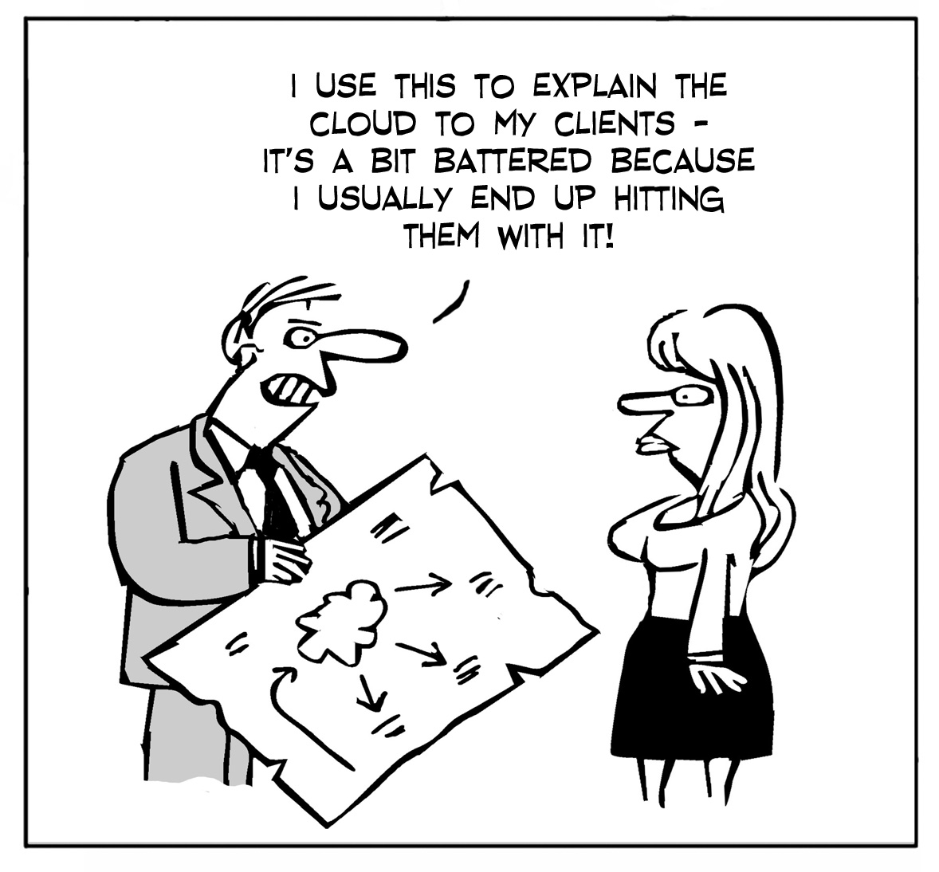
New Standards Required in Sales!

Slide 38
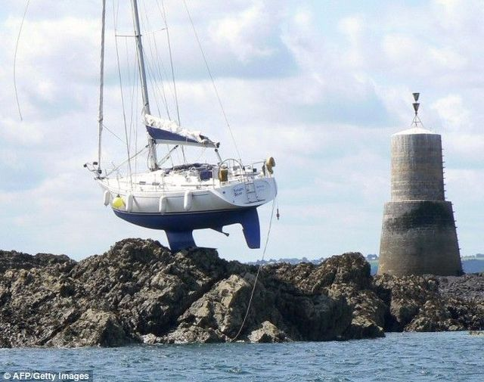
Notes:
It is invitable that both customer snad service providers will end up high and dry as we go through the birthing of some recognisable standardisation and visibility within the marketplace.

Slide 39

Partner is the key = IAMCP (International Association of Microsoft Channel Partners)
Notes:
Partnering is key and that is where the IAMCP is your friend and a trusted networking resource, your safety net of professional organisations that can be drawn on as an extension of your own team.
IAMCP cuts through the dross and gives you a support network to develop your business into the cloud and build the all valuable service tail revenue.

Slide 40
IAMCP Vision & Mission - PACE
Vision
IAMCP the global business community for the Microsoft Channel
Mission
To maximize the business potential of its members through:
Peer to Peer Networking | Rhythm of events occurring globally
Advocacy | To legislatures, the media, to Microsoft and Microsoft Partners (liaison with VFI)
Community Outreach | On the lines of Social Entrepreneurship
Education and Growth | Provide Programs & experiences to grow Partner business capability & capacity

Slide 41
ENISA (European Network & Information Security Agency)
Cloud Computing Security Risk Assessment
http://www.enisa.europa.eu/act/rm/files/deliverables/cloud-computing-risk-assessment

Slide 42
CSA (Cloud Security Alliance )
Security Guidance in Cloud Computing
https://cloudsecurityalliance.org/research/projects/security-guidance-for-critical-areas-of-focus-in-cloud-computing/

Slide 43
Eurocloud (Cloud Security Alliance )
EuroCloud Guidelines Cloud Computing
(German Law, Data Protection and Compliance)
http://en.eurocloud.de/2011/03/04/eurocloud-guidelines-cloud-computing-german-law-data-protection-and-compliance/
Please request the guide as PDF by sending a mail to
guide-law@eurocloud.de

Slide 44
Thank You !

Slide 45
Partner Calls to Action Key Actions, Resources and WPC Related Sessions/Activities
Evaluate this session
complete the evaluation form <here>
Do
Placeholder
most partners grant you 1 action, focus your ask
Placeholder
invite partners to your other breakout sessions, panels and interactive sessions
Attend
Placeholder
invite partners to your other activities: Expo, executive meetings, group meetings, parties and other
Placeholder
share your latest content: links, documents, other digital
Learn
Placeholder
ask partners to participate online: forums, social (Facebook, Twitter)

Slide 46


Your Feedback is Very Important to Us
Submit your Session Evaluation for a chance to Win! www.digitalwpc.com/contest
Complete a WPC evaluation and you’re automatically entered to win the daily drawing for a luxury vacation AND a chance to win instant prizes!
Learn more in the Microsoft Partner Network Booth
Grand Prize Luxury Vacation for 2

Slide 47
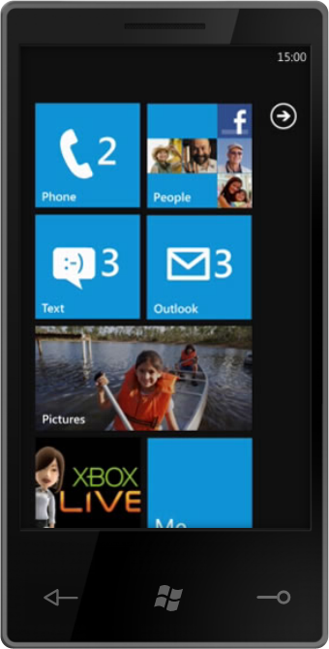

Your Feedback is Very Important to Us
Submit your Session Evaluation for a chance to Win! www.digitalwpc.com/contest
Luxury Vacation for 2
Complete a WPC evaluation and you’re automatically entered to win the daily drawing for a luxury vacation AND a chance to win instant prizes!
Learn more in the Microsoft Partner Network Booth
Windows 7 Phone
Online Giftcards

Slide 48

© 2011 Microsoft Corporation. All rights reserved. Microsoft, Windows, Windows Vista and other product names are or may be registered trademarks and/or trademarks in the U.S. and/or other countries.
The information herein is for informational purposes only and represents the current view of Microsoft Corporation as of the date of this presentation. Because Microsoft must respond to changing market conditions, it should not be interpreted to be a commitment on the part of Microsoft, and Microsoft cannot guarantee the accuracy of any information provided after the date of this presentation. MICROSOFT MAKES NO WARRANTIES, EXPRESS, IMPLIED OR STATUTORY, AS TO THE INFORMATION IN THIS PRESENTATION.

