Slide 2

Selling to the Strengths of Security & Compliance with Office 365 & the Cloud
BL13
Ro Kolakowski
Company Partner
6th Street Consulting
MPN partner since 2006
SharePoint
Nigel Gibbons
Executive Chairman
UniTech _{tm}
Lisa Slim
Microsoft Alliance Business Manager
Hewlett-Packard
MPN partner since 1989
HP Enterprise Business

Slide 3

Notes:
NRG Business Details

Slide 4
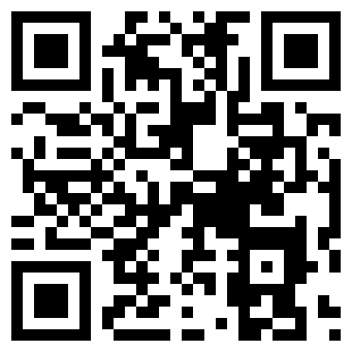
Notes:
NRG URL http://www.nigelgibbons.net

Slide 5



Nigel Gibbons
Executive Chairman – UniTech _{tm}
Chartered IT Professional (CITP)
Microsoft Buisness Value Planning (MBVP)
Certified Information Systems Auditor (CISA)
Certified Information Systems Security Professional(CISSP)
Microsoft Certified Inromation Technology Professional (MCITP)
Strategic Business Planning & Audit.
IAMCP UK & International Board Member
Microsoft Partner Advisory Council
Microsoft Executive Partner Board
Cloud Security Alliance - UK & Ireland
Insititute of Information Security Professionals (IISP)
Information Security Audit & Control Association (ISACA)
International Information Systems Security Certification Consortium or (ISC)2
EuroCloud
Voices for Innovation
http://nigelgibbons.net
#NRG_fx
Notes:
Its not about me its about the shared insights I believe I continuously experience from my engagements across the security industry, and especially the SME sector which is the predominant space that Microsoft Partners occupy.
I am here by the grace of IAMCP and whilst I may reference experiences these are from the broader church of IAMCP members and not exclusively my own.

Slide 6


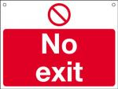
NRG ‘PB’ Curve
(Presentation Benefits)
Benefit
Number of slide
Notes:
My job today is to keep you in the Green Zone.

Slide 7
Overview
Cloud Security
Customers
Microsoft & Office 365 / Azure
Frameworks
Engagement Framework & References
Real World application
Security in Context
Notes:
Why do we need to put this in context? After all its ‘Cloud’ isn’t it, and we all know that the economies of scale allow cloud providers to lavish more £££ per MD of data on security pro-rata that of any private or even Government organisation? Don’t we?
Well yes… BUT!

Slide 8
Customer is King
To keep you head, listen to what the king says!
Excited
  Opportunities to reduce Capital costs
  Chance to divest themselves of infrastructure management
  Focus on core competencies
  Agility offered from on-demand provisioning
  More readily align IT with Business Strategy
…….. BUT

Slide 9
Customer is King
To keep you head, listen to what the king says!
BUT …….
Nervous
  About the risks
  Loss of ‘direct’ control of systems
  Systems for which they are accountable
……. Security
Notes:
Customers are both excited and nervous at the prospects of Cloud Computing. They are excited by the opportunities to reduce capital costs. They are excited for a chance to divest themselves of infrastructure management, and focus on core competencies. Most of all, they are excited by the agility offered by the on-demand provisioning of computing and the ability to align information technology with business strategies and needs more readily. However, customers are also very concerned about the risks of Cloud Computing if not properly secured, and the loss of direct control over systems for which they are nonetheless accountable.

Slide 10
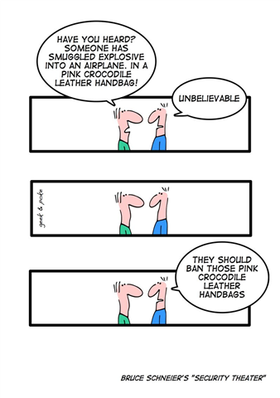
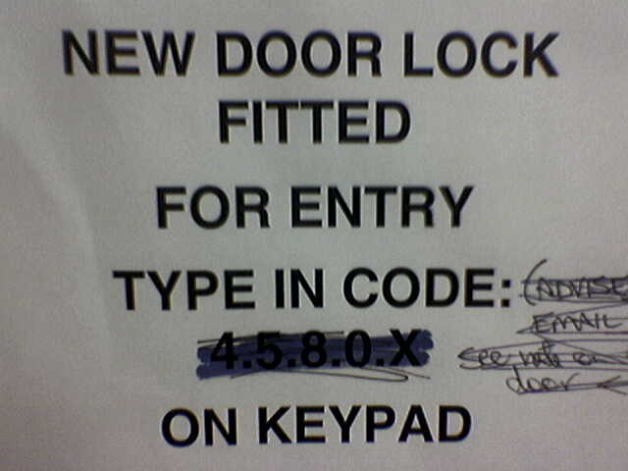
Different Things to Different People
(submitted by Antii Roppola)

Slide 11
Security
Risk
Trust
Security
Notes:
But what do we mean by Security?
It is often that iron bound door that is slammed in your face by a client who is in effect saying, don’t go there, I have used the S word and that is the end of the discussion.
Time for a little push back. Security is something that is very indistinct, it means different things to different people. For a business not to get hamstrung by a security paranoia culture it needs to be rationalised in terms of business impacts, values attributed and practical decisions based on those outcomes made to reflect and support the business strategy.

Slide 12
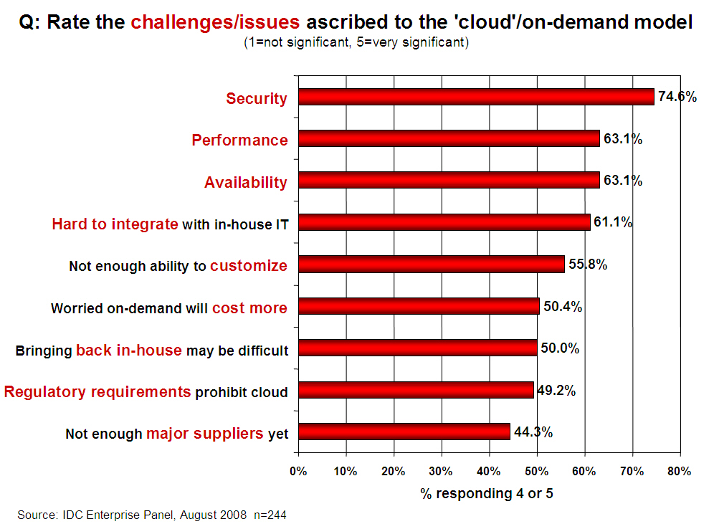
Notes:
OK so we understand the Security context but how is this reflected in the market?
FACT – Security IS the principle up front and central issue on customers minds.
All the other issues are largely diffused once the Security issue has been addressed.

Slide 13
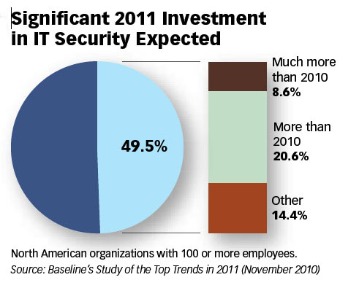

Slide 14
Threat #1
Abuse and Nefarious Use of Cloud Computing
Criminal leverage of cloud resources
Cloud providers Targeted
IaaS offerings have hosted:
  Zeus botnet,
  InfoStealer trojan horses
  botnets command & control
Impact = IaaS blacklisting

Slide 15
Threat #2
Insecure Interfaces and APIs
Exposed software interfaces or APIs
Security and availability of services dependent upon the security of these.
Exposures:
  unknown service or API dependencies.
  clear-text authentication
  Data unencrypted to process

Slide 16
Threat #3
Malicious Insiders
Level of access means impact considerable
Lack of hiring standards
Legislative friction
Impact:
  Brand damage,
  Financial loss
  Productivity downtime

Slide 17
Threat #4
Shared Technology Issues
Multi-tenant architecture challenge hardware technologies & hypervisors
Inappropriate levels of control or influence on the underlying platform
Examples:
  Joanna Rutkowska’s Red and Blue Pill exploits
  Kortchinksy’s CloudBurst presentations

Slide 18
Threat #5
Data Loss or Leakage
Deletion or alteration of records without a backup
Loss of an encoding key
Jurisdiction and political issues
Impact:
  Loss of core intellectual property
  Compliance violations

Slide 19
Threat #6
Account or Service Hijacking
Reuse of Credentials and passwords
Eavesdrop on activities and transactions:
  manipulate data,
  return falsified information,
  Redirect clients to illegitimate sites
Notes:
Prohibit the sharing of account credentials between users and services.
• Leverage strong two-factor authentication techniques where possible.
• Employ proactive monitoring to detect unauthorized activity.
• Understand cloud provider security policies and SLAs.
References
• http://www.infoworld.com/d/cloud-computing/hackers-findhome-in-amazons-ec2-cloud-742
• http://vmetc.com/2009/03/12/virtual-machine-sniffer-on-esxhosts/

Slide 20
Threat #7
Unknown Risk Profile
When adopting a cloud service, features and functionality may be well advertised,
What about:
  details of internal security procedures,
  configuration hardening,
  patching, auditing, and logging
  Compliance?
Notes:
IRS asked Amazon EC2 to perform a C&A; Amazon refused. http://news.qualys.com/newsblog/forrester-cloud-computingqa.html
• Heartland Data Breach: Heartland’s payment processing systems were using known-vulnerable software and actually infected, but Heartland was “willing to do only the bare minimum and comply with state laws instead of taking the extra effort to notify every single customer, regardless of law, about whether their data has been stolen.”
http://www.pcworld.com/article/158038/heartland_has_no_heart_for_violated_customers.html

Slide 21
References
CSA (Cloud Security Alliance) – Top Threats
Gartner report -‘Assessing the Security Risks of Cloud Computing’
Notes:
Gartner – ‘Assessing the Security Risks of Cloud Computing’ report.
Here are seven of the specific security issues Gartner says customers should raise with vendors before selecting a cloud vendor.
1. Privileged user access. Sensitive data processed outside the enterprise brings with it an inherent level of risk, because outsourced services bypass the "physical, logical and personnel controls" IT shops exert over in-house programs. Get as much information as you can about the people who manage your data. "Ask providers to supply specific information on the hiring and oversight of privileged administrators, and the controls over their access," Gartner says.
2. Regulatory compliance. Customers are ultimately responsible for the security and integrity of their own data, even when it is held by a service provider. Traditional service providers are subjected to external audits and security certifications. Cloud computing providers who refuse to undergo this scrutiny are "signalling that customers can only use them for the most trivial functions," according to Gartner.
3. Data location. When you use the cloud, you probably won't know exactly where your data is hosted. In fact, you might not even know what country it will be stored in. Ask providers if they will commit to storing and processing data in specific jurisdictions, and whether they will make a contractual commitment to obey local privacy requirements on behalf of their customers, Gartner advises.
4. Data segregation. Data in the cloud is typically in a shared environment alongside data from other customers. Encryption is effective but isn't a cure-all. "Find out what is done to segregate data at rest," Gartner advises. The cloud provider should provide evidence that encryption schemes were designed and tested by experienced specialists. "Encryption accidents can make data totally unusable, and even normal encryption can complicate availability," Gartner says.
5. Recovery. Even if you don't know where your data is, a cloud provider should tell you what will happen to your data and service in case of a disaster. "Any offering that does not replicate the data and application infrastructure across multiple sites is vulnerable to a total failure," Gartner says. Ask your provider if it has "the ability to do a complete restoration, and how long it will take."
6. Investigative support. Investigating inappropriate or illegal activity may be impossible in cloud computing, Gartner warns. "Cloud services are especially difficult to investigate, because logging and data for multiple customers may be co-located and may also be spread across an ever-changing set of hosts and data centers. If you cannot get a contractual commitment to support specific forms of investigation, along with evidence that the vendor has already successfully supported such activities, then your only safe assumption is that investigation and discovery requests will be impossible."
7. Long-term viability. Ideally, your cloud computing provider will never go broke or get acquired and swallowed up by a larger company. But you must be sure your data will remain available even after such an event. "Ask potential providers how you would get your data back and if it would be in a format that you could import into a replacement application," Gartner says.

Slide 22
The Mobile Effect
Cloud is a form of mobile computing
But then there is Mobile as well…
24x7x365 from anywhere, anytime, anyways
90% internal
80% external
Notes:
When once 90% of data was contained and shared within a secure corporate LAN environment it is now inverted to over 80% external shared and often hosted as well. Furthermore the added dimension of partner and customer access portals increases the management nightmare.

Slide 23


Notes:
The message first and for most is clear.

Slide 24

Notes:
“Cloud computing” is a consequence of economic and technological conditions.
We are witnessing a seismic shift in information technology — the kind that comes around every decade or so. It is so massive that it affects not only business models, but the underlying architecture of how we develop, deploy, run and deliver applications.
Economic and technological that have combined to cause a disruptive change in I.T. towards a service based economy.
And every wants a piece of the pie!

Slide 25
NIST
(The National Institute of Standards and Technology)
Despite concerns about security and privacy, the NIST concludes that:
"public cloud computing is a compelling computing paradigm that agencies need to incorporate as part of their information technology solution set."
Notes:
The good news for NIST is …. And when they refer to Agencies they mean Government Agencies. So if it is good for Government then it should be good for business.
But that does not mean just signing up and away you go.

Slide 26
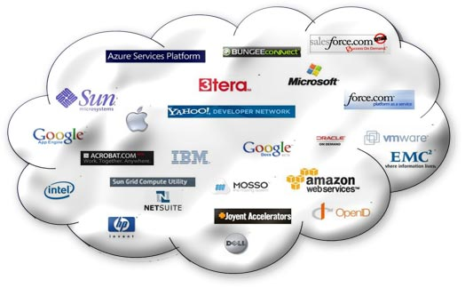
Cloud All in!
Notes:
The outlook is distinctly cloudy!

Slide 27
Microsoft
The case for a Cloud Business
Technology Roadmap
Technical Certification
Notes:
Microsoft has done a good job of selling the business case to partners, providing a technology roadmap and technical certification.
BUT they have not done the best job in guiding partners through the minefield that is the pre-sales and post sales critical factors that are appearing in the real world.

Slide 28

Security & Reliability
Financially-backed, guaranteed 99.9% uptime Service Level Agreement (SLA)
Always-up-to-date antivirus and anti-spam solutions to protect email
Safeguarded data with geo-redundant, enterprise-grade reliability and disaster recovery with multiple datacentres and automatic failovers
Best-of-breed data centres with SAS 70 and ISO 27001 certification
Notes:
Don’t get me wrong Microsoft are doing a fantastic job and with 365 coming up the pipe in a month’s time the game is going to change again.
If you have not taken a look at 365 then you must. It will impact your business whether your an ISV, SI, infrastructure or Dynamics.
Which is why the next few slides are CLITICAL for you to understand. These are built on experience and real market lessons you will not get elsewhere.

Slide 29
Monetising the Cloud
Little margin in subscription annuity
Money is in the service tail, but how?
Notes:
If you have not established a core trust

Slide 30
Trust is King
Honesty
Confidence
Trust
Notes:
You will only realise the true value of Cloud if you can engage the ‘Service Tail’. To do so you have to achieve the holy grail of DEEP trust.
Trust not just in technical competency but in an understanding of your customers business and objectives.
Sometimes the truth can hurt but honesty is the key to the door. An open and frank engagement forms a sound platform for successful delivery, and there is nothing like success to foster trust.

Slide 31

Ignorance
Notes:
Danger with security is we all experience it and think we know how to deal with it.
Well that may be true in our own competencies but security is hard to take in isolation. You tighten one are and it is compromised by the backdoor weaknesses of another.

Slide 32

Temptation / Ignorance
Notes:
Security looks like low hanging fruit and for the uninitiated it can present itself as a cudgel to get customers to submit!

Slide 33
Certifications
Services
(Office 365 and FOPE)
ISO 27001
Data Centers
ISO 27001
SAS 70 Type II
Microsoft
Safe Harbor
More to come …
Notes:
ISO certs:
BPOS-S: IS 552878
FOPE: IS 560057
Safe Harbor: # 9838 http://www.export.gov/safehrbr/companyinfo.aspx?id=9838

Slide 34

Multi-Layered Defense
Strategy: employ a risk-based, multi-dimensional approach to safeguarding services and data
Security Management
Threat & Vulnerability Management, Monitoring & Response
Data
Access Control & Monitoring, File/Data Integrity
User
Account Mgmt, Training & Awareness, Screening
Application
Secure Engineering (SDL), Access Control & Monitoring,
Anti-Malware
Host
Access Control & Monitoring, Anti-Malware, Patch & Config Mgmt
Internal Network
Dual-factor Auth, Intrusion Detection, Vulnerability scanning
Network perimeter
Edge Routers, Firewalls, Intrusion Detection, Vulnerability scanning
Facility
Physical controls, video surveillance, Access Control

Slide 35
Data Encryption at Rest
Data stored non-encrypted
Encryption impacts service functionality (e.g. search)
Technical solutions are challenging, e.g. identity and key management issues
Solution
For “sensitive” data, customers implement Rights Management
For “sensitive” externally sent/received email, customers employ PGP or similar

Slide 36
Enhanced Email Security Features
Require TLS for all mail between customer and partner domain (in and outbound)
Centralized mail control (all mail for domain sent/received from customer servers) - Enables custom filtering and archiving
Outbound mail delivery to a smarthost - Enables additional processing, e.g. DLP
Future: Expanded DLP capabilities in Forefront Online Protection for Exchange (FOPE)

Slide 37
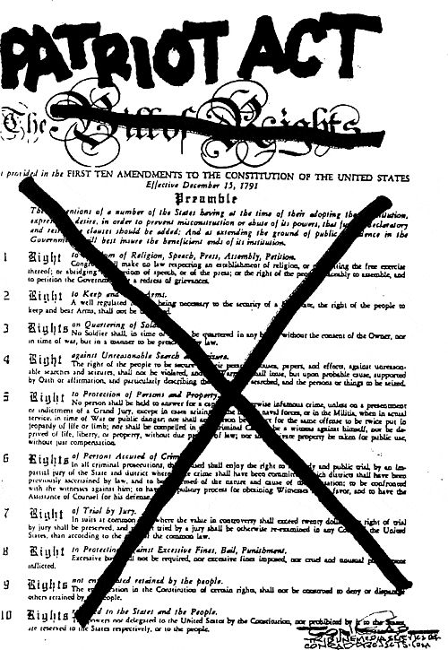
Subpoenas
Will Microsoft turn over my data to law enforcement or gov’t?

Slide 38
Subpoenas
Will Microsoft turn over my data to law enforcement or gov’t?
Microsoft believes customers should control their own information
When compelled by U.S. law enforcement to produce customer records, Microsoft will first attempt to redirect these demands to the customer
Microsoft will notify the customer unless it cannot, either because Microsoft is unable to reach the customer or is legally prohibited from doing so!
Microsoft will only produce the specific records ordered by law enforcement and nothing else

Slide 39
Continuity Concerns
Does Microsoft have a formalized continuity program in place?
Yes, a robust service continuity program is in place based on industry best practices and provides the ability to recover subscribed services in a timely manner
Does each service have the ability to recover from a disastrous event?
Yes, all offerings have redundancy and resiliency to ensure that any major outage is minimized
Is the plan exercised (tested) on a regular basis?
The plan and solution are validated at least on an annual basis

Slide 40
Global Privacy Regulations
Microsoft Online Services has been built focusing on transparency, allowing customers control over their data, and enabling them to adhere to recognized privacy principles
  Example: Many locales require a privacy notice and a recording notice. It's ultimately the responsibility of the customer to comply, but Microsoft built one in as a default so customers are assisted
Microsoft complies with global privacy norms. It abides by the Safe Harbor privacy framework regarding the collection, use, transfer, and retention of data from the European Union, the European Economic Area, and Switzerland
Each of Microsoft Online Services has a privacy statement that details how customers’ data will be treated
Longer term → Working with governments and partners to adapt regulations to their type of services

Slide 41
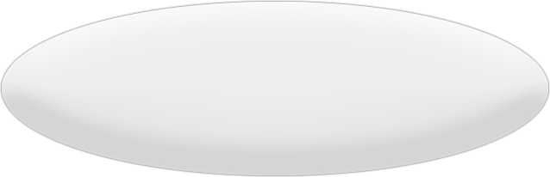
Why Is Privacy Compliance Important?
It’s the law
Helps ensure to Customers that they’ve made the right choice by entrusting their data to Microsoft
It’s the right thing to do

Slide 42
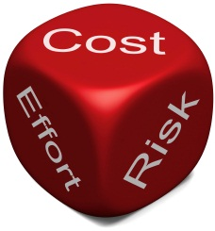
Notes:
There is risk with an uneducated approach.
The Cloud is all about risk mitigation.
How secure is my data, how can I trust the provider etc…
Guidance must be applied within the context of the business mission, risks, rewards, and cloud threat environment — using sound risk management practices and understanding.
But keep it in relative to the size of organisation you are dealing with.

Slide 43
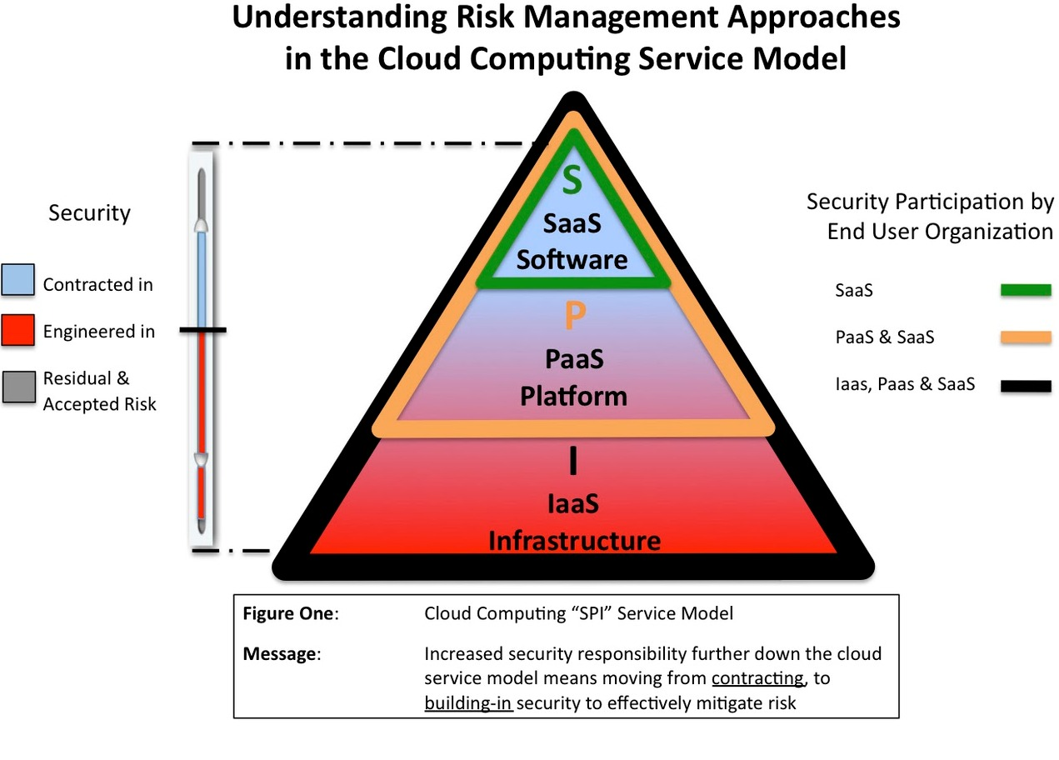
Cloud Stack (SPI Model)
Notes:
Approach to Risk in SPI Model
Each of the 3 service models has a slightly different approach to mitigating risk. These approaches are detailed in the Cloud Security Alliance guidance document available found at www.cloudsecurityalliance.org
The “all inclusive” nature of SaaS means that risk is most effectively controlled by contract terms, and few engineering choices exist because a standardized application, platform and infrastructure is shared across a large base of users.
In the case of PaaS, risk may be mitigated by a combination of contract terms and technical engineering choices and controls. This is because the user is responsible for much of the application environment and some security features can be built in to mitigate risk.
With IaaS, a combination of contract terms and technical engineering choices and controls is still relevant, but there is much more emphasis and choice about technical security infrastructure as the user has control and responsibility for much of the operating environment.
Summary & Conclusions
• For SaaS, the primary risk control mechanism is contract terms, whereas PaaS and IaaS require a combination of technical engineering controls as well as contract terms to effectively manage risk.
• The lower down the SPI model the chosen service exists, the more control and customization available. The trade-off is more responsibility for security and management.
• The nature and types of specialty skill-sets required to assess and manage risk will vary depending on the service model chosen.
• Decisions need to be made about whether security controls can be outsourced to a provider, or maintained under the control of the user organization or an independent third party.
• To meet regulatory and compliance requirements, in every case organizational policies require careful review and consideration must be given to whether the choice of a particular model is valid.
• Irrespective of the appeal that any given technical approach may have, the business implications require alignment with an organizations overall Enterprise Security Risk Management program.
Cloud is not a “one-size-fits-all” proposition, and service model options provide choices, depending on needs. For each service model, there are differently balanced options to mitigating risk; primarily the proportions of contractual and engineering resources, which may require more direct participation in technology risk decisions by the user.

Slide 44
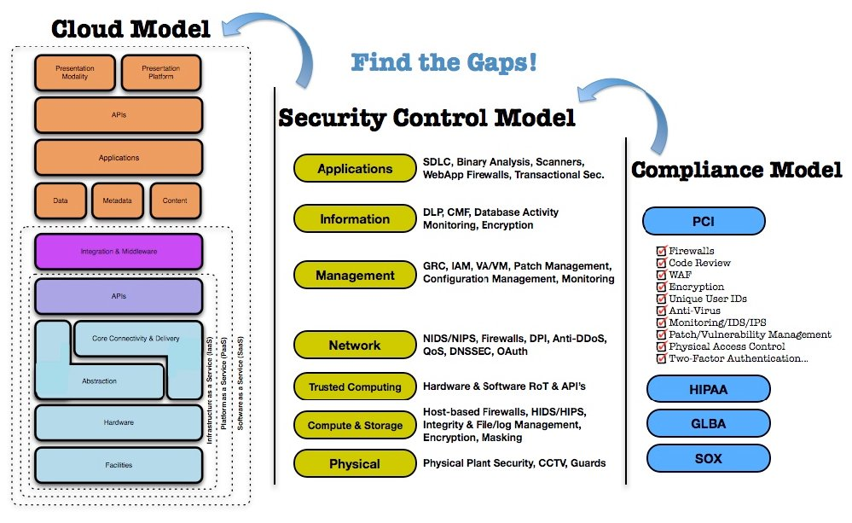
Notes:
Mapping the Cloud Model to the Security Control and compliance Model.
This demonstrates the level of complexity that we can go into for large organisations, but I do not recommend untrained staff trying to undertake this, this is a multi-disciplined activity and as always needs to be kept in context with the size of the organisation you are working with.

Slide 45
Risk Management
Measure
Assess
Evaluate
Manage
Notes:
Selecting appropriate security controls and otherwise deploying scarce security resources optimally require a correct reading of the threat environment.

Slide 46
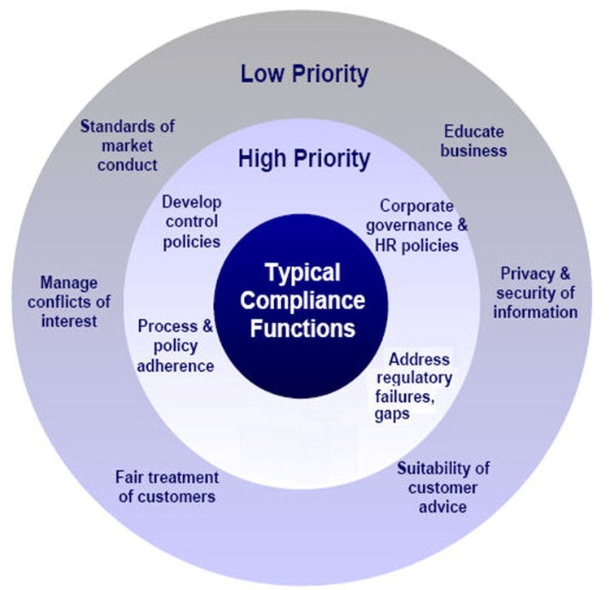
Compliance Landscape

Slide 47
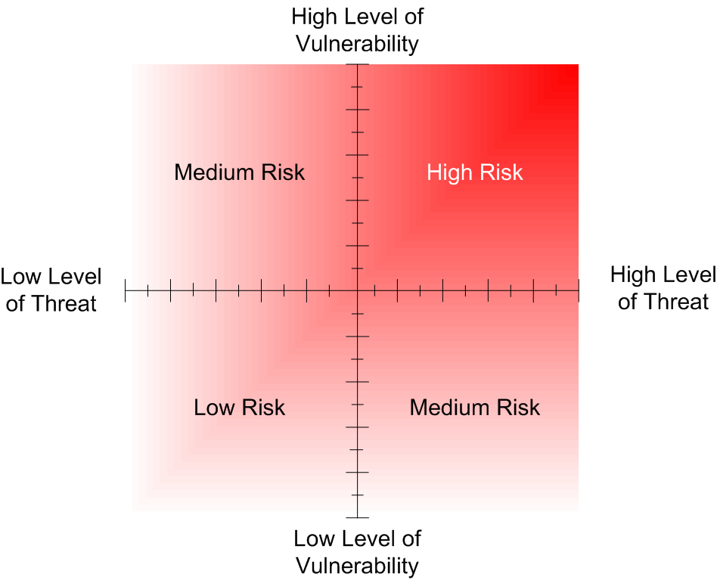
Risk Mitigation
Notes:
Businesses do not understand their risk profiles, or very few do. If they did many would realise the futility of investments they are making.
Over protective measures that are like pouring cement into a corporate process reducing business dynamics.
Unattainable expectations that can better be filled by a specialised service provider.
Focusing on managing and maintaining resources that are not core to the business brand or market offering.
And many more, but you start to get the idea.
http://technet.microsoft.com/en-us/library/cc751212.aspx

Slide 48

Attack Tree
Compromise Customer Data
Value to Business
£50,000
£1m+
Obtain Backup Media
eMail Intercept
Hack Web Server
Hack Firewall
Burglarise Office
Bribe Staff or Service Provider
Hack teleworker Home System
£ 5,000
£ 5,000
£ 10,000
£ 1,000
Hack SMTP service
£ 2,000
£5,000
£10,000
£1,000
£2,000
£7,000
Notes:
Value the risk and balance investment accordingly.
The Sleeper awakes!

Slide 49
Notes:
The message first and for most should be …

Slide 50

Security On Ramp
Microsoft Security Assessment Tool
Gain visibility of service revenue potential
Identify in competency areas
Out of competency = Engage a Pro!
Notes:
If you follow this process you will not go wrong.
Use the tool, and impress the client, its billable and gets everyone onto a baseline for discussion.
Identify what your strengths are and stick to them. Partner to do the rest and enjoy building a trusted network of partner companies that can help you accelerate into future projects with conviction and the confidence of customers (back to the key trust point).

Slide 51
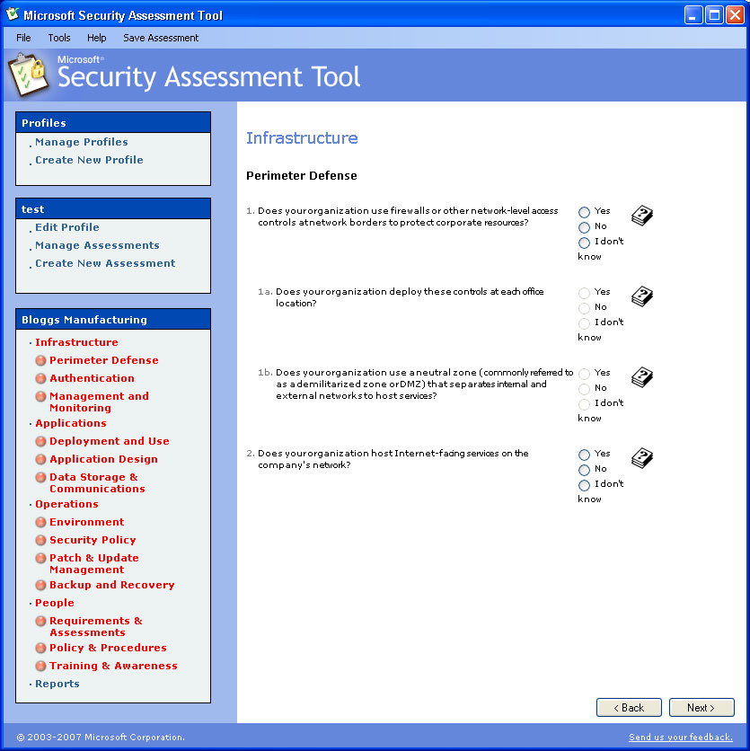
Microsoft Security Assessment Toolkit
http://technet.microsoft.com/en-gb/security/cc185712.aspx
Notes:
The Microsoft Security Assessment Tool is not a cloud specific tool. What it does is provide a valuable base lining exercise for organisations BEFORE they move to the cloud.
When you start talking cloud to clients and the security barriers start going up, it is useful to have a direct comparison with what the organisation is currently operating under. Often Cloud can deliver better than existing security and if not then it provides a clear demarcation line for negotiation with the cloud provider.

Slide 52
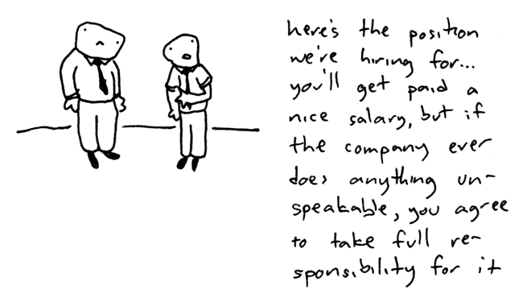
The Alternative!

Slide 53

Partner is the key = IAMCP
(International Association of Microsoft Channel Partners)
Notes:
Partnering is key and that is where the IAMCP is your friend and a trusted networking resource, your safety net of professional organisations that can be drawn on as an extension of your own team.
IAMCP cuts through the dross and gives you a support network to develop your business into the cloud and build the all valuable service tail revenue.

Slide 54
IAMCP
Vision & Mission - PACE
Vision
IAMCP the global business community for the Microsoft Channel
Mission
To maximize the business potential of its members through:
Peer to Peer Networking | Rhythm of events occurring globally
Advocacy | To legislatures, the media, to Microsoft and Microsoft Partners (liaison with VFI)
Community Outreach | On the lines of Social Entrepreneurship
Education and Growth | Provide Programs & experiences to grow Partner business capability & capacity

Slide 55
Microsoft
(Your R&D and soon to become your customers IT dept.!)
Office 365 Security & Service Continuity Service Description
http://www.microsoft.com/download/en/details.aspx?id=13602

Slide 56
ENISA
(European Network & Information Security Agency)
Cloud Computing Security Risk Assessment
http://www.enisa.europa.eu/act/rm/files/deliverables/cloud-computing-risk-assessment

Slide 57
CSA
(Cloud Security Alliance )
Security Guidance in Cloud Computing
https://cloudsecurityalliance.org/research/projects/security-guidance-for-critical-areas-of-focus-in-cloud-computing/

Slide 58
NIST
(The National Institute of Standards and Technology)
DRAFT Guidelines on Security and Privacy in Public Cloud Computing:
http://csrc.nist.gov/publications/drafts/800-144/Draft-SP-800-144_cloud-computing.pdf
DRAFT Cloud Computing Synopsis and Recommendations
http://csrc.nist.gov/publications/PubsDrafts.html#SP-800-146
Notes:
The good news for NIST is …. And when they refer to Agencies they mean Government Agencies. So if it is good for Government then it should be good for business.
But that does not mean just signing up and away you go.

Slide 59
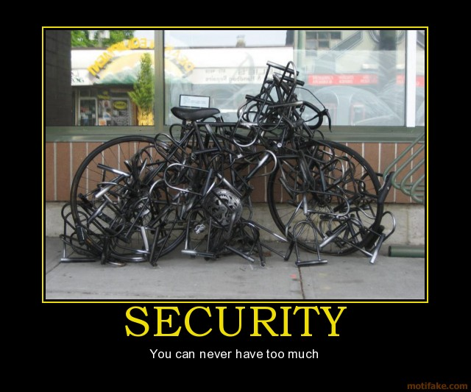
Notes:
You still need to ride the bike!

Slide 60
Thank You !
http://nigelgibbons.net
#NRG_fx

Slide 61
Partner Calls to Action
Key Actions, Resources and WPC Related Sessions/Activities
Evaluate this
session
complete the evaluation form <here>
Do
Placeholder
most partners grant you 1 action, focus your ask
Placeholder
invite partners to your other breakout sessions, panels and interactive sessions
Attend
Placeholder
invite partners to your other activities: Expo, executive meetings,
group meetings, parties and other
Placeholder
share your latest content: links, documents, other digital
Learn
Placeholder
ask partners to participate online: forums, social (Facebook, Twitter)

Slide 62


Your Feedback is Very Important to Us
Submit your Session Evaluation for a chance to Win! www.digitalwpc.com/contest
Complete a WPC evaluation and you’re automatically entered to
win the daily drawing for a luxury vacation AND a chance to win instant prizes!
Learn more in the Microsoft Partner Network Booth
Grand Prize Luxury Vacation for 2

Slide 63
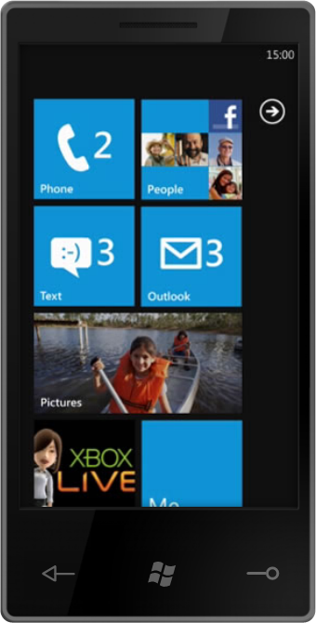
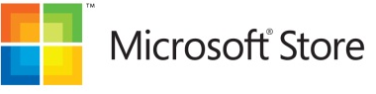
Your Feedback is Very Important to Us
Submit your Session Evaluation for a chance to Win! www.digitalwpc.com/contest
Luxury Vacation for 2
Complete a WPC evaluation and you’re automatically entered to
win the daily drawing for a luxury vacation AND a chance to win instant prizes!
Learn more in the Microsoft Partner Network Booth
Windows 7
Phone
Online Giftcards

Slide 64
Notes:
NRG Business Details

Slide 65

© 2011 Microsoft Corporation. All rights reserved. Microsoft, Windows, Windows Vista and other product names are or may be registered trademarks and/or trademarks in the U.S. and/or other countries.
The information herein is for informational purposes only and represents the current view of Microsoft Corporation as of the date of this presentation. Because Microsoft must respond to changing market conditions, it should not be interpreted to be a commitment on the part of Microsoft, and Microsoft cannot guarantee the accuracy of any information provided after the date of this presentation. MICROSOFT MAKES NO WARRANTIES, EXPRESS, IMPLIED OR STATUTORY, AS TO THE INFORMATION IN THIS PRESENTATION.

