Slide 1

SME’s Tapping the value in The Cloud
Presenter ~ Nigel Gibbons
Notes:
Welcome…
But First…

Slide 2
Hype Cycle for Cloud Computing
expectations
Cloud Computing
Compute
Infrastructure Services
'In the Cloud' Security Services
Cloud/Web Platforms
Public Cloud Computing/the Cloud
Enterprise Portals as a Service
Elasticity
Cloud Storage
Cloud Security Concerns
Real-Time Infrastructure
Cloud-Enabled BPM Platforms
Cloud-Based E-Mail Services
Cloud Application Development Tools
Hybrid Cloud Computing
Business Process Utility
Application
Platform
as a Service
Private Cloud Computing
DBMS in the Cloud
Cloud Computing for
the Enterprise
Virtual Private
Cloud Computing
Integration as a Service
Cloud Service
Management Tools
Grid Computing
Tera-architectures
Cloud Advertising
Cloudbursting/Overdraft
Virtualization
Cloud Computing/
SaaS Integration
Cloud-Driven Professional
IT Services and Solutions
SaaS Sales Force Automation
SaaS
Cloud Services Governance
IT Infrastructure Utility
As of July 2009
Peak of
Inflated Expectations
Slope of Enlightenment
Plateau of Productivity
Technology Trigger
Trough of Disillusionment
time
Years to mainstream adoption:
obsolete
before plateau
less than 2 years
2 to 5 years
5 to 10 years
more than 10 years
From "Hype Cycle for Cloud Computing, 2009," G00168780, 16 July 2009
Notes:
Key Issue: What vendors, markets and industries will be transformed by the cloud computing phenomenon?
Cloud computing is the latest superhyped concept in IT. However, it is simplistic to look only at the hype around the high-level term. As aspects of the cloud move into mainstream adoption, there will be misunderstandings, overestimations and underestimations that will cause users to have doubts and be disillusioned. There will be misuse and miscommunication among users and vendors, making it a subject that is ripe for Gartner's Hype Cycle. As usual, in cases like this, there is indeed overhype, but also benefits. Understanding those benefits requires tearing apart the hype surrounding cloud computing (just at the Peak of Inflated Expectations, and headed for the Trough of Disillusionment) and looking at the many more-granular topics, which are all part of the cloud phenomenon. This follows the pattern observed with other similarly broad labels as "the Internet" and "the Web."
Our special report "The What, Why and Where of Cloud Computing," G00168582, which references other research, provides a good overview of the details of cloud computing and the many issues facing enterprises today. With hype comes confusion. While cloud computing is about a very simple idea — consuming and/or delivering services from "the cloud" — there are many issues regarding types of cloud computing and the scope of deployment that make the details not nearly so simple. Everyone has a perspective and an opinion; confusion is rampant. Misconceptions abound, especially as it relates to cost cutting. Cloud is often part of cost-cutting discussions, even though its ability to cut costs is often a misconception. Although cost is often part of the discussion, the other part is around capabilities, agility, speed and innovation. These are the potential benefits that can be overlooked if hype fatigue sets in.
Tactical Imperative: It is important to dig beyond the main cloud term to the actual ideas and technologies to dodge the hype and take advantage of the benefits that exist.

Slide 3





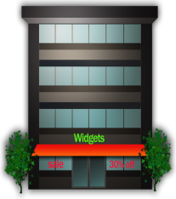
Economically Stimulation
Better
Cost Control
Reduced IT
Management Burden
“I want to focus on my Core Business,
not my IT”
Business-Class
Service Levels
Faster Return
of Business Value
Notes:
The choice for clients is an evolution on the Build or Buy or today. We now have subscribe.
Recession stimulating demand and business activity.

Slide 4
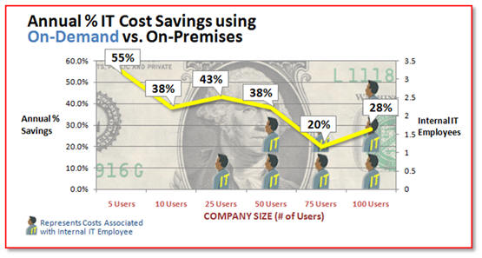
Market Research
Notes:
IDC - 25% of IT spending will be on Cloud by 2012

Slide 5
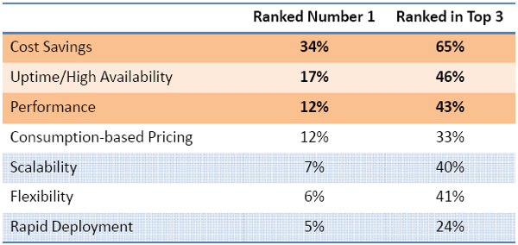
What SME’s want

Slide 6
The Challenge - Education
?
Business Centric
  Business Process + Cloud = Business Objectives
  V.
Implementation of IT Product(s) centric
  IT Initiative = Technology Feature Shopping!
?
?
Notes:
The cloud is not a technology Debate, the business environment is the driver.
A coherant set of business tools that are driving recognisable business processes.
Busines process that will tap Cloud services will not be based on a single technology or IT Philosophy. The uniqueness and demands of Business proces will only be serviced througth diversity.
Re-define Corporate Structures. Processes and traditional modus operandi.

Slide 7


A New World with Hidden Depths
Doing More with Less.
Microsoft
Technology can address
98% of requirements;
only part of the Challenge
The main challenges are below the surface
Security
Control
/Lock-in
What
Timescales
Cost
Trust
Value
Notes:
Business is reserved about the workloads they wish to commit due to the CONTROL and SECURITY issues.

Slide 8
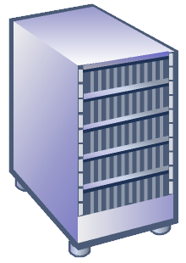
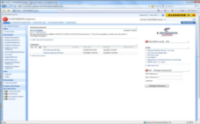
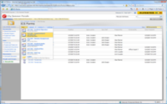
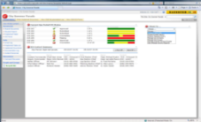




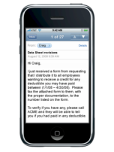
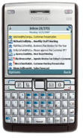
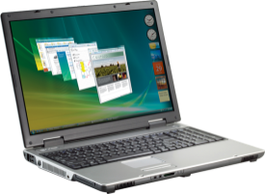
Service Provision
Software ’on premise’
Best of both worlds
    Business is in control (Remotes for Business!)
        Deployment choices & flexibility
          Reduced Labour force
+
Services ’in cloud’
Commoditised functions into the cloud
    Large Enterprise Experience for SME
        Best-in-class SLAs & IT Governance
          Agility 80/20 knowledge shift eg:BT Debatescape
Notes:
Business is reserved about the workloads they wish to commit.

Slide 9

Bushfire Season!
Trust & Guarantees
IDC Euro 39b in 2009 > Euro110b in 2014
Chance to challenge market dominance from competitors
A rising tide lifts all boats
Fundamental change to traditional Business Models:
  Software/hardware margins
  Services model = Financially backed SLA’s
Education – Business orientation & labour force ready
Agility & Competitiveness ~ Employment flexibility
Operating in a regulatory realm of uncertainty & conflict
Notes:
Levers of Control for Business & Regulators challenge.
Security Regulatory clarity ~ ISO 27000
Common legal frameworks between user and supplier?
Standards approach = Common standard for Hackers
Market dynamic can drive standards as in Banking Parallel!
Fund Research (Quantum N/W) ~ Educate the market
Tap industry strengths ~ IAMCP, EuroCloud, Trust in Digital Life etc.
Hardware/Software/Wetware >People/Process/Politics

Slide 10


Notes:
MPN and its competencies give you greater visibility of who can really do what.
IAMCP cuts through the dross and gives you a support network to develop your business into the cloud and build the all valuable service tail revenue.

Slide 11
IAMCP Vision and Mission - PACE
Vision
IAMCP the global business community for the Microsoft Channel
Mission
To maximize the business potential of its members through:
Peer to Peer Networking | Rhythm of events occurring globally
Advocacy | To legislatures, the media, to Microsoft and Microsoft Partners (liaison with VFI)
Community Outreach | On the lines of Social Entrepreneurship
Education and Growth | Provide Programs and experiences to grow the business capability and capacity of Partners

Slide 12
Thank You !
http://nigelgibbons.net
#NRG_fx
info@iamcp-uk.org
http://www.twitter.com/IAMCPUK
http://www.twitter.com/IAMCPOrg

