Slide 1

Economic sustainability and the cloud for Partners
Presenter ~ Nigel Gibbons
Notes:
Welcome…
But First…

Slide 2

Nigel Gibbons
UniTech - Executive Chairman
Chartered IT Professional (CITP)
Microsoft Buisness Value Planning (MBVP)
Certified Information Systems Auditor (CISA)
Certified Information Systems Security Professional(CISSP)
Microsoft Certified Inromation Technology Professional (MCITP)
Strategic Business Planning & Audit.
Insititute of Information Security Professionals (IISP)
Information Security Audit & Control Association (ISACA)
International Information Systems Security Certification Consortium or (ISC)2
Cloud Security Alliance - UK & Ireland
EuroCloud
Voices for Innovation
Microsoft Partner Advisory Council
Microsoft Executive Partner Board
IAMCP UK & International Board Member
Strategic Business Planning & Audit.
Notes:
Its not about me its about the shared insights I believe I continuously experience from my engagements across the security industry, and especially the SME sector which is the predominant space that Microsoft Partners occupy.

Slide 3
The NIST Cloud Definition Framework
Hybrid Clouds
Deployment
Models
Community
Cloud
Public Cloud
Private Cloud
Software as a Service (SaaS)
Platform as a Service (PaaS)
Infrastructure as a Service (IaaS)
Service
Models
On Demand Self-Service
Essential
Characteristics
Broad Network Access
Rapid Elasticity
Resource Pooling
Measured Service
Massive Scale
Resilient Computing
Homogeneity
Geographic Distribution
Common
Characteristics
Virtualization
Service Orientation
Low Cost Software
Advanced Security
Notes:
Cloud diagram idea inspired by Maria Spinola 8-31-09
NIST = The National Institute of Standards and Technology (US)

Slide 4
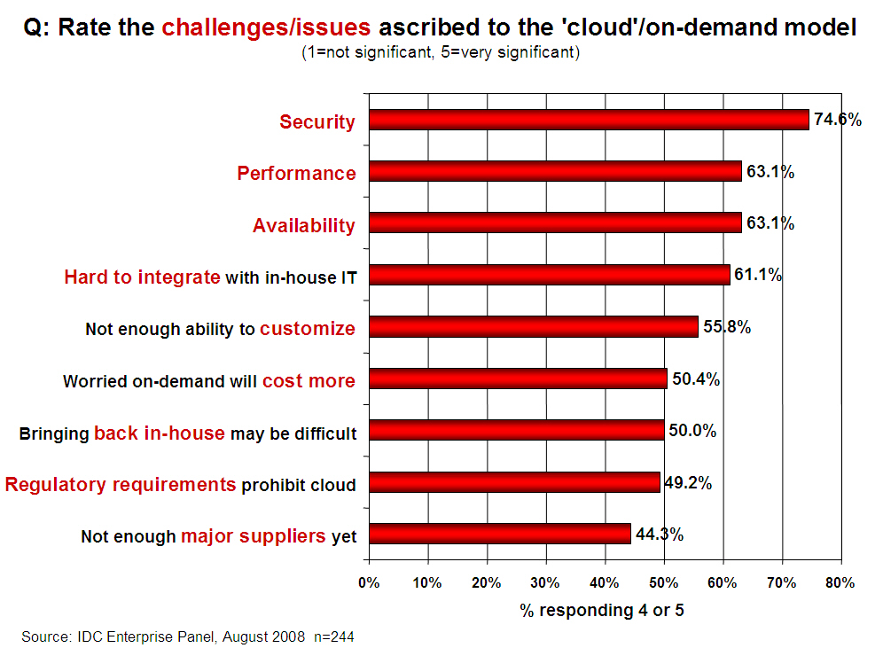
Notes:
OK so we understand the Security context but how is this reflected in the market?
FACT – Security IS the principle up front and central issue on customers minds.
All the other issues are largely diffused once the Security issue has been addressed.

Slide 5
The Mobile Effect
Cloud is a form of mobile computing
But then there is Mobile as well…
24x7x365 from anywhere, anytime, anyways
90% internal
80% external
Notes:
When once 90% of data was contained and shared within a secure corporate LAN environment it is now inverted to over 80% external shared and often hosted as well. Furthermore the added dimension of partner and customer access portals increases the management nightmare.

Slide 6
NIST (The National Institute of Standards and Technology)
Despite concerns about security and privacy, the NIST concludes that:
"public cloud computing is a compelling computing paradigm that agencies need to incorporate as part of their information technology solution set."
Notes:
The good news for NIST is …. And when they refer to Agencies they mean Government Agencies. So if it is good for Government then it should be good for business.
But that does not mean just signing up and away you go.

Slide 7

Notes:
You will have seen this, or if you haven't then welcome back from whatever far flung planet you have been living on.
Not the best headline to ingratiate yourself to Partners and Customers with.
It came across as an agenda to force march the industry into a Cloud based computing model which in reality form the majority is quiet the opposite. Far from being ‘All In’ we are working out what should be in and what will stay out!
Despite the marketing gloss there is real value in Cloud computing for businesses and vendors alike and the key to this ‘in v. out’ debate has largely orbited around one thorny subject. ‘ Security’.

Slide 8
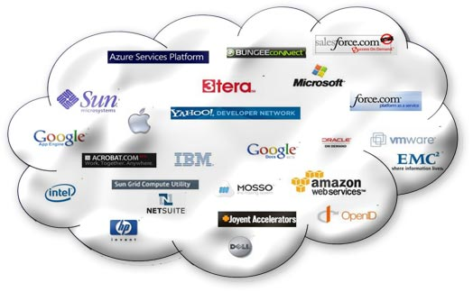
Cloud All in!

Slide 9
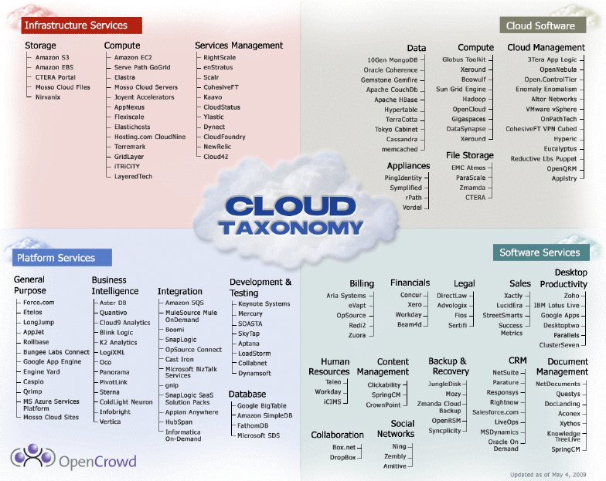

Slide 10
Microsoft
The case for a Cloud Business
Technology Roadmap
Technical Certification
Notes:
Microsoft has done a good job of selling the business case to partners, providing a technology roadmap and technical certification.
BUT they have not done the best job in guiding partners through the minefield that is the pre-sales and post sales critical factors that are appearing in the real world.

Slide 11
Monetising the Cloud
Little margin in subscription annuity
Money is in the service tail, but how?
Notes:
If you have not established a core trust

Slide 12
Trust is King
Honesty
Delivery
Trust
Notes:
You will only realise the true value of Cloud if you can engage the ‘Service Tail’. To do so you have to achieve the holy grail of DEEP trust.
Trust not just in technical competency but in an understanding of your customers business and objectives.
Sometimes the truth can hurt but honesty is the key to the door. An open and frank engagement forms a sound platform for successful delivery, and there is nothing like success to foster trust.

Slide 13
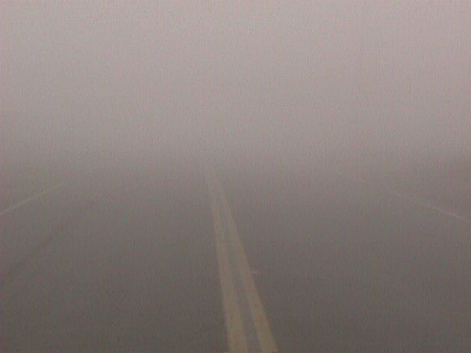
Ignorance
Notes:
Danger with security is we all experience it and think we know how to deal with it.
Well that may be true in our own competencies but security is hard to take in isolation. You tighten one are and it is compromised by the backdoor weaknesses of another.

Slide 14

Temptation / Ignorance
Notes:
Security looks like low hanging fruit and for the uninitiated it can present itself as a cudgel to get customers to submit!

Slide 15
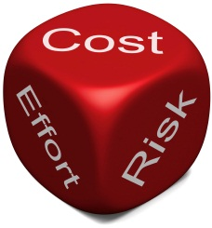
Notes:
There is risk with an uneducated approach.
The Cloud is all about risk mitigation.
How secure is my data, how can I trust the provider etc…
But keep it in relative to the size of organisation you are dealing with.

Slide 16


Notes:
MPN and its competencies give you greater visibility of who can really do what.
IAMCP cuts through the dross and gives you a support network to develop your business into the cloud and build the all valuable service tail revenue.

Slide 17
IAMCP Vision and Mission - PACE
Vision
IAMCP the global business community for the Microsoft Channel
Mission
To maximize the business potential of its members through:
Peer to Peer Networking | Rhythm of events occurring globally
Advocacy | To legislatures, the media, to Microsoft and Microsoft Partners (liaison with VFI)
Community Outreach | On the lines of Social Entrepreneurship
Education and Growth | Provide Programs and experiences to grow the business capability and capacity of Partners

Slide 18
Thank You !
http://nigelgibbons.net
#NRG_fx
info@iamcp-uk.org
http://www.twitter.com/IAMCPUK
http://www.twitter.com/IAMCPOrg

