Slide 1

Cloud Computing
~ Security & Customer Trust/Risk Frameworks ~
Presenter ~ Nigel Gibbons
Notes:
Welcome…
But First…

Slide 2


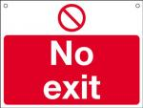
NRG ‘PB’ Curve
(Presentation Benefit)
Benefit
Number of slide
Notes:
My job today is to keep you in the Green Zone.

Slide 3

Nigel Gibbons
UniTech - Executive Chairman
Chartered IT Professional (CITP)
Microsoft Buisness Value Planning (MBVP)
Certified Information Systems Auditor (CISA)
Certified Information Systems Security Professional(CISSP)
Microsoft Certified Inromation Technology Professional (MCITP)
Strategic Business Planning & Audit.
Insititute of Information Security Professionals (IISP)
Information Security Audit & Control Association (ISACA)
International Information Systems Security Certification Consortium or (ISC)2
Cloud Security Alliance - UK & Ireland
EuroCloud
Voices for Innovation
Microsoft Partner Advisory Council
Microsoft Executive Partner Board
IAMCP UK & International Board Member
Strategic Business Planning & Audit.
Notes:
Its not about me its about the shared insights I believe I continuously experience from my engagements across the security industry, and especially the SME sector which is the predominant space that Microsoft Partners occupy.

Slide 4
Overview
Cloud Security
Security in Context
Customers
Microsoft
Frameworks
Engagement Framework & References
Real World application
Notes:
Why do we need to put this in context? After all its ‘Cloud’ isn’t it, and we all know that the economies of scale allow cloud providers to lavish more £££ per MD of data on security pro-rata that of any private or even Government organisation? Don’t we?
Well yes… BUT!

Slide 5
Security
Risk
Trust
Security
Notes:
But what do we mean by Security?
It is often that iron bound door that is slammed in your face by a client who is in effect saying, don’t go there, I have used the S word and that is the end of the discussion.
Time for a little push back. Security is something that is very indistinct, it means different things to different people. For a business not to get hamstrung by a security paranoia culture it needs to be rationalised in terms of business impacts, values attributed and practical decisions based on those outcomes made to reflect and support the business strategy.

Slide 6
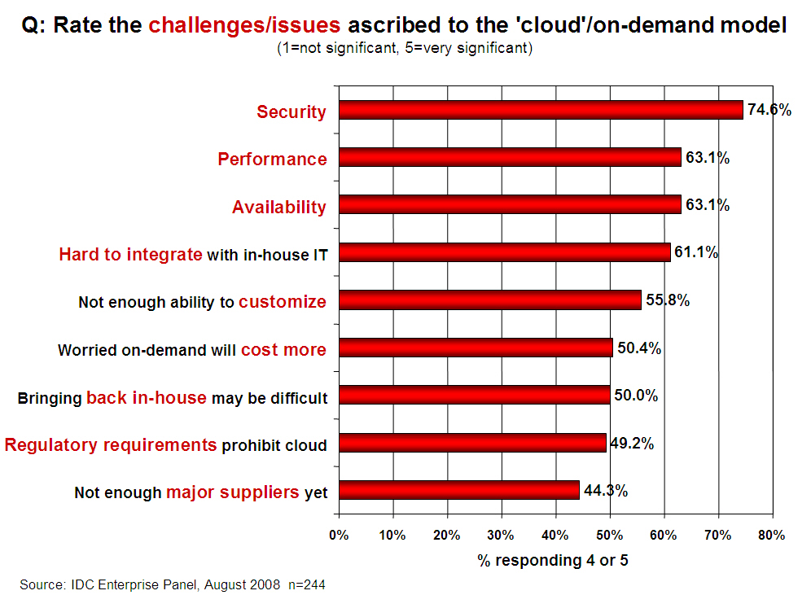
Notes:
OK so we understand the Security context but how is this reflected in the market?
FACT – Security IS the principle up front and central issue on customers minds.
All the other issues are largely diffused once the Security issue has been addressed.

Slide 7
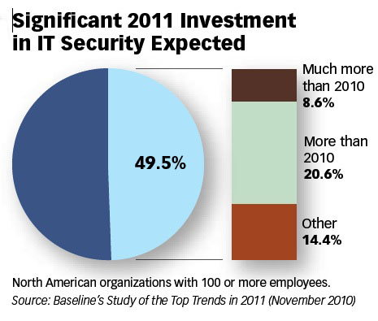
Security Investment

Slide 8
Threat #1: Abuse and Nefarious Use of Cloud Computing
Criminal leverage of cloud resources
Cloud providers Targeted
IaaS offerings have hosted:
  Zeus botnet,
  InfoStealer trojan horses
  botnets command & control
Impact = IaaS blacklisting

Slide 9
Threat #2: Insecure Interfaces and APIs
Exposed software interfaces or APIs
Security and availability of services dependent upon the security of these.
Exposures:
  unknown service or API dependencies.
  clear-text authentication
  Data unencrypted to process

Slide 10
Threat #3: Malicious Insiders
Level of access means impact considerable
Lack of hiring standards
Legislative friction
Impact:
  Brand damage,
  Financial loss
  Productivity downtime

Slide 11
Threat #4: Shared Technology Issues
Multi-tenant architecture challenge hardware technologies & hypervisors
Inappropriate levels of control or influence on the underlying platform
Examples:
  Joanna Rutkowska’s Red and Blue Pill exploits
  Kortchinksy’s CloudBurst presentations

Slide 12
Threat #5: Data Loss or Leakage
Deletion or alteration of records without a backup
Loss of an encoding key
Jurisdiction and political issues
Impact:
  Loss of core intellectual property
  Compliance violations

Slide 13
Threat #6: Account or Service Hijacking
Reuse of Credentials and passwords
Eavesdrop on activities and transactions:
  manipulate data,
  return falsified information,
  Redirect clients to illegitimate sites
Notes:
Prohibit the sharing of account credentials between users and services.
• Leverage strong two-factor authentication techniques where possible.
• Employ proactive monitoring to detect unauthorized activity.
• Understand cloud provider security policies and SLAs.
References
• http://www.infoworld.com/d/cloud-computing/hackers-findhome-in-amazons-ec2-cloud-742
• http://vmetc.com/2009/03/12/virtual-machine-sniffer-on-esxhosts/

Slide 14
Threat #7: Unknown Risk Profile
When adopting a cloud service, features and functionality may be well advertised,
What about:
  details of internal security procedures,
  configuration hardening,
  patching, auditing, and logging
  Compliance?
Notes:
IRS asked Amazon EC2 to perform a C&A; Amazon refused. http://news.qualys.com/newsblog/forrester-cloud-computingqa.html
• Heartland Data Breach: Heartland’s payment processing systems were using known-vulnerable software and actually infected, but Heartland was “willing to do only the bare minimum and comply with state laws instead of taking the extra effort to notify every single customer, regardless of law, about whether their data has been stolen.”
http://www.pcworld.com/article/158038/heartland_has_no_heart_for_violated_customers.html

Slide 15
References
CSA (Cloud Security Alliance) – Top Threats
Gartner report -‘Assessing the Security Risks of Cloud Computing’
Notes:
Gartner – ‘Assessing the Security Risks of Cloud Computing’ report.
Here are seven of the specific security issues Gartner says customers should raise with vendors before selecting a cloud vendor.
1. Privileged user access. Sensitive data processed outside the enterprise brings with it an inherent level of risk, because outsourced services bypass the "physical, logical and personnel controls" IT shops exert over in-house programs. Get as much information as you can about the people who manage your data. "Ask providers to supply specific information on the hiring and oversight of privileged administrators, and the controls over their access," Gartner says.
2. Regulatory compliance. Customers are ultimately responsible for the security and integrity of their own data, even when it is held by a service provider. Traditional service providers are subjected to external audits and security certifications. Cloud computing providers who refuse to undergo this scrutiny are "signalling that customers can only use them for the most trivial functions," according to Gartner.
3. Data location. When you use the cloud, you probably won't know exactly where your data is hosted. In fact, you might not even know what country it will be stored in. Ask providers if they will commit to storing and processing data in specific jurisdictions, and whether they will make a contractual commitment to obey local privacy requirements on behalf of their customers, Gartner advises.
4. Data segregation. Data in the cloud is typically in a shared environment alongside data from other customers. Encryption is effective but isn't a cure-all. "Find out what is done to segregate data at rest," Gartner advises. The cloud provider should provide evidence that encryption schemes were designed and tested by experienced specialists. "Encryption accidents can make data totally unusable, and even normal encryption can complicate availability," Gartner says.
5. Recovery. Even if you don't know where your data is, a cloud provider should tell you what will happen to your data and service in case of a disaster. "Any offering that does not replicate the data and application infrastructure across multiple sites is vulnerable to a total failure," Gartner says. Ask your provider if it has "the ability to do a complete restoration, and how long it will take."
6. Investigative support. Investigating inappropriate or illegal activity may be impossible in cloud computing, Gartner warns. "Cloud services are especially difficult to investigate, because logging and data for multiple customers may be co-located and may also be spread across an ever-changing set of hosts and data centers. If you cannot get a contractual commitment to support specific forms of investigation, along with evidence that the vendor has already successfully supported such activities, then your only safe assumption is that investigation and discovery requests will be impossible."
7. Long-term viability. Ideally, your cloud computing provider will never go broke or get acquired and swallowed up by a larger company. But you must be sure your data will remain available even after such an event. "Ask potential providers how you would get your data back and if it would be in a format that you could import into a replacement application," Gartner says.

Slide 16
The Mobile Effect
Cloud is a form of mobile computing
But then there is Mobile as well…
24x7x365 from anywhere, anytime, anyways
90% internal
80% external
Notes:
When once 90% of data was contained and shared within a secure corporate LAN environment it is now inverted to over 80% external shared and often hosted as well. Furthermore the added dimension of partner and customer access portals increases the management nightmare.

Slide 17


Notes:
The message first and for most is clear.

Slide 18
NIST (The National Institute of Standards and Technology)
Despite concerns about security and privacy, the NIST concludes that:
"public cloud computing is a compelling computing paradigm that agencies need to incorporate as part of their information technology solution set."
Notes:
The good news for NIST is …. And when they refer to Agencies they mean Government Agencies. So if it is good for Government then it should be good for business.
But that does not mean just signing up and away you go.

Slide 19

Notes:
You will have seen this, or if you haven't then welcome back from whatever far flung planet you have been living on.
Not the best headline to ingratiate yourself to Partners and Customers with.
It came across as an agenda to force march the industry into a Cloud based computing model which in reality form the majority is quiet the opposite. Far from being ‘All In’ we are working out what should be in and what will stay out!
Despite the marketing gloss there is real value in Cloud computing for businesses and vendors alike and the key to this ‘in v. out’ debate has largely orbited around one thorny subject. ‘ Security’.

Slide 20
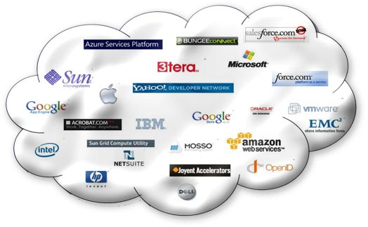
Cloud All in!

Slide 21
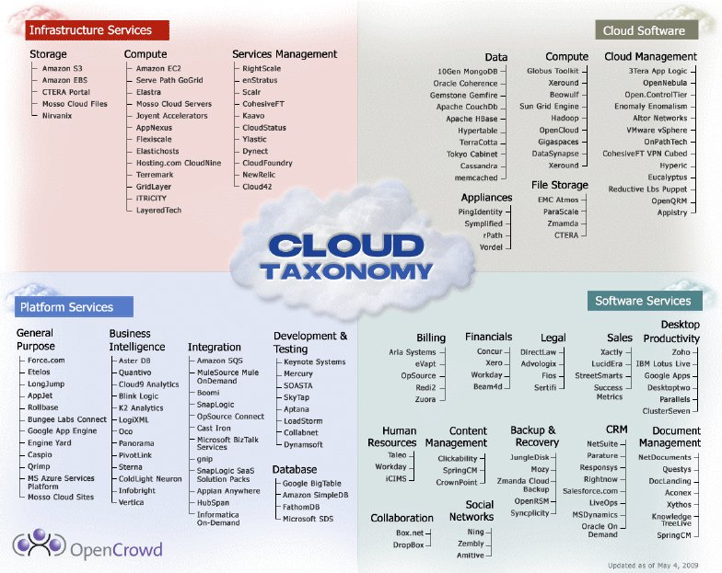

Slide 22
Microsoft
The case for a Cloud Business
Technology Roadmap
Technical Certification
Notes:
Microsoft has done a good job of selling the business case to partners, providing a technology roadmap and technical certification.
BUT they have not done the best job in guiding partners through the minefield that is the pre-sales and post sales critical factors that are appearing in the real world.

Slide 23
Monetising the Cloud
Little margin in subscription annuity
Money is in the service tail, but how?
Notes:
If you have not established a core trust

Slide 24

Security & Reliability
Financially-backed, guaranteed 99.9% uptime Service Level Agreement (SLA)
Always-up-to-date antivirus and anti-spam solutions to protect email
Safeguarded data with geo-redundant, enterprise-grade reliability and disaster recovery with multiple datacentres and automatic failovers
Best-of-breed data centres with SAS 70 and ISO 27001 certification
Notes:
Don’t get me wrong Microsoft are doing a fantastic job and with 365 coming up the pipe in a month’s time the game is going to change again.
If you have not taken a look at 365 then you must. It will impact your business whether your an ISV, SI, infrastructure or Dynamics.
Which is why the next few slides are CLITICAL for you to understand. These are built on experience and real market lessons you will not get elsewhere.

Slide 25
Trust is King
Honesty
Delivery
Trust
Notes:
You will only realise the true value of Cloud if you can engage the ‘Service Tail’. To do so you have to achieve the holy grail of DEEP trust.
Trust not just in technical competency but in an understanding of your customers business and objectives.
Sometimes the truth can hurt but honesty is the key to the door. An open and frank engagement forms a sound platform for successful delivery, and there is nothing like success to foster trust.

Slide 26

Ignorance
Notes:
Danger with security is we all experience it and think we know how to deal with it.
Well that may be true in our own competencies but security is hard to take in isolation. You tighten one are and it is compromised by the backdoor weaknesses of another.

Slide 27

Temptation / Ignorance
Notes:
Security looks like low hanging fruit and for the uninitiated it can present itself as a cudgel to get customers to submit!

Slide 28
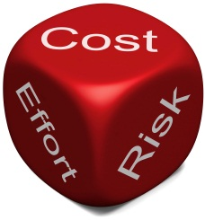
Notes:
There is risk with an uneducated approach.
The Cloud is all about risk mitigation.
How secure is my data, how can I trust the provider etc…
But keep it in relative to the size of organisation you are dealing with.

Slide 29
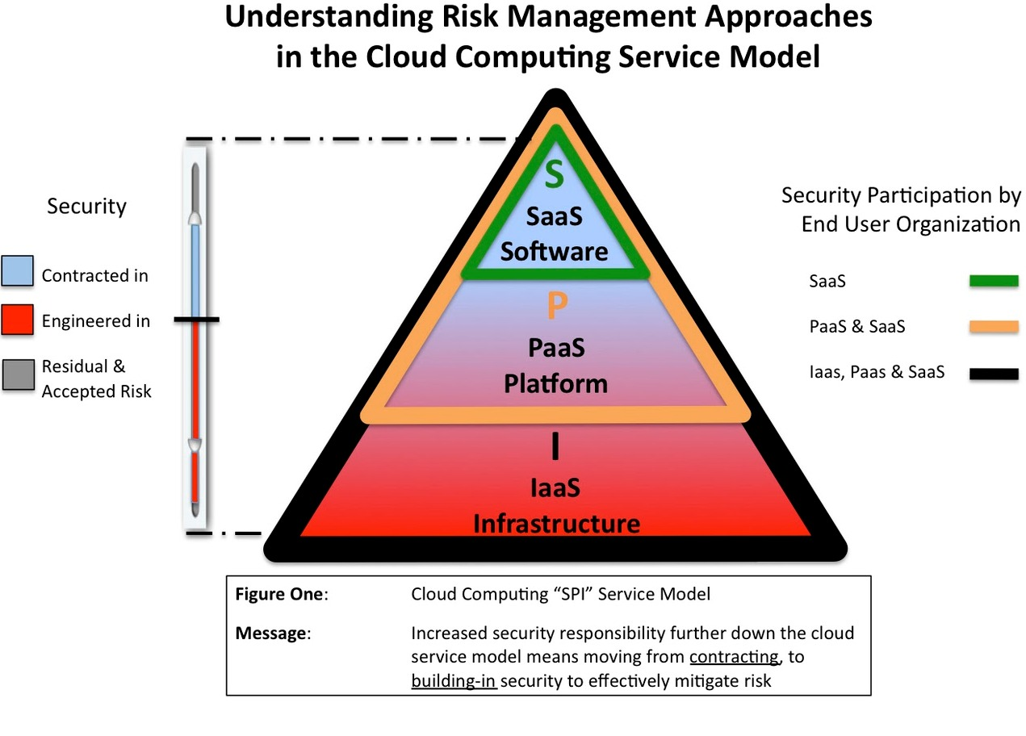
Cloud Stack (SPI Model)
Notes:
Approach to Risk in SPI Model
Each of the 3 service models has a slightly different approach to mitigating risk. These approaches are detailed in the Cloud Security Alliance guidance document available found at www.cloudsecurityalliance.org
The “all inclusive” nature of SaaS means that risk is most effectively controlled by contract terms, and few engineering choices exist because a standardized application, platform and infrastructure is shared across a large base of users.
In the case of PaaS, risk may be mitigated by a combination of contract terms and technical engineering choices and controls. This is because the user is responsible for much of the application environment and some security features can be built in to mitigate risk.
With IaaS, a combination of contract terms and technical engineering choices and controls is still relevant, but there is much more emphasis and choice about technical security infrastructure as the user has control and responsibility for much of the operating environment.
Summary & Conclusions
• For SaaS, the primary risk control mechanism is contract terms, whereas PaaS and IaaS require a combination of technical engineering controls as well as contract terms to effectively manage risk.
• The lower down the SPI model the chosen service exists, the more control and customization available. The trade-off is more responsibility for security and management.
• The nature and types of specialty skill-sets required to assess and manage risk will vary depending on the service model chosen.
• Decisions need to be made about whether security controls can be outsourced to a provider, or maintained under the control of the user organization or an independent third party.
• To meet regulatory and compliance requirements, in every case organizational policies require careful review and consideration must be given to whether the choice of a particular model is valid.
• Irrespective of the appeal that any given technical approach may have, the business implications require alignment with an organizations overall Enterprise Security Risk Management program.
Cloud is not a “one-size-fits-all” proposition, and service model options provide choices, depending on needs. For each service model, there are differently balanced options to mitigating risk; primarily the proportions of contractual and engineering resources, which may require more direct participation in technology risk decisions by the user.

Slide 30
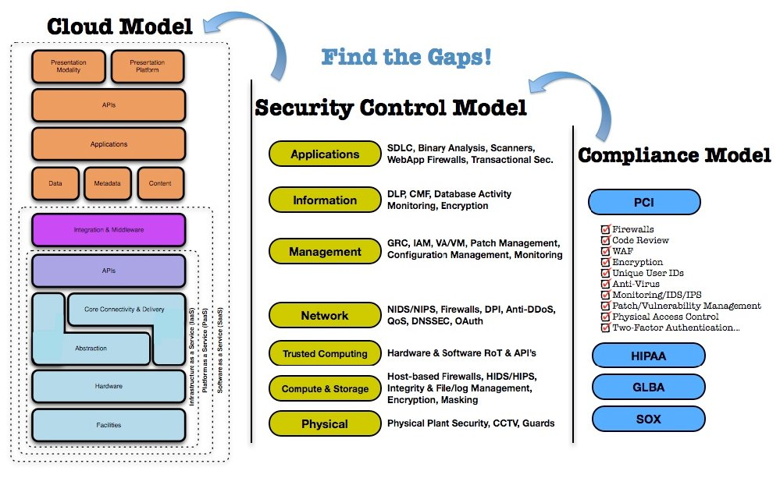
Notes:
Mapping the Cloud Model to the Security Control and compliance Model.
This demonstrates the level of complexity that we can go into for large organisations, but I do not recommend untrained staff trying to undertake this, this is a multi-disciplined activity and as always needs to be kept in context with the size of the organisation you are working with.

Slide 31
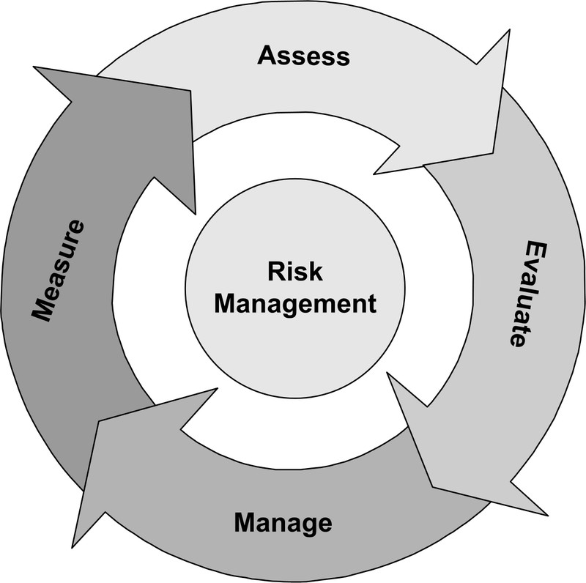
Risk Assessment

Slide 32
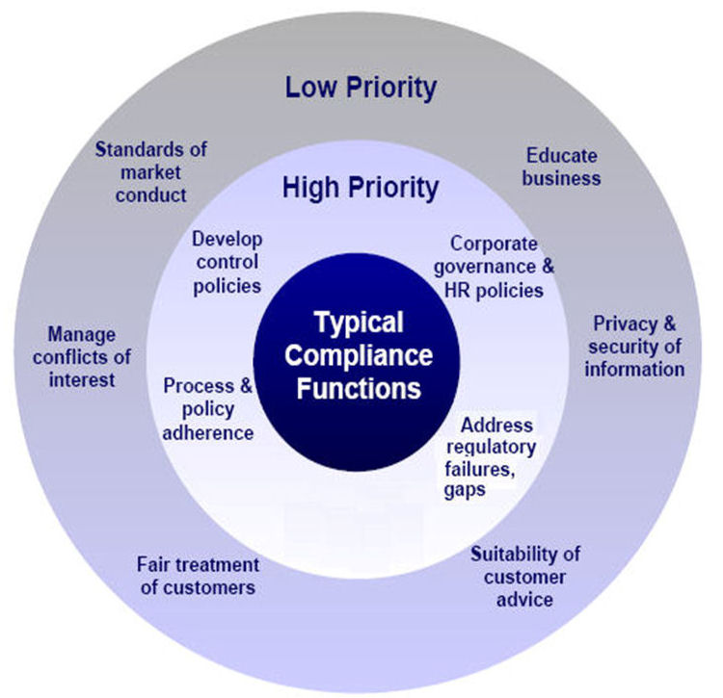
Compliance Landscape

Slide 33
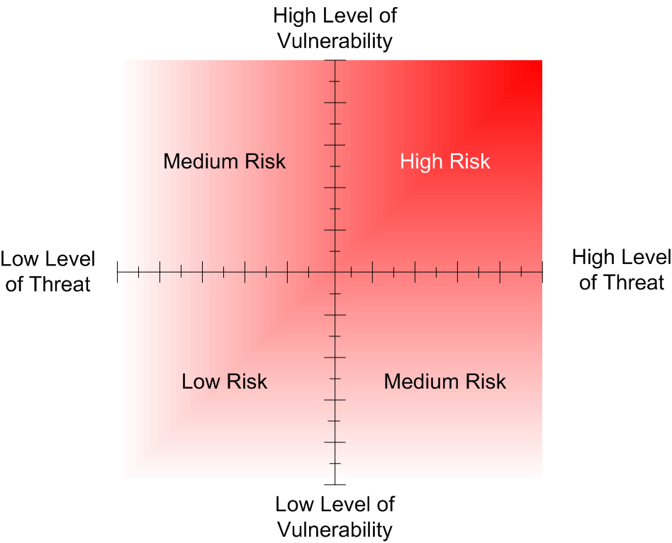
Risk Mitigation
Notes:
Businesses do not understand their risk profiles, or very few do. If they did many would realise the futility of investments they are making.
Over protective measures that are like pouring cement into a corporate process reducing business dynamics.
Unattainable expectations that can better be filled by a specialised service provider.
Focusing on managing and maintaining resources that are not core to the business brand or market offering.
And many more, but you start to get the idea.
http://technet.microsoft.com/en-us/library/cc751212.aspx

Slide 34

Attack Tree
Compromise Customer Data
Value to Business
£50,000
£1m+
Obtain Backup Media
eMail Intercept
Hack Web Server
Hack Firewall
Burglarise Office
Bribe Staff or Service Provider
Hack teleworker Home System
£ 5,000
£ 5,000
£ 10,000
£ 1,000
Hack SMTP service
£ 2,000
£5,000
£10,000
£1,000
£2,000
£7,000
Notes:
Value the risk and balance investment accordingly.
The Sleeper awakes!

Slide 35
Notes:
The message first and for most is clear.

Slide 36

Security On Ramp
Microsoft Security Assessment Tool
Gain visibility of service revenue potential
Identify in competency areas
Out of competency = Engage a Pro!
Notes:
If you follow this process you will not go wrong.
Use the tool, and impress the client, its billable and gets everyone onto a baseline for discussion.
Identify what your strengths are and stick to them. Partner to do the rest and enjoy building a trusted network of partner companies that can help you accelerate into future projects with conviction and the confidence of customers (back to the key trust point).

Slide 37
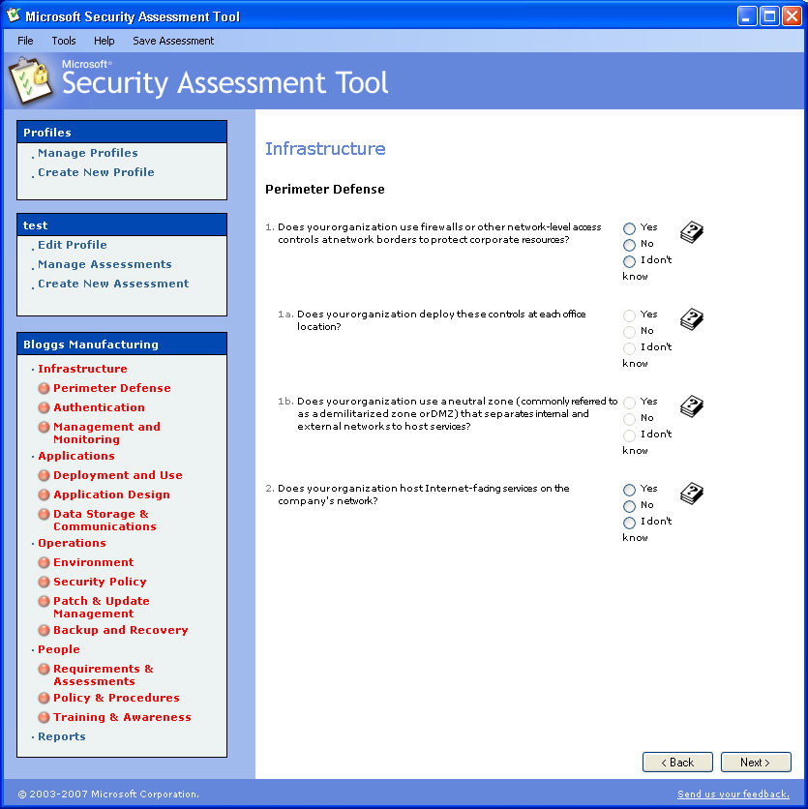
Microsoft Security Assessment Toolkit
http://technet.microsoft.com/en-gb/security/cc185712.aspx
Notes:
The Microsoft Security Assessment Tool is not a cloud specific tool. What it does is provide a valuable base lining exercise for organisations BEFORE they move to the cloud.
When you start talking cloud to clients and the security barriers start going up, it is useful to have a direct comparison with what the organisation is currently operating under. Often Cloud can deliver better than existing security and if not then it provides a clear demarcation line for negotiation with the cloud provider.

Slide 38
European Network and
Information Security Agency(ENISA)
Cloud Computing Security Risk Assessment
http://www.enisa.europa.eu/act/rm/files/deliverables/cloud-computing-risk-assessment

Slide 39
Cloud Security Alliance (CSA)
Security Guidance in Cloud Computing
https://cloudsecurityalliance.org/research/projects/security-guidance-for-critical-areas-of-focus-in-cloud-computing/

Slide 40
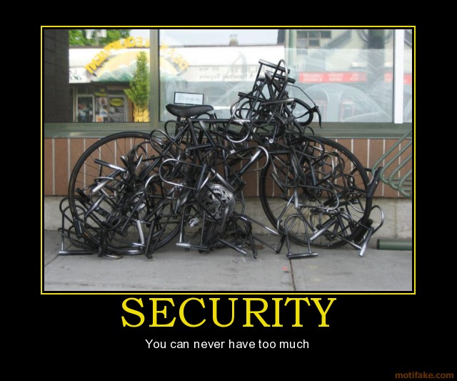
Notes:
You still need to ride the bike!

Slide 41
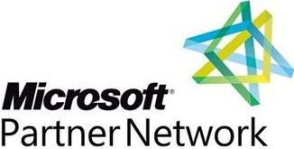

Notes:
MPN and its competencies give you greater visibility of who can really do what.
IAMCP cuts through the dross and gives you a support network to develop your business into the cloud and build the all valuable service tail revenue.

Slide 42
IAMCP Vision and Mission - PACE
Vision
IAMCP the global business community for the Microsoft Channel
Mission
To maximize the business potential of its members through:
Peer to Peer Networking | Rhythm of events occurring globally
Advocacy | To legislatures, the media, to Microsoft and Microsoft Partners (liaison with VFI)
Community Outreach | On the lines of Social Entrepreneurship
Education and Growth | Provide Programs and experiences to grow the business capability and capacity of Partners

Slide 43
Thank You !
http://nigelgibbons.net
#NRG_fx
info@iamcp-uk.org
http://www.twitter.com/IAMCPUK
http://www.twitter.com/IAMCPOrg

