Slide 1
Cloud Computing
~ Hybrid or All In? ~
Notes:
Welcome…
But First…

Slide 2



NRG ‘PB’ Curve
(Presentation Benefit)
Benefit
Number of slide
Notes:
My job today is to keep you in the Green Zone, the way I am going to try and do this is by applying the messages in terms of how I have understood partners view their businesses, the interactions with their clients and the external forces that will be impacting you all most notably Cloud Computing, but also MPN.

Slide 3

Nigel Gibbons
UniTech - Executive Chairman
Chartered Surveyor (MRICS)
Chartered IT Professional (CITP)
Microsoft Buisness Value Planning (MBVP)
Certified Information Systems Auditor (CISA)
Microsoft Certified Systems Engineer (MCSE)
Certified Information Systems Security Professional(CISSP)
IAMCP Board Member (UK Microsoft Liaison)
Microsoft Partner Advisory Council
Microsoft Executive Partner Board
UK Interoperability Council
EuroCloud
Voices for Innovation
Lybian British Business Council
Royal Institute of Chartered Surveyors
Insititute of Information Security professionals
Information Security Audit & Control Association
Strategic Business Planning & Audit.
Notes:
Its not about me its about the shared insights I believe I continuously experience from my engagements across the industry and especially the SME sector, which is the predominant space that Microsoft Partners occupy.

Slide 4
“Computing may someday be organized as a public utility”
- John McCarthy,
MIT Centennial in 1961
Notes:
But were not there yet!

Slide 5

The New Battle-Ground
Notes:
“Cloud computing” is a consequence of economic and technological conditions.
We are witnessing a seismic shift in information technology — the kind that comes around every decade or so. It is so massive that it affects not only business models, but the underlying architecture of how we develop, deploy, run and deliver applications.
Economic and technological that have combined to cause a disruptive change in I.T. towards a service based economy.
Want do I mean by this?

Slide 6
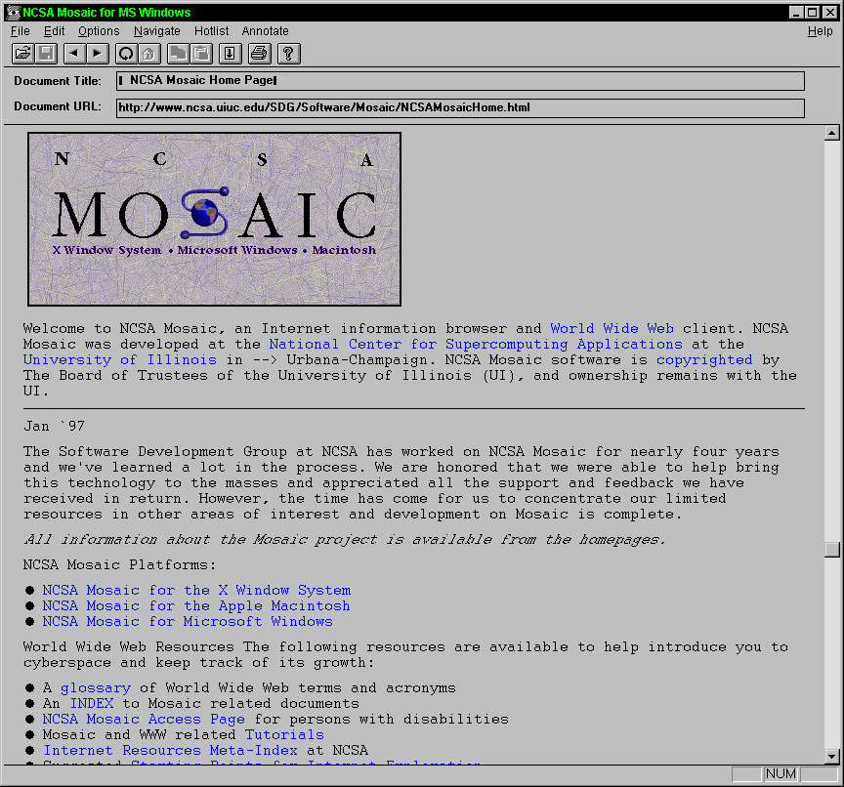
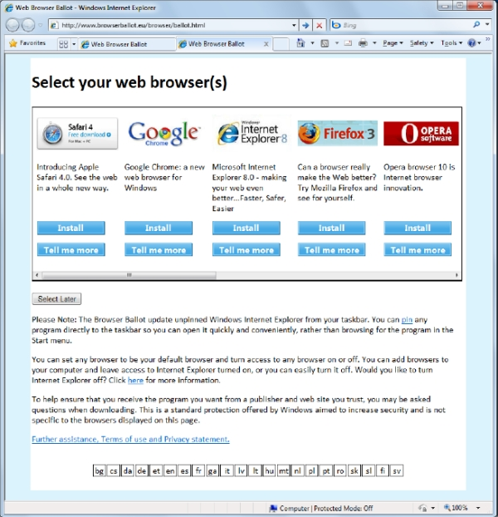
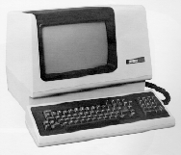
Deja Vue
Notes:
Some of you who have been in the industry for some time will no doubt feel a sense of Deja Vue, and you will not be wrong.
We have come through generations of Cloud starting with the Time Sharing started launched in 1965 by DEC (Digital Equipment Corporation) and VT class terminals. To what we would probably not associated with these dinosaurs but which delivers a similar service and function in the Web Browser.
What is different though is the degree of Control that now exists and the capacity to break out of the Browser onto the desktop and deliver the + Services.

Slide 7
“The opening up of new markets and the organizational development from the craft shop and factory to such concerns as US Steel illustrate the process of industrial mutation that incessantly revolutionizes the economic structure from within, incessantly destroying the old one, incessantly creating a new one. The process must be seen in its role in the perennial gale of creative destruction; it cannot be understood on the hypothesis that there is a perennial lull.”
Joseph Schumpeter,
The Process of Creative Destruction,
1942
Notes:
The Theory of Economic Development ‘treatise of circular flow’ which, excluding any innovations and innovative activities, leads to a stationary state.
The stationary state is, described by Walrasian equilibrium.
The hero of his story, though, is, in fine Austrian fashion, the entrepreneur.
‘Perfect Competition’ = when innovation and competitive advantage goes mainstream and all vendors are equal with similar product and price offerings. In a vibrant market this equilibrium is soon disrupted by the advent of a new product or strategy.

Slide 8






The March of Time
Bespoke
Leading Edge
Ubiquitous
Unique and individual:
Cutting Edge
Unpredictable costs
One-off Delivery model
Quality & Support unknown
Innovation
Categories of distinction – Pack Animals:
Matured Solution sets.
Feature variations
Cost differentiator
Standards
Quality & Support maturity
Productisation
Equality:
Automated delivery
Cost neutral
New Licensing models
Quality & Support Expectation
SLA
Commoditisation
Notes:
In one slide, we have moved from the top left to the bottom right.
In so doing Technology has been neutralised as a tool for businesses advantage.
For IT companies, traditional product is being challenged by evolving delivery models cutting across traditional licensing models

Slide 9

Creative Destruction
Notes:
Creative destruction is an economic theory of innovation and progress, introduced by German sociologist Werner Sombart.
Creative destruction is a powerful economic concept - Successful innovation is often a source of temporary market power, eroding the profits and position of old firms, yet ultimately succumbing to the pressure of new inventions commercialised by competing entrants.
Commoditisation has created a downward spiral of customer/vendor behaviour, with cost driven priorities meaning less and less attention to quality of service as margins are cut and squeezed.
Where price and cost saving have become all-consuming.
IT was seen as the easy target in organisations for budgetary tightening, and by association the service vendor relationships to the detriment of the organisations as they have lost the added value contributions that price pressure has made unaffordable to IT companies.
Cannot get
Strategy and Planning is the function of in-house IT management, but the spiral has led to eth worst of both worlds as neither vendors nor the customer retains these strategic capabilities within their teams.

Slide 10
Cloud Computing Demystified
It is NONE of the following:
  Subscription based software or service
  Internet Hosted Applications
  Virtual Data Centres
  Web Services
  A Solution
  An answer to all your problems!
  American!
Notes:
A challenge in one slide, but like much of the marketing hype around technology it is a lot simpler than it is made out to be.
You will all have your own perceptions as to what Cloud is, but I would like to suggest a few thing's that it is not.
Cloud Computing is relative to the vertical (Platform, Application or Service) or horizontal use case of the instant!
That last one is for the EU, they think it is some US domination play!

Slide 11
The NIST Cloud Definition Framework
Hybrid Clouds
Deployment
Models
Community
Cloud
Public Cloud
Private Cloud
Software as a Service (SaaS)
Platform as a Service (PaaS)
Infrastructure as a Service (IaaS)
Service
Models
On Demand Self-Service
Essential
Characteristics
Broad Network Access
Rapid Elasticity
Resource Pooling
Measured Service
Massive Scale
Resilient Computing
Homogeneity
Geographic Distribution
Common
Characteristics
Virtualization
Service Orientation
Low Cost Software
Advanced Security
Notes:
Cloud diagram idea inspired by Maria Spinola 8-31-09
NIST = The National Institute of Standards and Technology (US)

Slide 12

S&M
Notes:
Cloud Computing is a marketing term. A very appropriate marketing moniker, the cloud metaphor is as amorphous and indistinct as it is clear. Cloud Computing like its meteorological simile means different things to different people. A characteristic that reflect its flexibility and adaptability but does little to help provide any definitive clarity.

Slide 13
Definition !
‘Cloud Computing’ is a consequence of economic and technological conditions that have combined to cause a disruptive change in I.T. towards a service based economy.
‘Cloud Computing’ is not a thing but a transition of certain IT activities encapsulating both technological and non-technological aspects to a more service based economy with economies of scale delivered by experts at a price point with guaranteed Service Levels.
Notes:
The challenge is not a technical one – In fact the concepts and ideas around cloud, orchestration, platforms, the economics, the barriers to adoption and how to play in this game are all well known. Mainframes have been using virtualisation for years, cheap virtualisation technologies forming one of the key catalysts of Cloud Computing’s coming of age.

Slide 14

It’s all in the Game
Notes:
The benefits of utility computing will create pressure for you in order to remain competitive, adoption is inevitable whether you like it or not, this is the "Red Queen Hypothesis“.

Slide 15
“It takes all the running you can do, to keep in the same place.”
Lewis Carroll,
Through the Looking Glass
Notes:
Whilst progress is never linear it will start to reflect

Slide 16

The Challenge
Notes:
The Challenge is how business get their heads around the ‘Cloud Computing’.
Business on both sides of the table – IT Companies and their Customers.
The reason for this is Cloud Computing is not very distinct, nice one for the salesman, not so good for the customer.

Slide 17
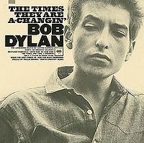
Change
Notes:
Hmmm… I believe they have changed, we are just not aware of it yet.
Vendors need to change their model and adopt a ‘Mentor’ approach to customers, and be prepared to say NO, where usage is not suitable. This will be awkward for the DNA hardened license salesman.
Cloud computing is more than just the technologies and products needed to build and deliver Cloud services. It is about the real benefits Cloud computing models deliver to business and the tectonic shifts this is having, accelerated by the recession, on how traditional businesses operate and view their strategies now and into the future.
What is demanded by the market today is an increased ability for IT services companies to communicate and shape purpose in a Business context NOT just Technological, the challenge is how to provide visibility of this capability to the customer and ready the delivery channel.
There is a requirement for analysis of a businesses systems, and stripping these down to core fundamentals before building up the Cloud Computing Architecture best suited for that organisation.

Slide 18
Why?
Notes:
Why should we be doing this!
Cloud computing is more than just the technologies and products needed to build and deliver Cloud services. It is about the real benefits Cloud computing models deliver to business and the tectonic shifts this is having, accelerated by the recession, on how traditional businesses operate and view their strategies now and into the future.
What is demanded by the market today is an increased ability for IT services companies to communicate and shape purpose in a Business context NOT just Technological, the challenge is how to provide visibility of this capability to the customer and ready the delivery channel.

Slide 19
The Good News
“25% of IT spending
will be on Cloud by 2012”
– IDC

Slide 20
More Good News!
“$ 50b in 2009
> $138b in 2013”
– IDC

Slide 21

False Dawn
Notes:
A rising tide lifts all boats.
You may thing it is all rosy and plain sailing…

Slide 22
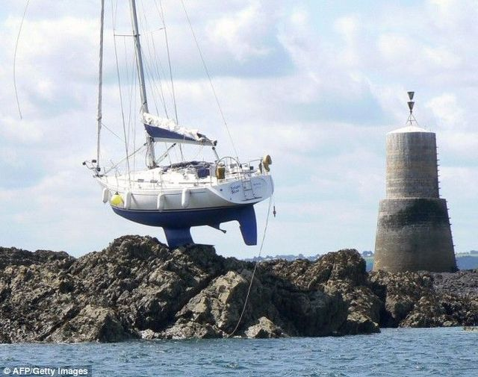
Notes:
Please believe me this is Re-defining Corporate Structures as we have known them, their processes and traditional modus operandi.
For companies that think this is a cut & paste of marketing terminology to inject Cloud and Services, then you will be the dinosaurs, extinct in a very short period of time.
No I am not repeating myself, I wish to make sure this point get’s across, you will remember someone saying this in a few years time….
It is to use another natural phenomenon, as regular as clockwork….ish.

Slide 23

Re-Generation
Notes:
For the service industry its going to be a bit like Bushfire season.
When a certain level of maturity is reached in any ecosystem to break through to the next level often demands a revitalisation and that means change which is often challenging, to extend my bushfire metaphor – Burning the Heather, beating the Olive trees, aggressing pruning the fruit bushes – Whilst I don’t advocate taking a torch to our offices and sticks to our staff, I do mean the flexibility to adapt in an agile way, activities that we cannot constrain businesses from exercising in order to maintain competitiveness.
BCS – IT department changing beyond recognition.
IT departments need to shift and focus on adding value to the business instead of just keeping the lights on.

Slide 24


Notes:
We are all in the same boat.

Slide 25

Directive
Notes:
Please believe me this is Re-defining Corporate Structures as we have known them, their processes and traditional modus operandi. The old way’s of selling may exist in discrete niches, but not in the Cloud.

Slide 26
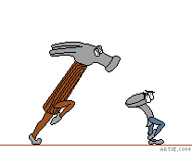
Vendor Dilemma
Notes:
Vendors and their salesman are going to be challenged.
Everything is going to be adopting the Cloud nomenclature, this will risk bad placement and ultimately disillusionment.

Slide 27

Obfuscation

Slide 28
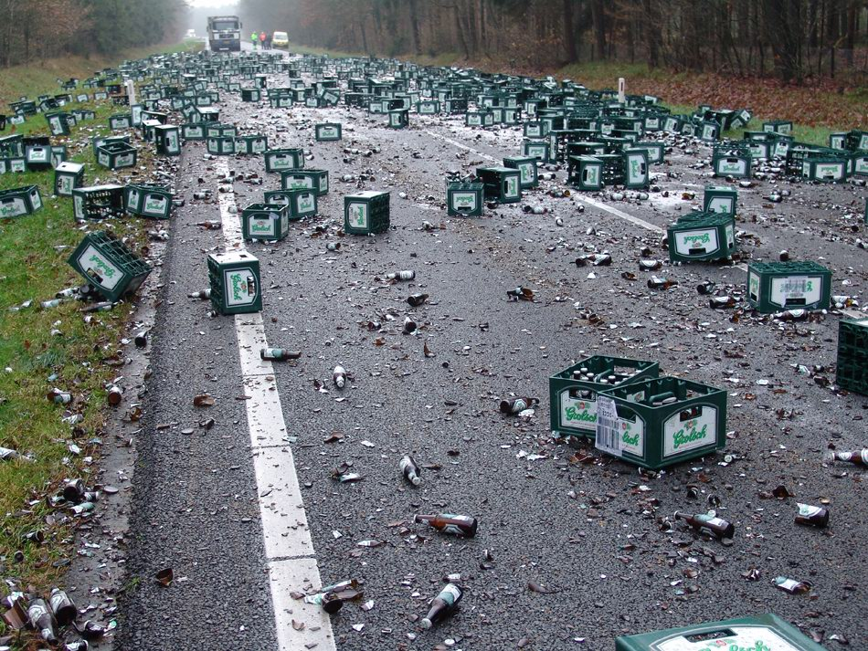

Slide 29
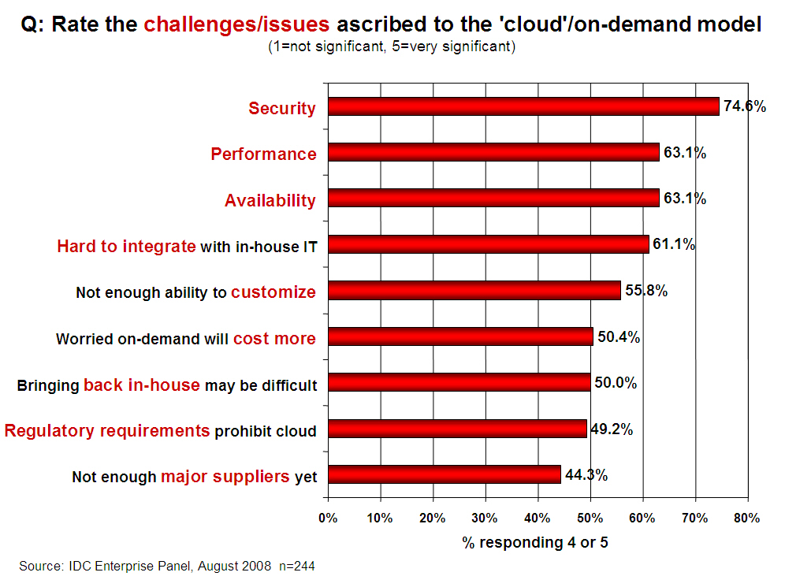
Notes:
Clients know what their priorities and challenges are, but are not clear on how to confront these!

Slide 30
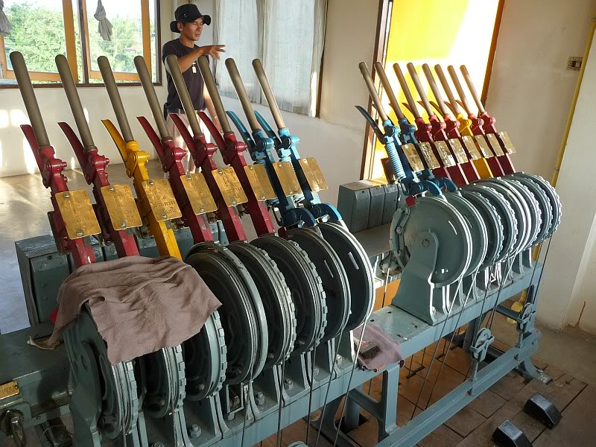
Leavers of Control
Notes:
We can give our customers the levers to control their Business like they have never had before.
Business is reserved about the workloads they wish to commit due to the CONTROL and SECURITY issues.
Service companies MUST be prepared to give up this control to the customers.

Slide 31
Why?
IT labour costs are 18 times equipment costs
The number of computers is growing at 38% each year
Servers capacity utilisation 15%
80% of enterprise software expenditure is on installation and maintenance of software
Average power consumption per server quadrupled from 2001 to 2006
Notes:
The current rate of computing consumption is unsustainable and in simple business return terms offers negligible value to business.
Source: 18:1 statistics, Trends in technology’, survey, Berkeley University of California, USA, March 2002
Source: 38% statistic, Xiaolong Jin and Jiming Liu, "From Individual Based Modeling to Autonomy Oriented Computation", in Matthias Nickles, Michael Rovatsos, and Gerhard Weiss (editors), Agents and Computational Autonomy: Potential, Risks, and Solutions, pages 151–169, Lecture Notes in Computer Science, vol. 2969, Springer, Berlin, 2004. ISBN 978-3-540-22477-8.
Source: $800, Ron Markezich, Vice President Microsoft Online, Microsoft talk at the Booz Allen Hamilton Cloud Computing Summit, 11/20/2008.

Slide 32
“American executives spend too much money on computer systems that allow them to do the wrong things faster”
Paul A. Strassman
1988 & 1995
“The best that computerization can accomplish is to make management more effective and employees more productive”
Notes:
The best that computerization can accomplish is to make management more effective and employees more productive.

Slide 33
“There are no generally accepted principles to guide executives in reconciling the euphoric promises of the computer advocates and their staff's ability to prove that information technology investments are profitable”
~ Paul Strassman 1996
The Value Of Computers, Information and Knowledge
Notes:
SOURCE: Paul Strassman 1996 - The Value Of Computers, Information and Knowledge
The 1994 data shows that the relationship between corporate profitability and computer spending has not changed in more than twenty years. It is unlikely that any direct relationship between computerization and profitability can be ever demonstrated. Computers are only a catalysts. Business value is created by well organized, well motivated and knowledgeable people who understand what to do with all of the information that shows up on the computer screens.

Slide 34
Mr.IT Co….
How can Cloud Computing help my enterprise?
Is Cloud Computing the right strategy for my Enterprise?
What are the economic implications of Cloud Computing for my Enterprise?
Which applications in my portfolio are the best candidates for Cloud?
How can we incrementally adopt Cloud Computing and what would a roadmap look like?
Notes:
Start by getting your own business into the cloud.
Hybrid or All-In

Slide 35
Step 1 – A New Trust
Help customers knowingly choose the correct mix for their organization of
  standard portable features
  proprietary advanced capabilities
  Technology mapped to business outcomes
Notes:
The issue is to break down the business reality of what IT delivers and clarify the commoditisation.
This openness will be the first step in building a new trust.

Slide 36
Step 2 – Demonstrating Leadership
Become business people
  Strategic focus
  Business Objectives
  Operational agility
  Straight answers to questions….
Notes:
Re-skill, re-oreintate thinking

Slide 37

Notes:
There is risk with an uneducated approach.
The Cloud is all about risk mitigation.
How secure is my data, how can I trust the provider etc…

Slide 38
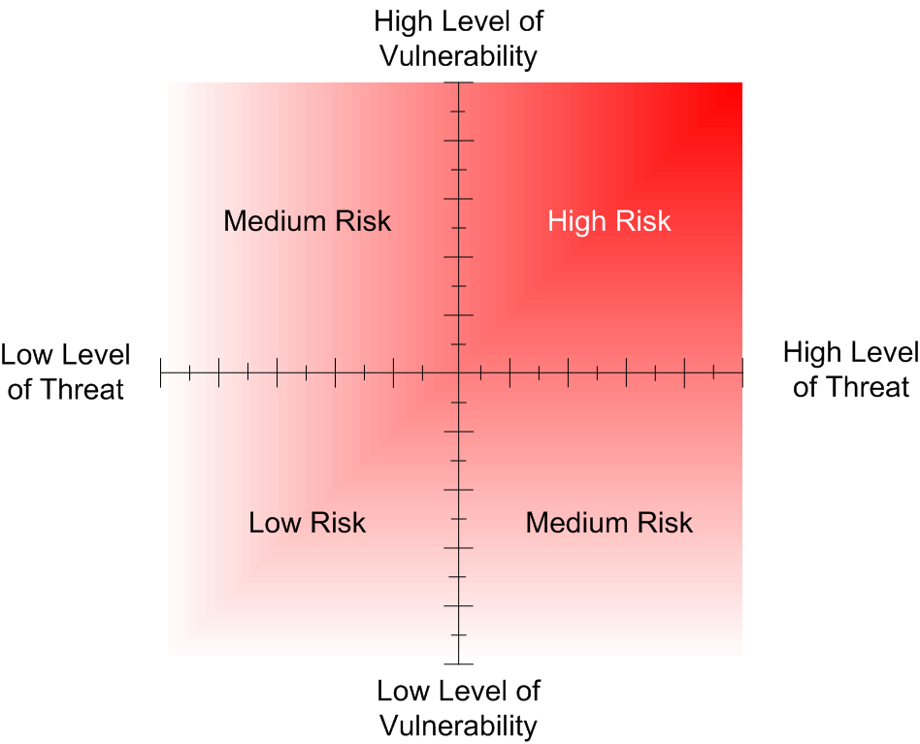
Risk Mitigation
Notes:
Businesses do not understand their risk profiles, or very few do. If they did many would realise the futility of investments they are making.
Over protective measures that are like pouring cement into a corporate process reducing business dynamics.
Unattainable expectations that can better be filled by a specialised service provider.
Focusing on managing and maintaining resources that are not core to the business brand or market offering.
And many more, but you start to get the idea.
http://technet.microsoft.com/en-us/library/cc751212.aspx

Slide 39
How !

Slide 40

Attack Tree
Compromise Customer Data
Value to Business
£50,000
£1m+
Obtain Backup Media
eMail Intercept
Hack Web Server
Hack Firewall
Burglarise Office
Bribe Staff or Service Provider
Hack teleworker Home System
£ 5,000
£ 5,000
£ 10,000
£ 1,000
Hack SMTP service
£ 2,000
£5,000
£10,000
£1,000
£2,000
£7,000
Notes:
Value the risk and balance investment accordingly.
The Sleeper awakes!

Slide 41
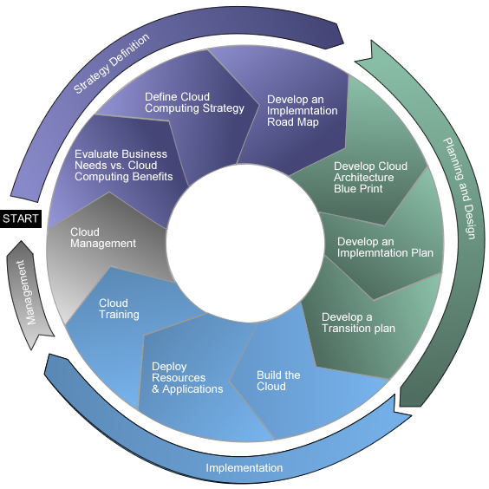
Methodologies

Slide 42

Notes:
Don’t try and become what your not, focus on what you do best and partner to do the rest.
MPN alignment with the cloud
The Cloud is unavoidably up front and central in the changes you will all be making to your business.

Slide 43
MPN = The Event Horizon
Time to Innovate
Time to change the way you work
"The losers have no choice except to continue arming themselves with the best weapons they can get.”
Paul Strassmann, 2004
Notes:
Paul Strassman (MS Research) - IT arms race, where one organisation wanted bigger and better IT than competitors.

Slide 44
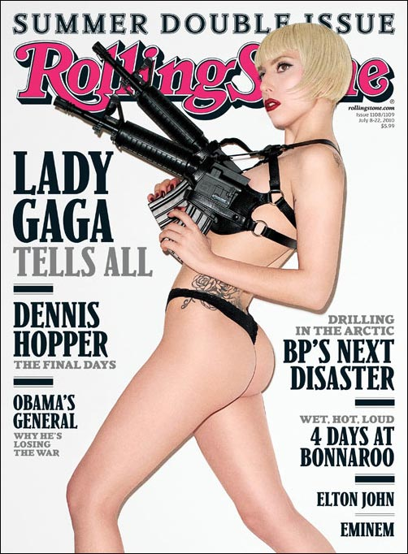

Slide 45
Hybrid or All In ?
Don’t wait. The Time will never be just right.
Napoleon Hill (Author, 1883 – 1970)
We all live under the same sky, but we don’t all have the same horizon.
Konrad Adenaur (German Statesman; 1876-1967
Notes:
Both will do but your going there whether you like it or not!

Slide 46
Partner Challenge
Hybrid or all in?

Slide 47


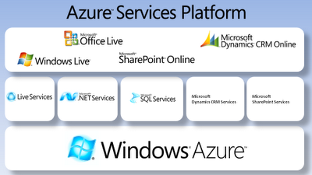
Operations
Your business platforms (email, Collab etc)
+

Slide 48



Services + R&D
+

Slide 49
Customers !

Slide 50
The Opportunity
“The Sleeper Awakes.”
H.G.Wells, 1910
Notes:
The Sleeper Awakes (1910) is a dystopian novel by H. G. Wells about a man who sleeps for two hundred and three years, waking up in a completely transformed London, where, because of compound interest on his bank accounts, he has become the richest man in the world.
Your clients are the sleepers.
Partners are the authors.
Write the ending YOU want.

Slide 51



Slide 52
IAMCP Vision and Mission - PACE
Vision
IAMCP the global business community for the Microsoft Channel
Mission
To maximize the business potential of its members through:
Peer to Peer Networking | Rhythm of events occurring globally
Advocacy | To legislatures, the media, to Microsoft and Microsoft Partners (liaison with VFI)
Community Outreach | On the lines of Social Entrepreneurship
Education and Growth | Provide Programs and experiences to grow the business capability and capacity of Partners

Slide 53
Thank You !
info@iamcp-uk.org
http://www.twitter.com/IAMCPUK
http://www.twitter.com/IAMCPOrg

